Slide 1
BRAICO’s Class 1/2
Friday, June 19, 2020

Slide 2
Table of Contents
Morning Message
Word Work
Reading
Writing
Math
Daily Physical Activity

Slide 3
Morning Message
Hello Kiddos,
Happy Friday! Last day of the school year! Today, we will look for words that end in ‘ft’ in our reading, we test out our comprehension of How I Became a Pirate, and do a data management review in Math. I am going to miss being your teacher, online or in person!
Happy Learning,
Mr. Braico

Slide 4
Reading
I can apply a variety of strategies to help solve words.
Step 1
Click and watch the video.
Step 2
Read a book from home or on RAZ kids.
Find any words that end in ‘ft' in your book. Remember if you get to a tricky word – stretch out each sounds using ‘Stretchy Snake’.
Step 3
Share your words you found with a parent or share it with Mr. Braico in an email or on your ClassDojo portfolio.

Slide 5
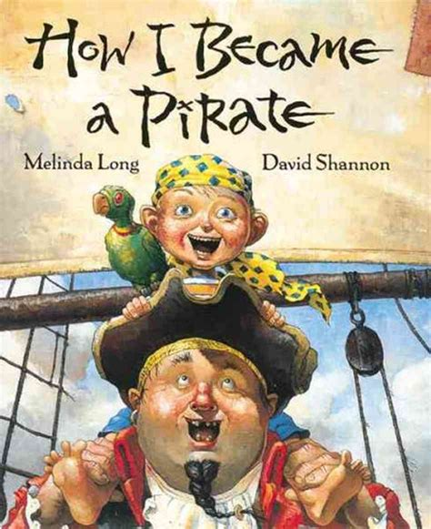
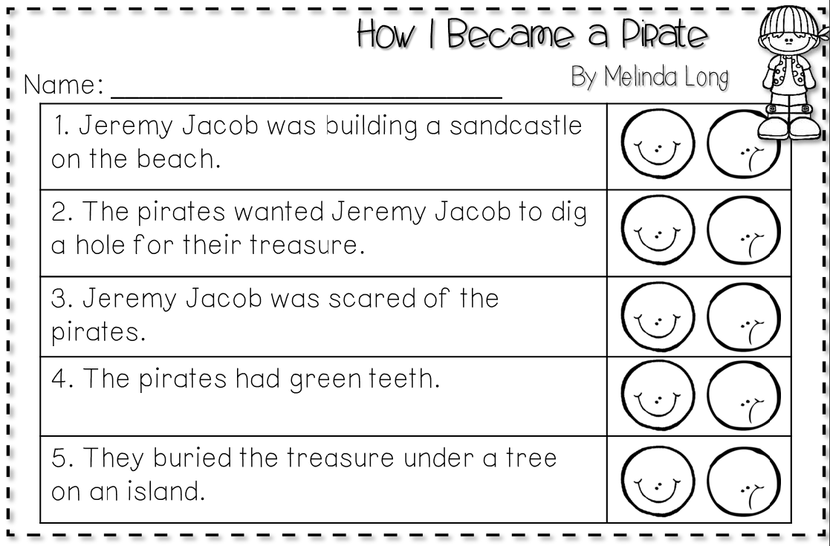
Writing
Step 1
Click the video to listen to Mrs. Biesbroek read How I Became a Pirate.
Step 2
Read and answer the questions from the comprehension test to see how well you remember the story.

Slide 6
Writing
Step 3
Click this video and see the answers to the comprehension test. How did you do?

Slide 7
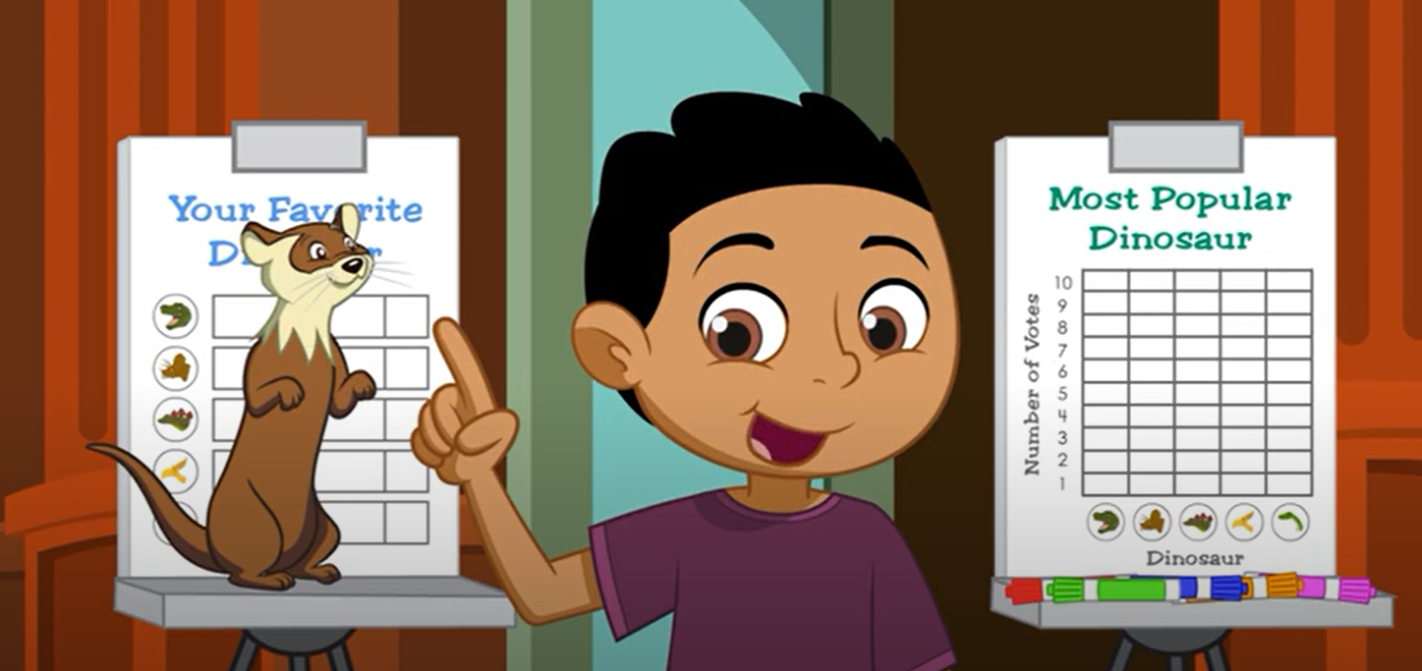
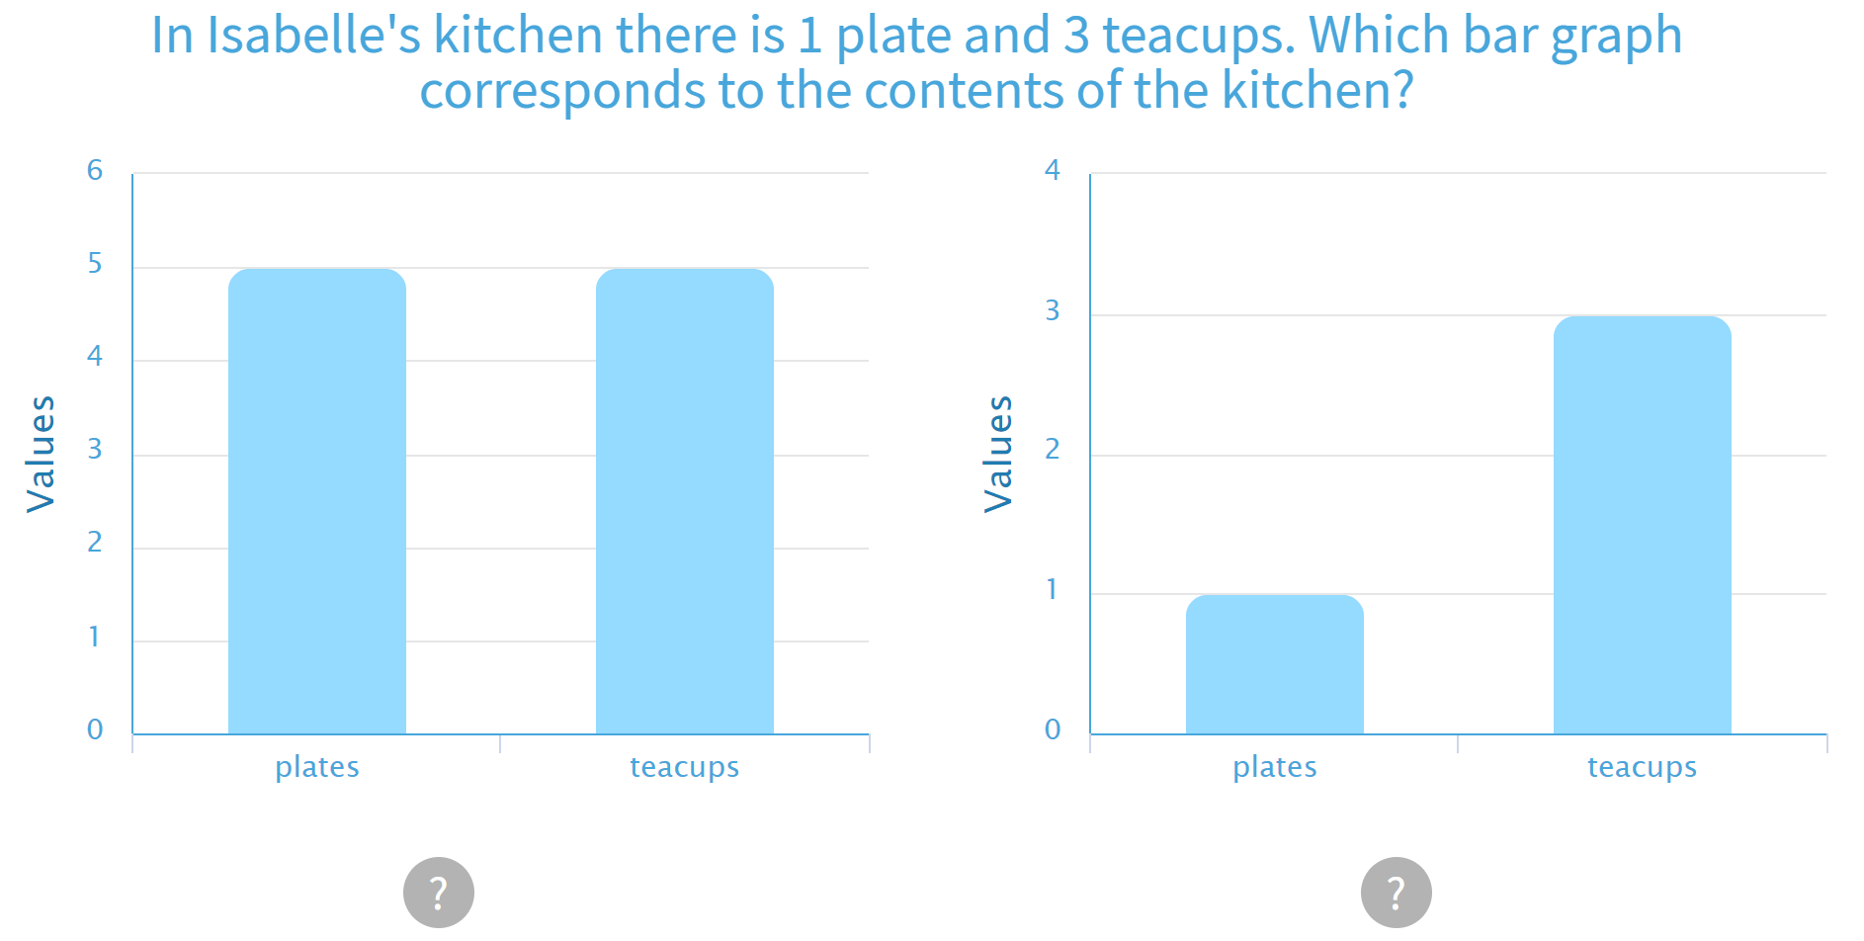
Math
I can interpret data to solve problems.
Step 1
Click the video to review data management.
Step 2
Sort the bugs into a graph.
Solve the problems using the graph.
Step 3
Use the information to solve the problems.

Slide 8
Daily Physical Activity
Choose one (or more) activities for your DPA.
GoNoodle
Fresh Start Fitness
Maximo
Calming Down
Mrs. McIntyre DPA

Slide 9
Thank You So Much
I just wanted to say thank you to all of you for working so hard for the past weeks with this online learning.
I have missed seeing your faces and giving high fives, but I am super proud to have been your teacher this year.
Have a great summer and be good for your families!

