Slide 1
BRAICO’s Class 1/2
Monday, June 15, 2020

Slide 2
Table of Contents
Morning Message
Word Work
Reading
Writing
Math
Daily Physical Activity

Slide 3
Morning Message
Hello Kiddos,
Happy Monday! Last Monday of the school year! I hope you had a great weekend. We will continue to look at ending blends in our reading today by finding words ending with ‘ng’, we will then read How I Became a Pirate and make a prediction, we will continue our review in Math and take a look back at addition.
Happy Learning,
Mr. Braico

Slide 4
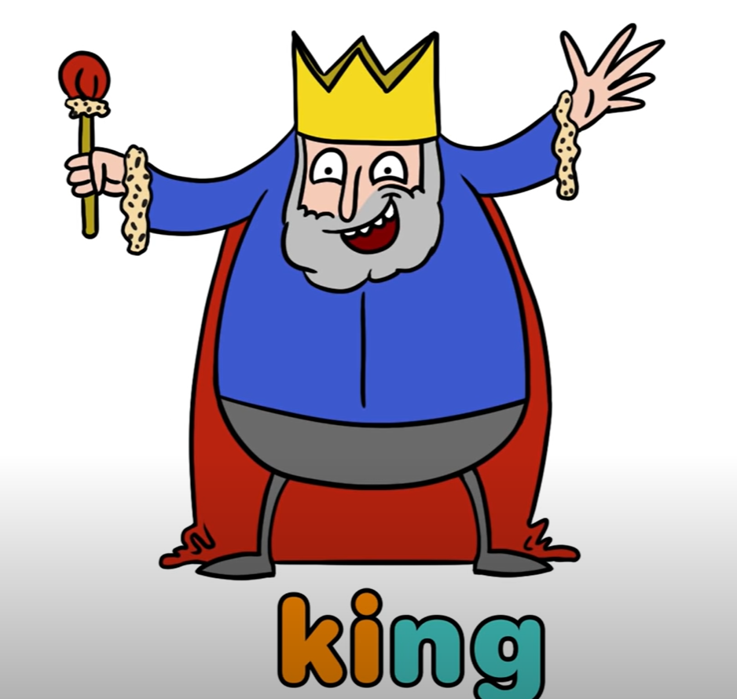
Reading
I can apply a variety of strategies to help solve words.
Step 1
Click and watch the video.
Step 2
Read a book from home or on RAZ kids.
Find any words that end in ‘ng' in your book. Remember if you get to a tricky word – stretch out each sounds using ‘Stretchy Snake’.
Step 3
Share your words you found with a parent or share it with Mr. Braico in an email or on your ClassDojo portfolio.

Slide 5
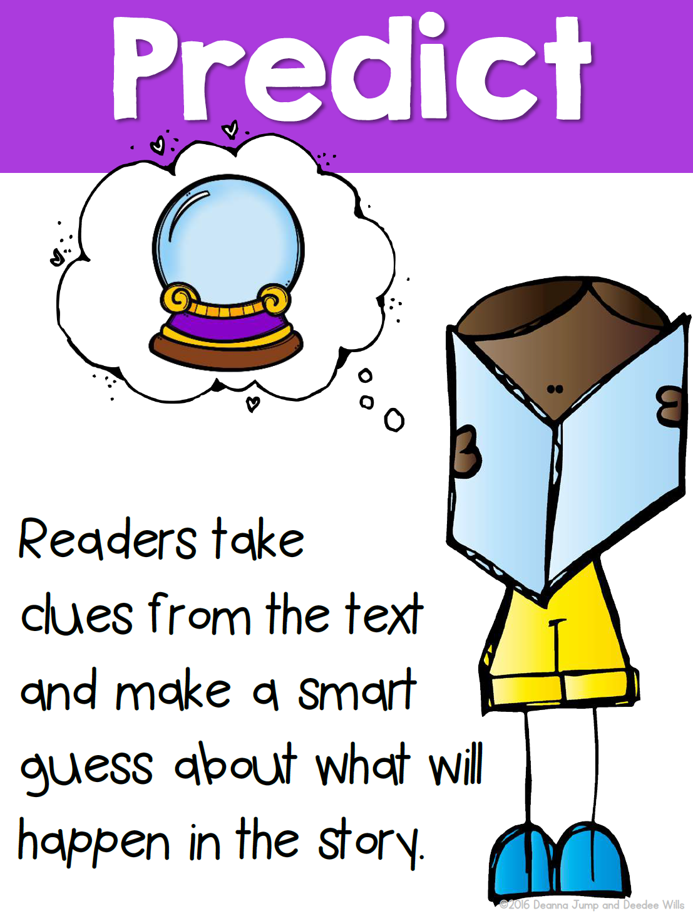
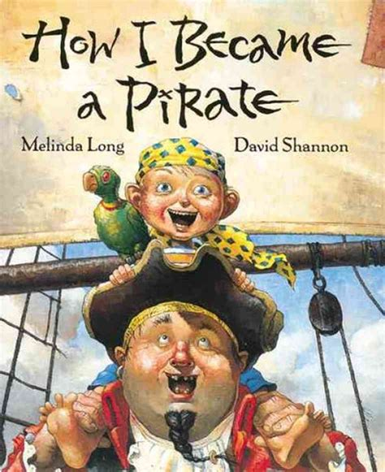
Writing
I can make predictions to draw conclusions of a story.
Step 1
Click the video to listen to Mrs. Biesbroek read How I Became a Pirate. Today we will be making a prediction.
Step 2
Watch until Mrs. Biesbroek says PAUSE. Jeremy Jacobs said he wanted to be a pirate forever. Will he change his mind?
Open a Word Document and title it “Pirate – Prediction” and add your prediction.
Step 3
Continue the video and see if your prediction was correct.
Write down if you were correct or if you were surprised. What actually happened in the story?

Slide 6
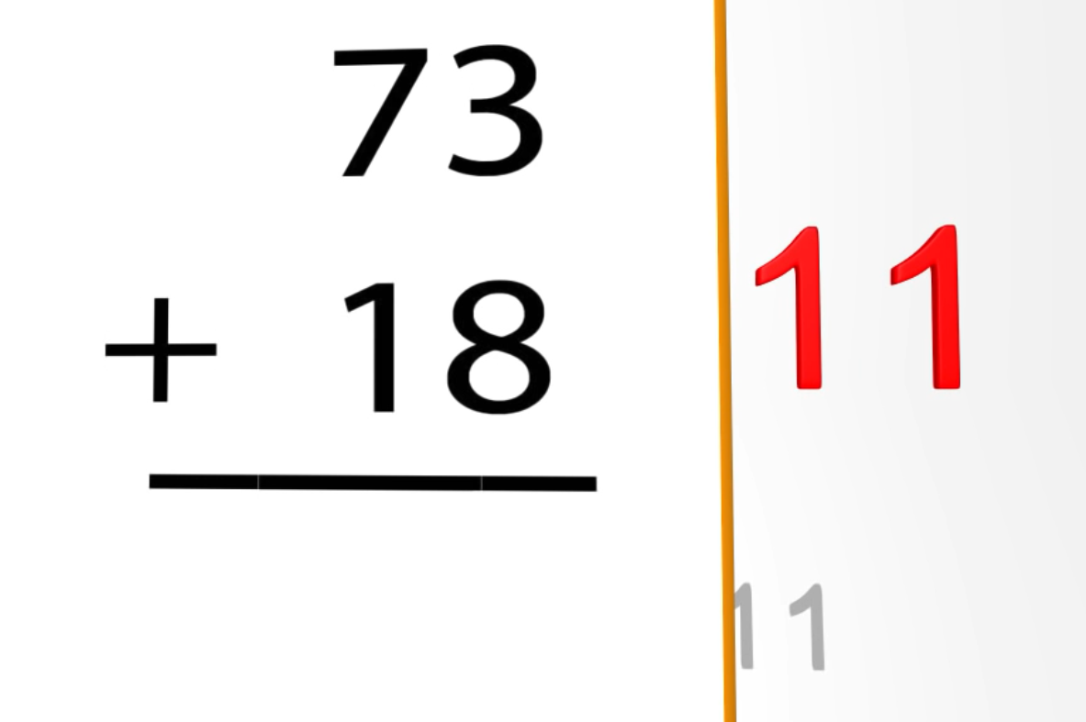
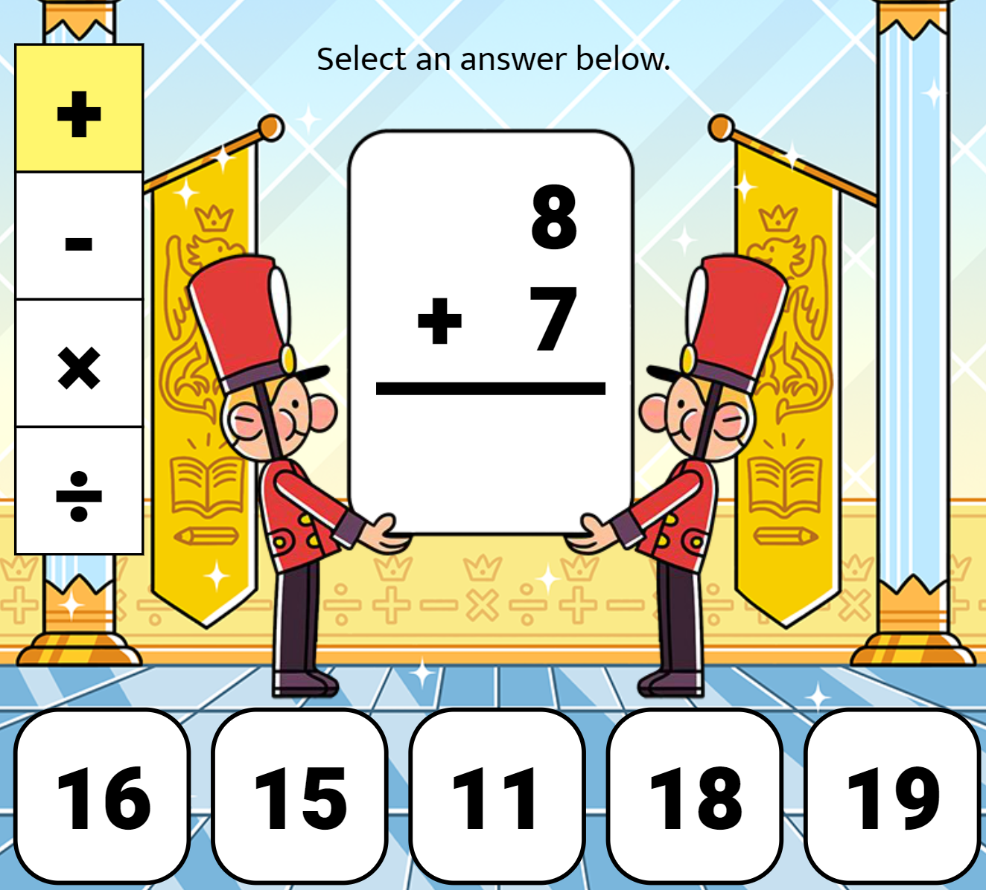
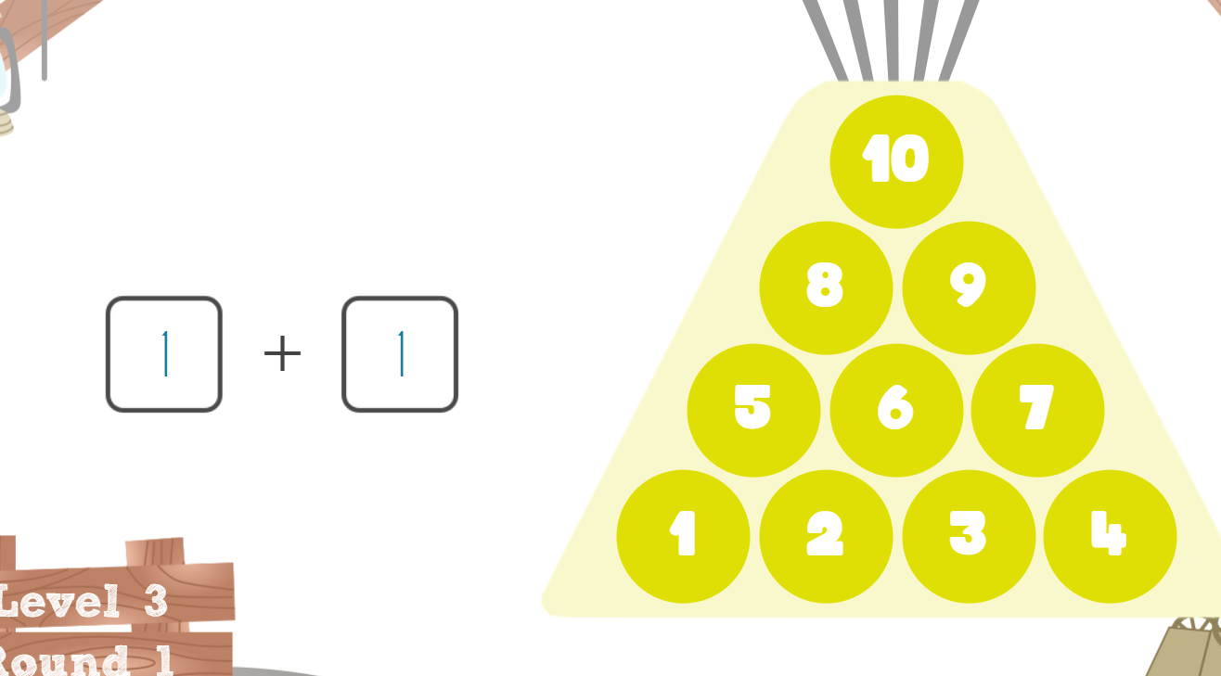
Math
I can demonstrate an understanding of addition.
Step 1
Click the video for a review on addition.
Step 2
Choose the correct missing number.
Choose the correct number to answer the question.
Step 3
Make the sum using the numbers.

Slide 7
Daily Physical Activity
Choose one (or more) activities for your DPA.
GoNoodle
Fresh Start Fitness
Maximo
Calming Down
Mrs. McIntyre DPA

