Slide 1
BRAICO’s Class 1/2
Friday, June 12, 2020

Slide 2
Table of Contents
Morning Message
Word Work
Reading
Writing
Math
Daily Physical Activity

Slide 3
Morning Message
Hello Kiddos,
Happy Friday! How has the Math review been going? Do you remember all your skills? Today, we will look for words that end in ‘nk’ in our reading, we test out our comprehension of ish, and do a skip counting review in Math. I hope you all have a great weekend! See you Monday!
Happy Learning,
Mr. Braico

Slide 4
Reading
I can apply a variety of strategies to help solve words.
Step 1
Click and watch the video.
Step 2
Read a book from home or on RAZ kids.
Find any words that end in ‘nk' in your book. Remember if you get to a tricky word – stretch out each sounds using ‘Stretchy Snake’.
Step 3
Share your words you found with a parent or share it with Mr. Braico in an email or on your ClassDojo portfolio.

Slide 5
Writing
Step 1
Click the video to listen to Mr. Braico read ish.
Step 2
Read and answer the questions from the comprehension test to see how well you remember the story.

Slide 6
Writing
Step 3
Click this video and see the answers to the comprehension test. How did you do?

Slide 7
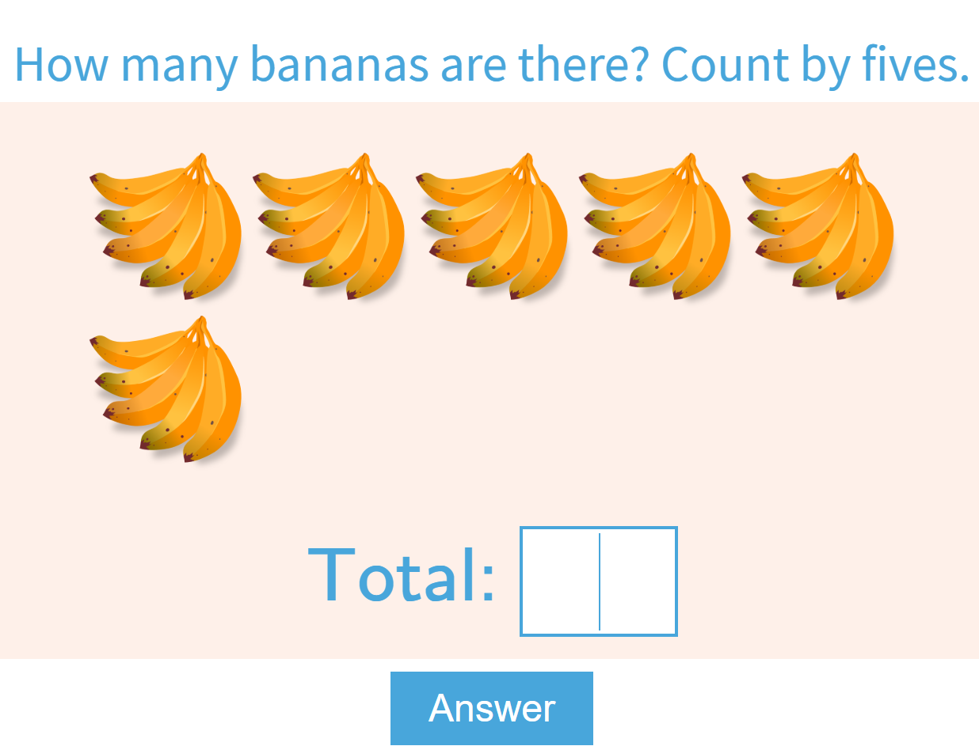
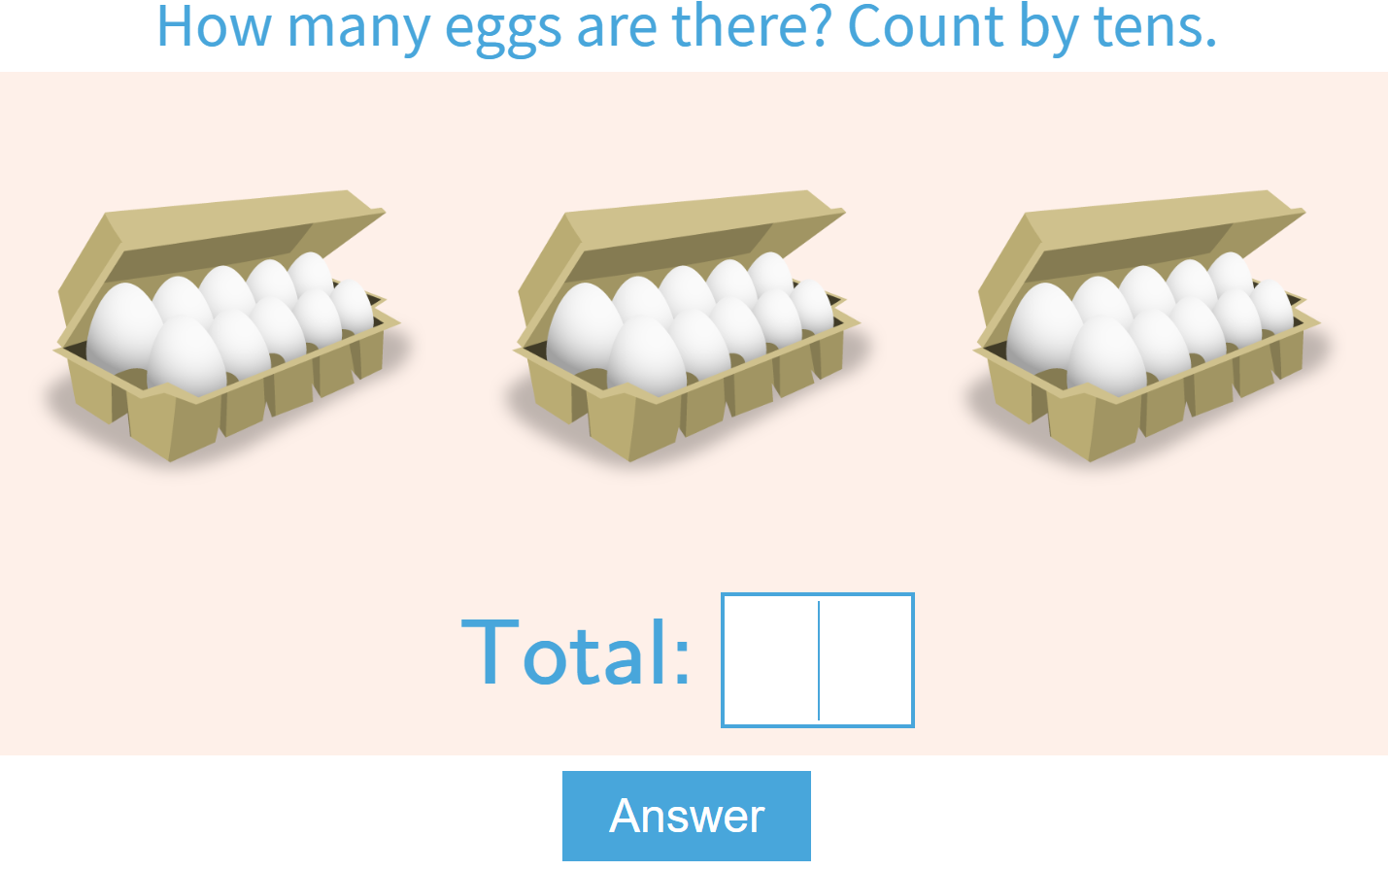
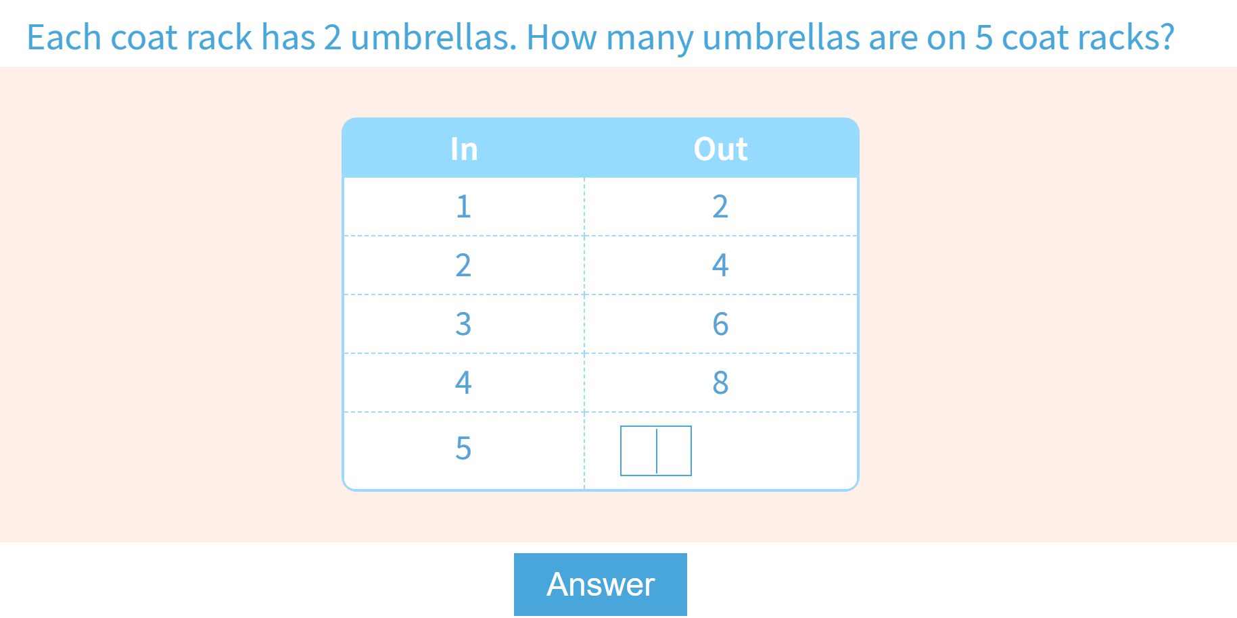
Math
I can say the number sequence from 0 to 100 using skip counting.
Step 1
Click the video to review skip counting.
Step 2
Practice counting by 5s.
Practice counting by 10s.
Find the skip count pattern .
Step 3
Take a video of yourself skip counting by your choice of 2s, 5s, or 10s. Better yet, do it while skipping or jumping.
Send it by email or put it up on your ClassDojo portfolio.

Slide 8
Daily Physical Activity
Choose one (or more) activities for your DPA.
GoNoodle
Fresh Start Fitness
Maximo
Calming Down
Mrs. McIntyre DPA

