Slide 1
BRAICO’s Class 1/2
Thursday, June 11, 2020

Slide 2
Table of Contents
Morning Message
Word Work
Reading
Writing
Math
Daily Physical Activity

Slide 3
Morning Message
Hello Kiddos,
Happy Thursday! I am glad Ramon was able to solve his problem in the story yesterday. Today, let’s find some words that end in ‘nt’ in our reading, read ish again and find the author’s purpose of writing the story, and let’s review comparing length in Math.
Happy Learning,
Mr. Braico

Slide 4
Reading
I can apply a variety of strategies to help solve words.
Step 1
Click and watch the video.
Step 2
Read a book from home or on RAZ kids.
Find any words that end in ‘nt' in your book. Remember if you get to a tricky word – stretch out each sounds using ‘Stretchy Snake’.
Step 3
Share your words you found with a parent or share it with Mr. Braico in an email or on your ClassDojo portfolio.

Slide 5
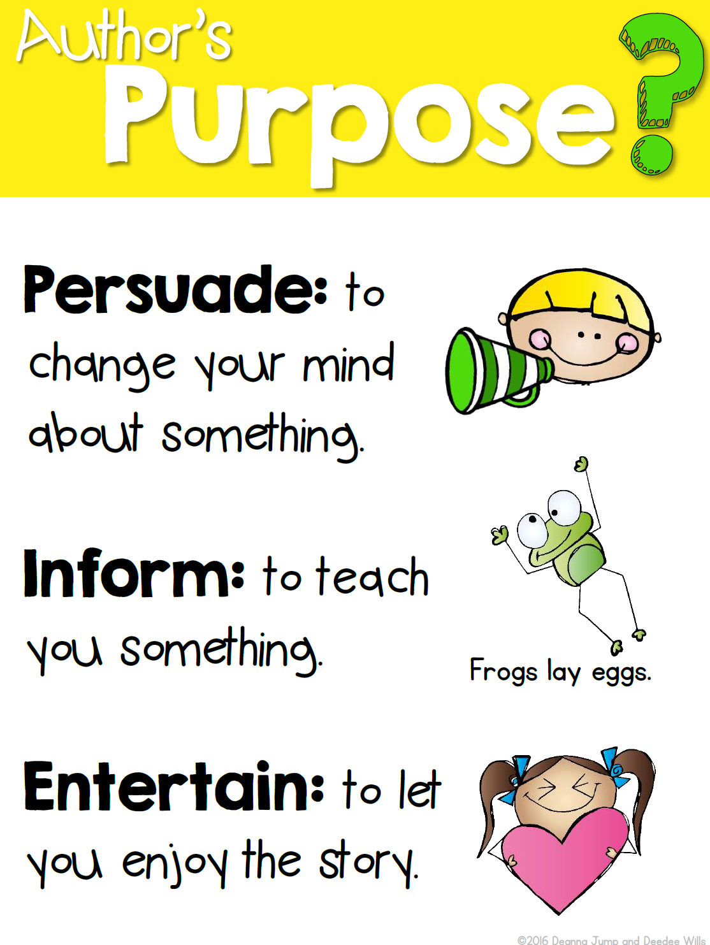
Writing
I can explain the author’s purpose of a story.
Step 1
Click the video to listen to Mr. Braico read ish. Today, we will write about the author’s purpose.
Step 2
Think about what you think the author is trying to teach us. What lesson did you learn from reading the story?
Step 3
Create a Word document called “ish – Author”. Write at least 3 sentences of the lesson you learned and why you thought so.

Slide 6
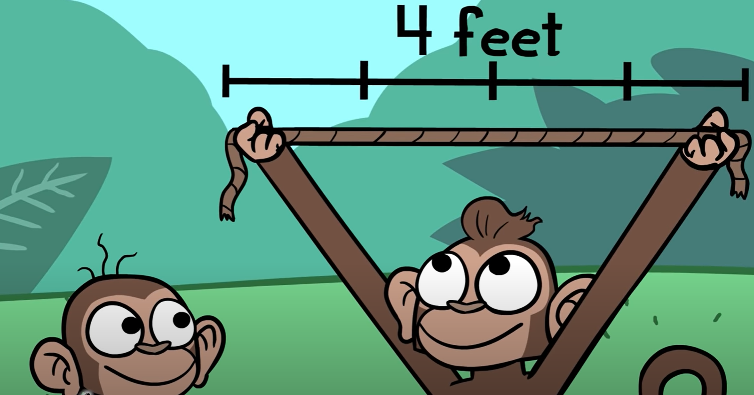
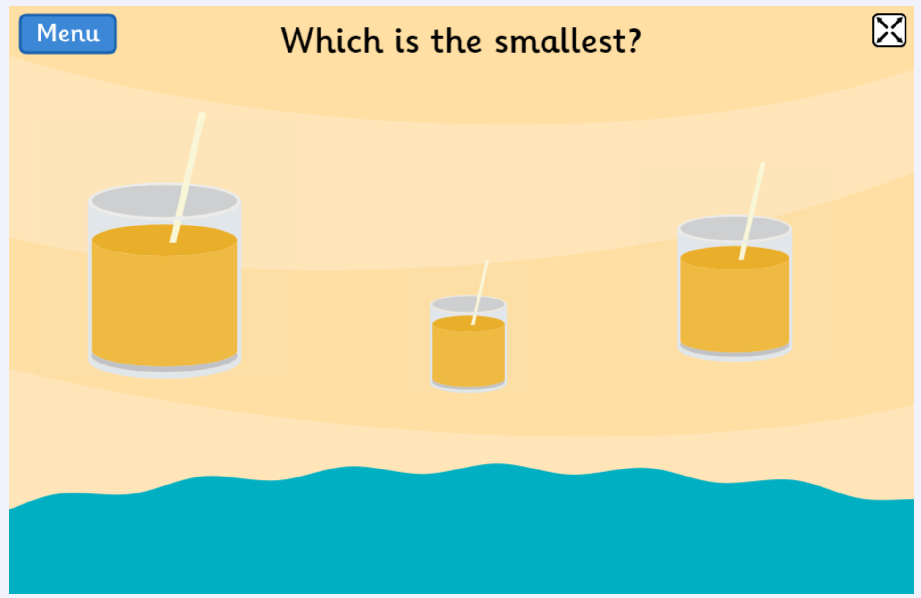
Math
I can compare and order objects by length.
Step 1
Click the video to review comparing lengths.
Step 2
Which is shorter or longer?
Which is smallest or bigger?
Step 3
Try making some measurement comparisons at home. Find some items that are longer and shorter, bigger and smaller.
Take a picture and email it or put it on your ClassDojo portfolio.

Slide 7
Daily Physical Activity
Choose one (or more) activities for your DPA.
GoNoodle
Fresh Start Fitness
Maximo
Calming Down
Mrs. McIntyre DPA

