Slide 1
BRAICO’s Class 1/2
Tuesday, June 9, 2020

Slide 2
Table of Contents
Morning Message
Word Work
Reading
Writing
Math
Daily Physical Activity

Slide 3
Morning Message
Hello Kiddos,
Happy Tuesday! Visualizing can help you remember what you read. Today, let’s look at words ending in ‘sk’, we will read ish again and make a connection to our lives, and we will review 2D shapes in Math.
Happy Learning,
Mr. Braico

Slide 4
Reading
I can apply a variety of strategies to help solve words.
Step 1
Click and watch the video.
Step 2
Read a book from home or on RAZ kids.
Find any words that end in ‘sk' in your book. Remember if you get to a tricky word – stretch out each sounds using ‘Stretchy Snake’.
Step 3
Share your words you found with a parent or share it with Mr. Braico in an email or on your ClassDojo portfolio.

Slide 5
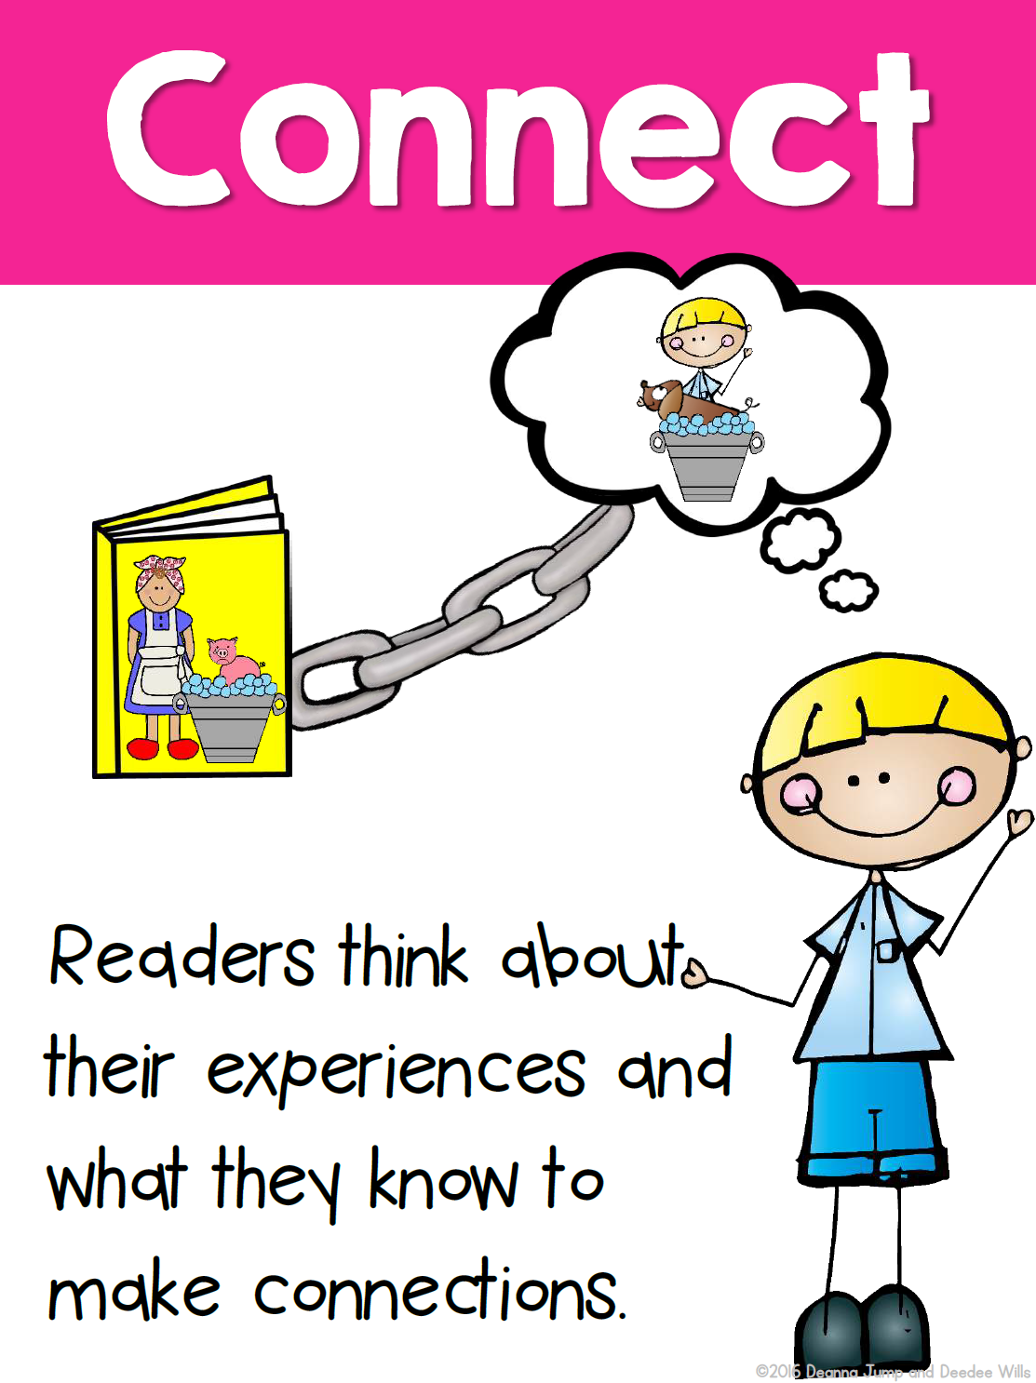
Writing
I can use past experiences to make a connection.
Step 1
Click the video to listen to Mr. Braico read ish.
Step 2
Today, we will make a connection to our lives. Ramon was frustrated because he did not feel like his drawings were right. Think of a time when you were frustrated about something you were trying to do.
Step 3
Start a new word document called “ish – Connection”. Write at least 3 sentences about a time when you were frustrated.. Answer what, why, and how.

Slide 6
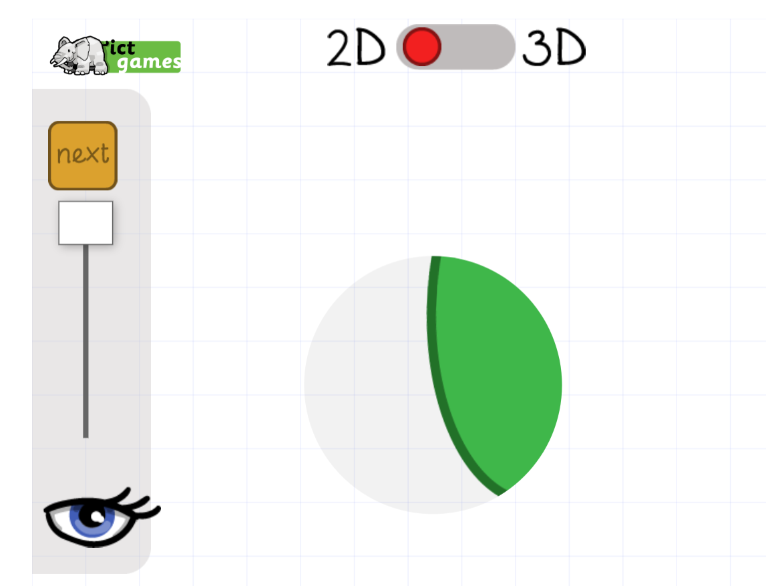
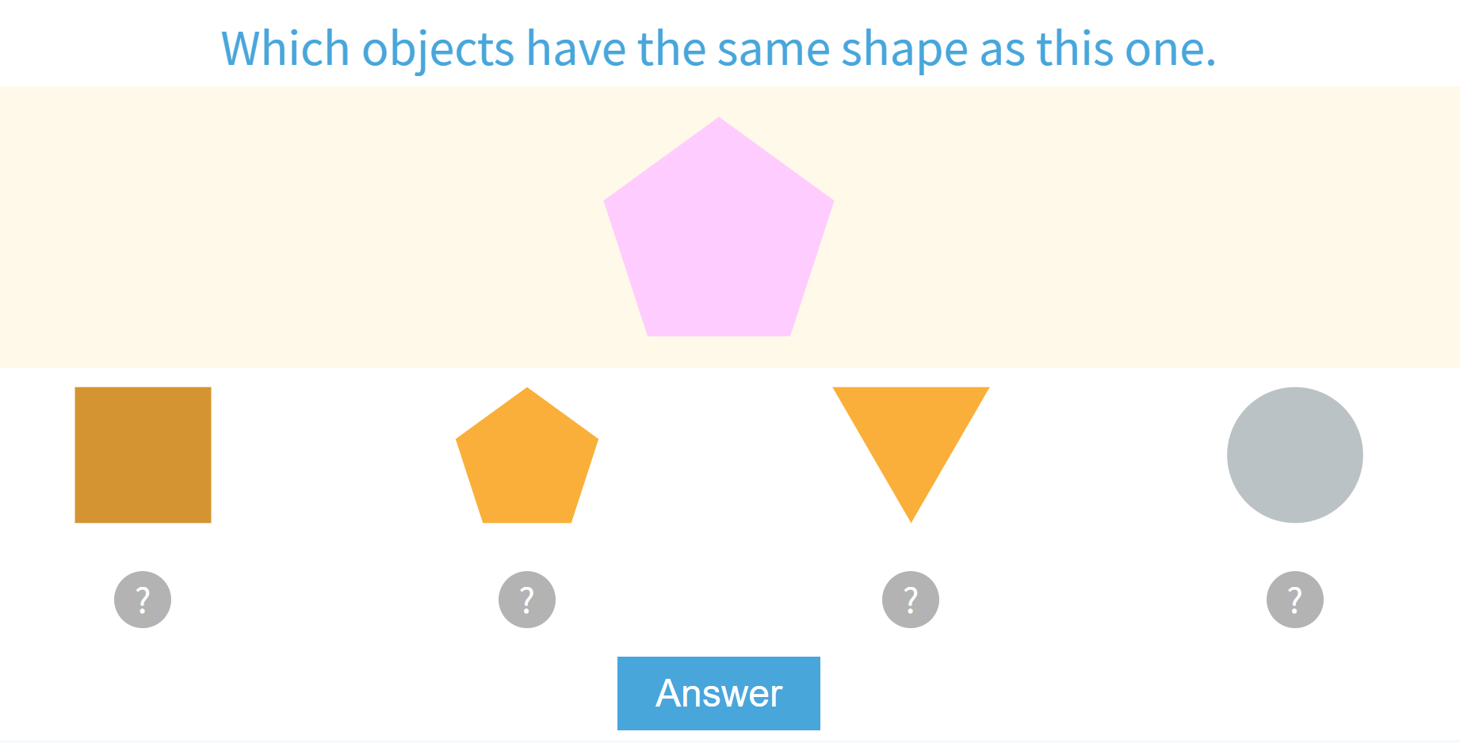
Math
I can sue attributes to sort and identify 2D shapes.
Step 1
Click the video for a review of 2D Shapes.
Step 2
Move the viewer and guess which shape.
Match the same shape.
Step 3
Around your house, find as many different shapes as you can or make different shapes using pencils or sticks.
Take a picture and email it or put it on your ClassDojo portfolio.

Slide 7
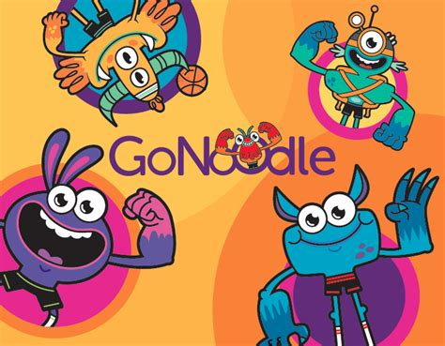
Daily Physical Activity
Choose one (or more) activities for your DPA.
GoNoodle
Fresh Start Fitness
Maximo
Calming Down
Mrs. McIntyre DPA

