Slide 1
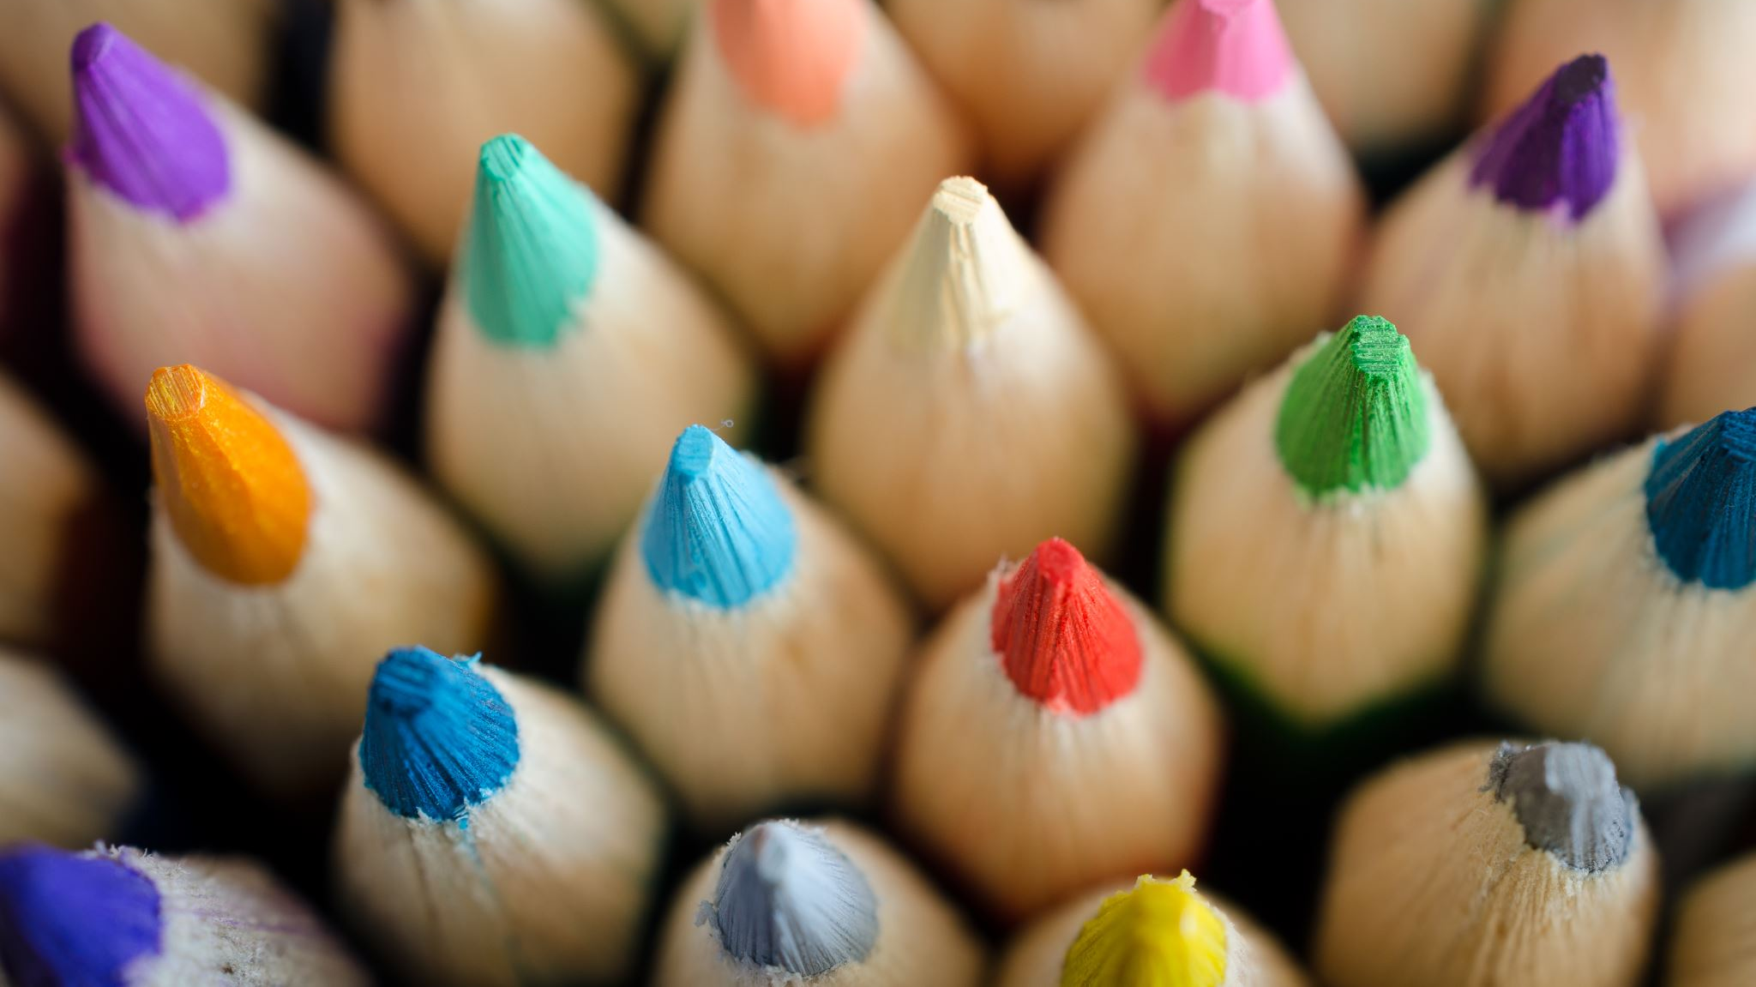
BRAICO’s Class 1/2
Monday, June 8, 2020

Slide 2
Table of Contents
Morning Message
Word Work
Reading
Writing
Math
Daily Physical Activity

Slide 3
Morning Message
Hello Kiddos,
Happy Monday! I hope you had a great weekend. As the school year starts to end, we will look at ending blends in our reading today, we start with ‘sh’, we will then read a story called ish and make a visualization, we will review our math skills for the last two weeks and we start off with patterns.
Happy Learning,
Mr. Braico

Slide 4
Reading
I can apply a variety of strategies to help solve words.
Step 1
Click and watch the video.
Step 2
Read a book from home or on RAZ kids.
Find any words that end in ‘sh' in your book. Remember if you get to a tricky word – stretch out each sounds using ‘Stretchy Snake’.
Step 3
Share your words you found with a parent or share it with Mr. Braico in an email or on your ClassDojo portfolio.

Slide 5
Writing
I can use pictures to construct and confirm meaning in stories I read.
Step 1
Click the video to listen to Mr. Braico read ish. Today we will be visualizing what happens in the book.
Step 2
Watch until Mr. Braico says PAUSE. Marisol went into her room with Ramon’s drawing and Ramon saw the “gallery” for the first time.
Open Paint, go to ClassDojo or grab a piece of paper to draw a picture of what you are visualizing.
Step 3
Continue the video and see if your visualization matched.
If it did, add colour to your picture. If it did not, add more and then colour your picture.

Slide 6
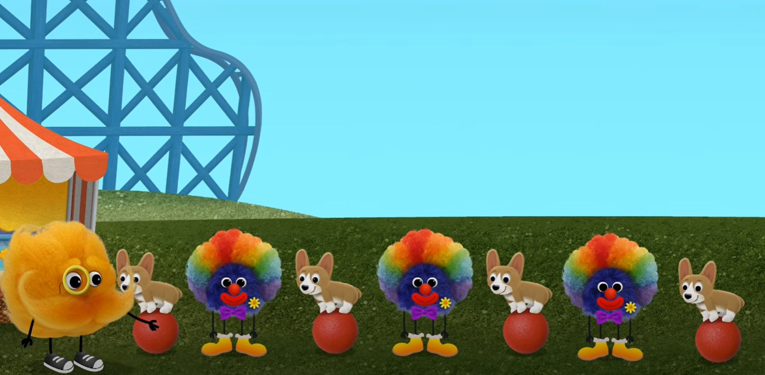
Math
I can show an understanding of repeating patterns.
Step 1
Click the video for a review on patterns.
Step 2
Choose the train to complete the pattern.
Use the pattern blocks to make your own pattern.
Step 3
Using items from home, make a 2-4 core pattern. Show a parent or take a picture and put it on ClassDojo.

Slide 7
Daily Physical Activity
Choose one (or more) activities for your DPA.
GoNoodle
Fresh Start Fitness
Maximo
Calming Down
Mrs. McIntyre DPA

