Slide 1
BRAICO’s Class 1/2
Monday, June 1, 2020

Slide 2
Table of Contents
Morning Message
Word Work
Reading
Writing
Math
Daily Physical Activity

Slide 3
Morning Message
Hello Kiddos,
Happy Monday! LAST MONTH OF THE SCHOOL YEAR. This week, we are going to look at trigraphs which are sounds made by 3 letters together, we start with ‘dge’, we will read a story called The Pout-Pout Fish and make a prediction, we take a look at time this week and start with the parts of a clock.
Happy Learning,
Mr. Braico

Slide 4
Reading
I can apply a variety of strategies to help solve words.
Step 1
Click and watch the video.
Step 2
Read a book from home or on RAZ kids.
Find any ‘dge' words in your book. Remember if you get to a tricky word – look for chunks you know by using ‘Chunky Monkey’.
Step 3
Share your words you found with a parent or share it with Mr. Braico in an email or on your ClassDojo portfolio.

Slide 5
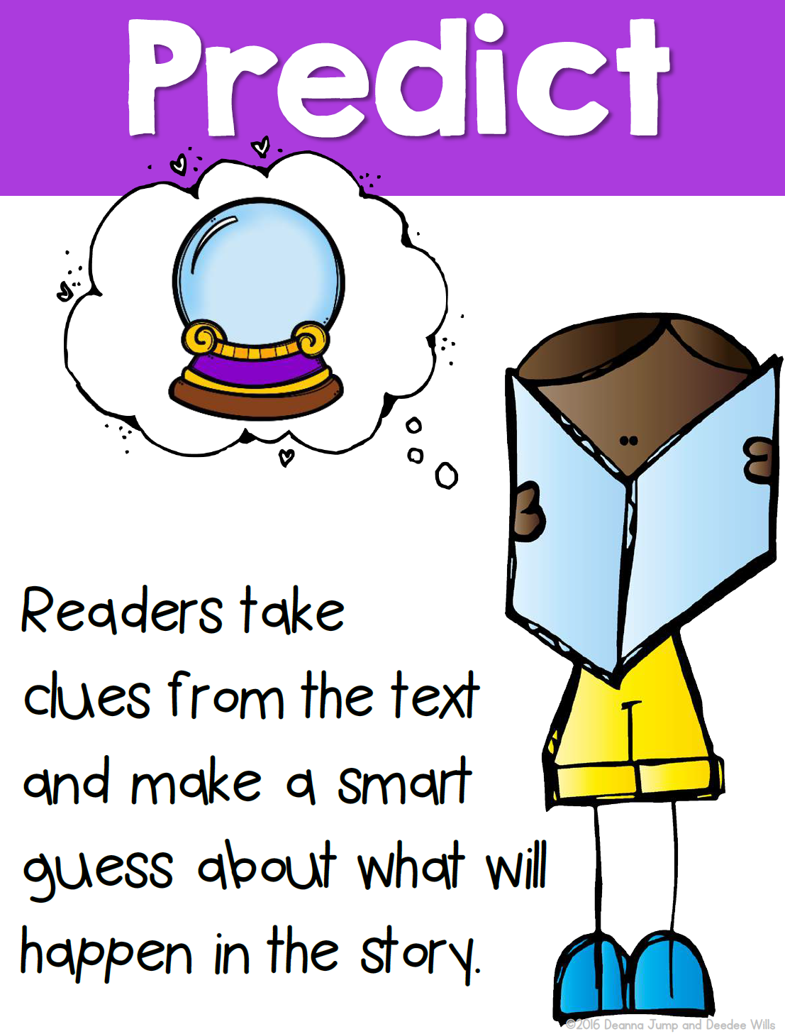
Writing
I can make predictions to draw conclusions of a story.
Step 1
Click the video to listen to Mr. Braico read The Pout-Pout Fish. Today we will be making a prediction.
Step 2
Watch until Mr. Braico says PAUSE. Mr. Fish just got kissed. Do you think he will change?
Open a Word Document and title it “Pout Pout – Prediction” and add your prediction.
Step 3
Continue the video and see if your prediction was correct.
Write down if you were correct or if you were surprised. What actually happened in the story?

Slide 6
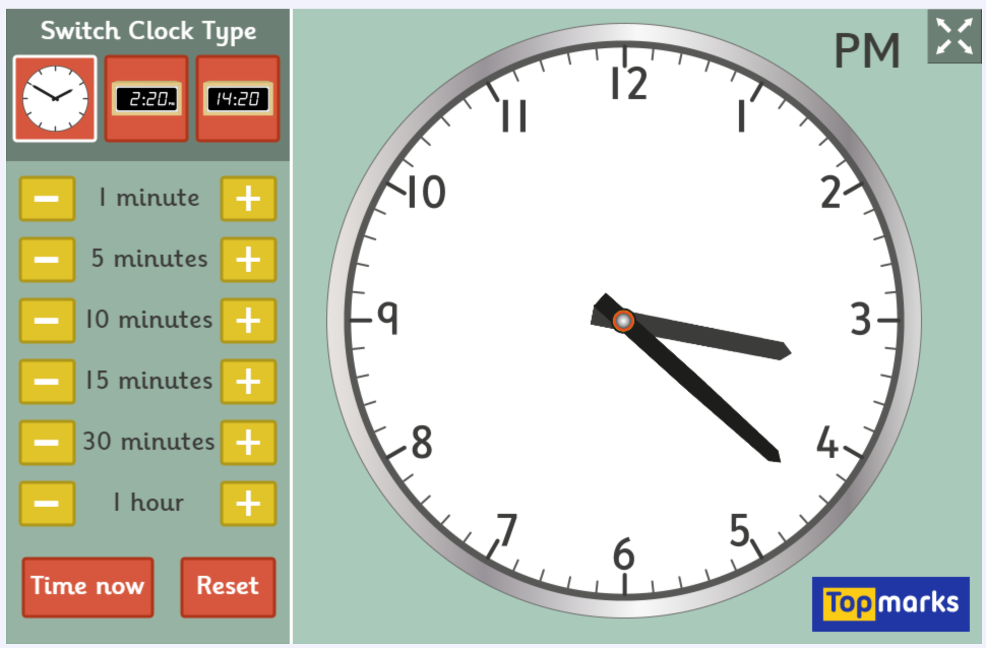
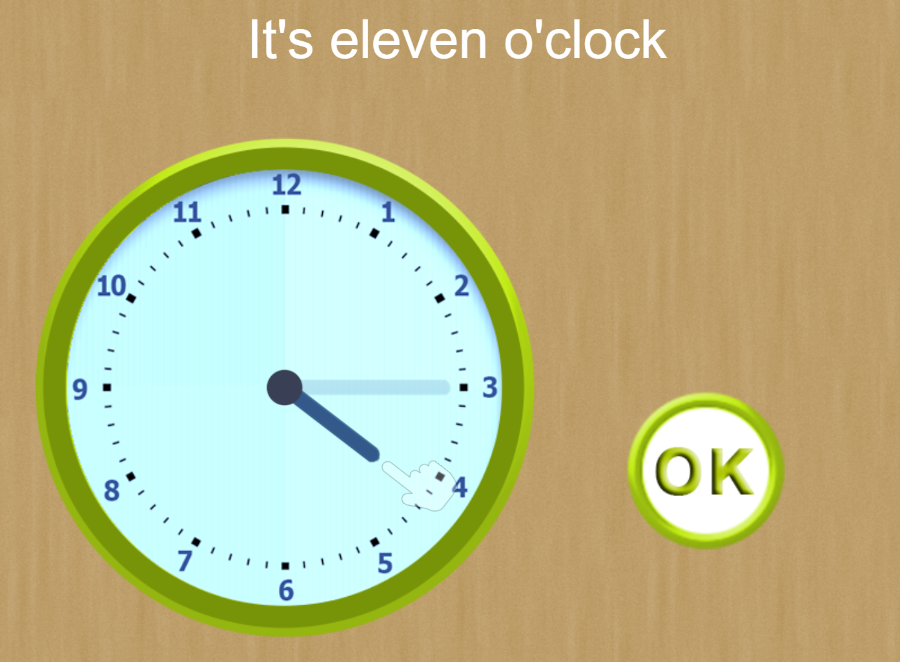
Math
I can relate the size of a unit of measure to the number of units to measure time.
Step 1
Click the video to learn about the parts of a clock.
User: westminster1
Password: westie1
Step 2
Do the EASY or HARD quiz found under the video.
Step 3
Practice adding time to the clock.
Change the time using the parts of a clock.

Slide 7
Daily Physical Activity
Choose one (or more) activities for your DPA.
GoNoodle
Fresh Start Fitness
Maximo
Calming Down
Mrs. McIntyre DPA

