Slide 1
BRAICO’s Class 1/2
Wednesday, June 3, 2020

Slide 2
Table of Contents
Morning Message
Word Work
Reading
Writing
Math
Daily Physical Activity

Slide 3
Morning Message
Hello Kiddos,
Happy Wednesday! I usually tell jokes to people when they are feeling gloomy. Today, let’s look for ‘air’ words in our reading, read The Pout-Pout Fish again and look at character traits, and we will learn more about time to the minute in Math.
Happy Learning,
Mr. Braico

Slide 4
Reading
I can apply a variety of strategies to help solve words.
Step 1
Click and watch the video.
Step 2
Read a book from home or on RAZ kids.
Find any ‘air’ words in your book. Remember if you get to a tricky word-look for chunks you know by using ‘Chunky Monkey’.
Step 3
Share your words you found with a parent or share it with Mr. Braico in an email or on your ClassDojo portfolio.

Slide 5
Writing
I can tell what characters do and what happens to them in a story.
Step 1
Click the video to listen to Mr. Braico read The Pout-Pout Fish.
Step 2
Today we will look more at the characters in a story. What do you know about Mr. Fish?
Create a Word Document called “Pout Pout – Character” and write down at least 2 things you know about Mr. Fish. Where was that in the book?
Step 3
In your Word document, write how Mr. Fish changed.

Slide 6
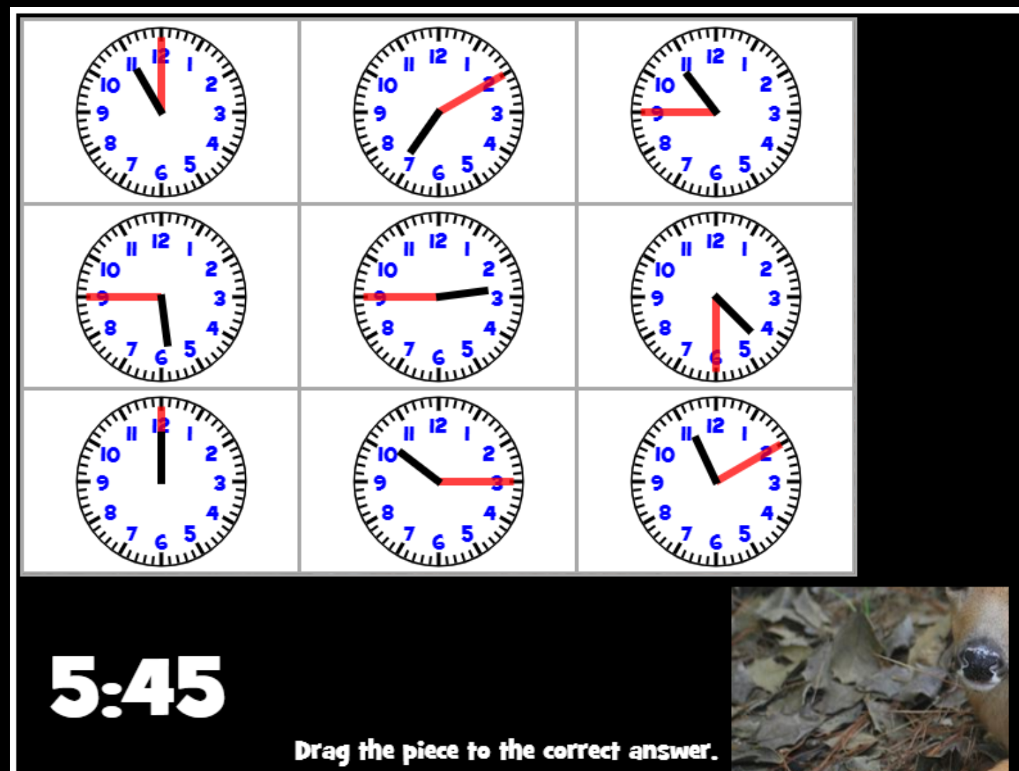
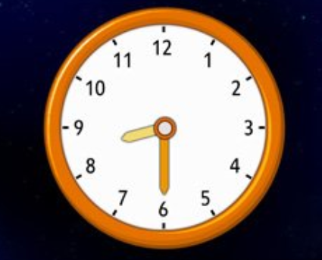
Math
I can relate the size of a unit of measure to the number of units to measure time.
Step 1
Click the video to learn about time to the minute.
User: westminster1
Password: westie1
Step 2
Do the EASY or HARD quiz found under the video.
Step 3
Drag the puzzle piece to the time displayed.
Tell time to the half hour.
Click Sign In → Class → JUMJUU → find name → Password: 1234

Slide 7
Daily Physical Activity
Choose one (or more) activities for your DPA.
GoNoodle
Fresh Start Fitness
Maximo
Calming Down
Mrs. McIntyre DPA

