Slide 1
BRAICO’s Class 1/2
Tuesday, May 26, 2020

Slide 2
Table of Contents
Morning Message
Word Work
Reading
Writing
Math
Daily Physical Activity

Slide 3
Morning Message
Hello Kiddos,
Happy Tuesday! Did you learn anything new about sharks? Our tricky letter sound we look at today is ‘ie’. We read Surprising Sharks again and identify if facts were in the story or not. In Math, we are counting by 5s.
Happy Learning,
Mr. Braico

Slide 4
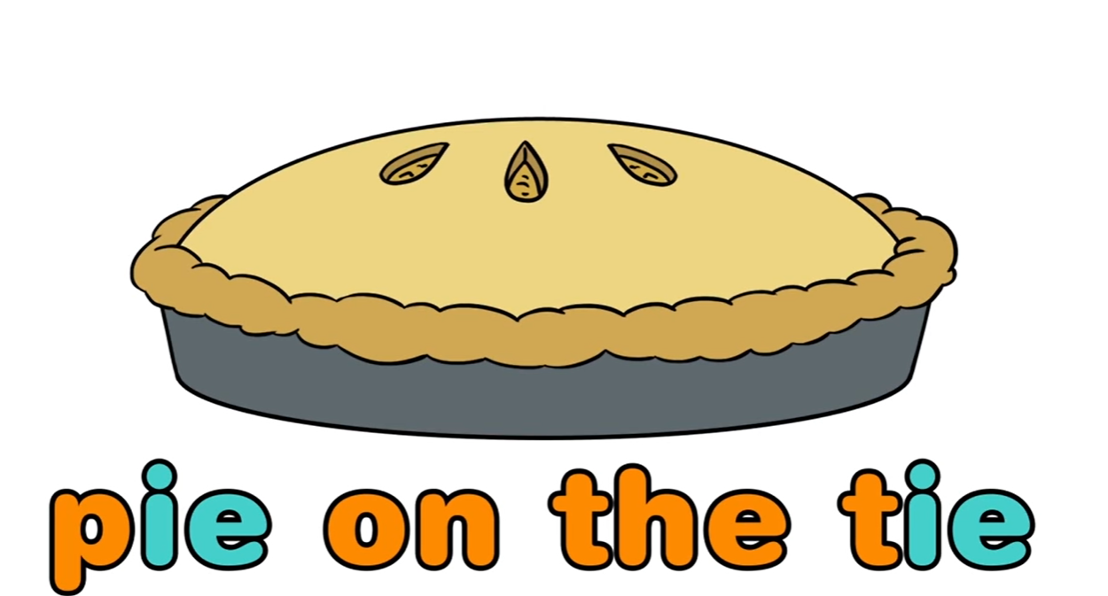
Reading
I can apply a variety of strategies to help solve words.
Step 1
Click and watch the video.
Step 2
Read a book from home or on RAZ kids.
Find any silent ‘ie’ words that sound like ‘i’ in your book. Remember if you get to a tricky word – flip the vowel sound like ‘Flippy the Dolphin’.
Step 3
Share your words you found with a parent or share it with Mr. Braico in an email or on your ClassDojo portfolio.

Slide 5
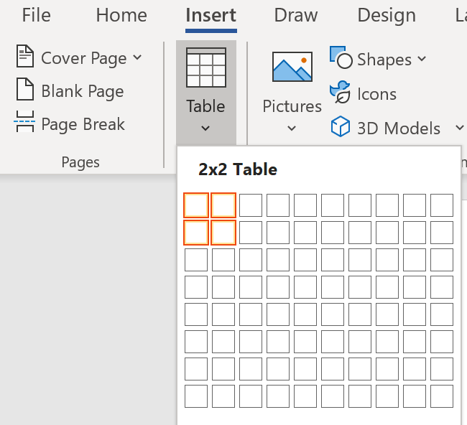
Writing
I can use past experiences to make connections with stories.
Step 1
Today we will be building our new knowledge of Sharks.
Open your “Sharks – Schema” Word Document and add a table with 2 rows and 2 columns.
First column will be ‘In Text’ – Second column – ‘Not In Text’

Slide 6
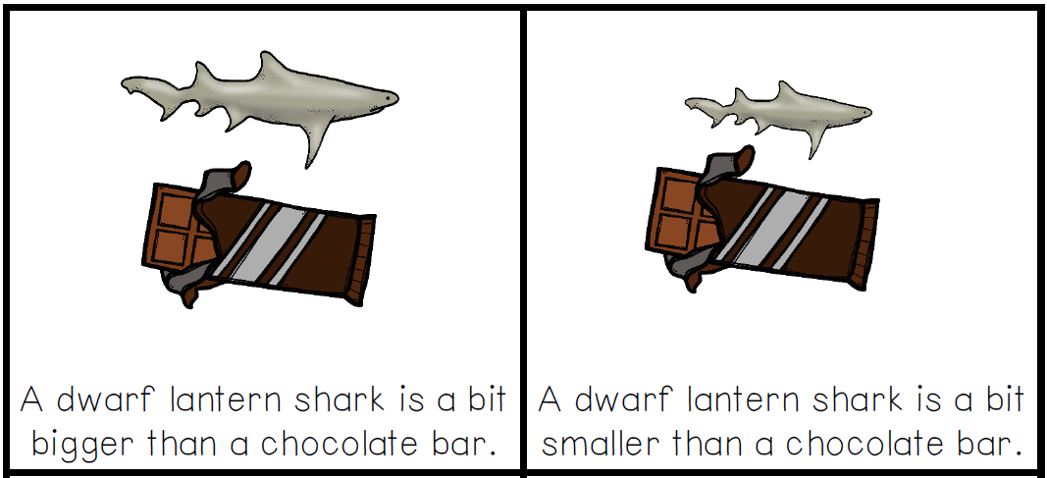
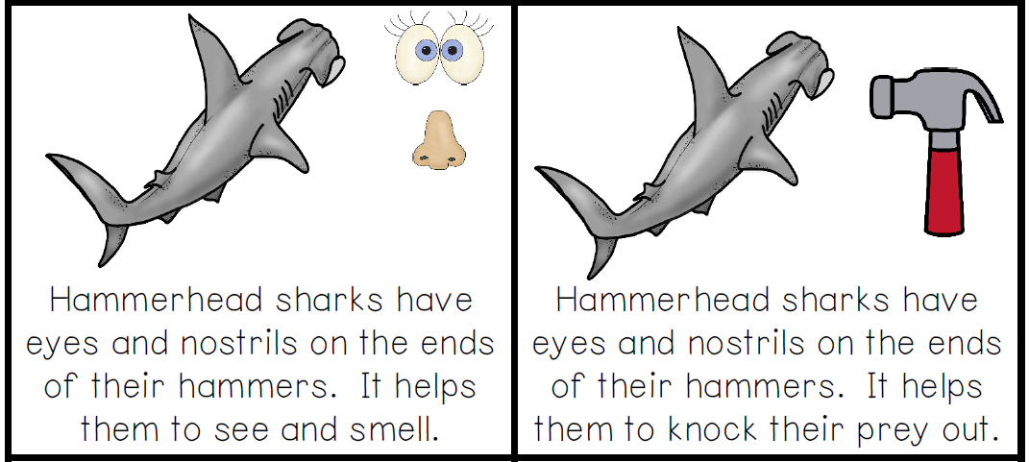
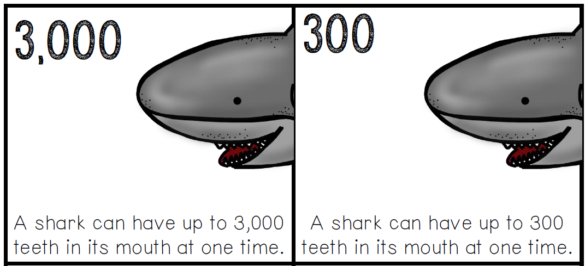
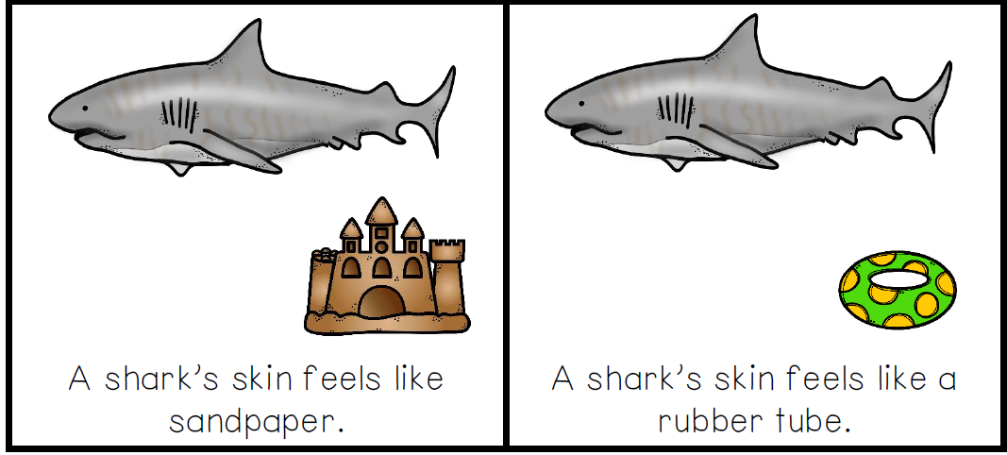
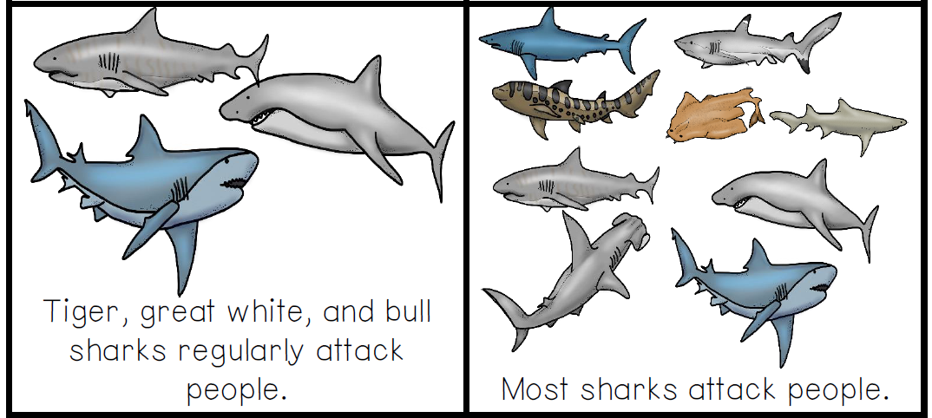
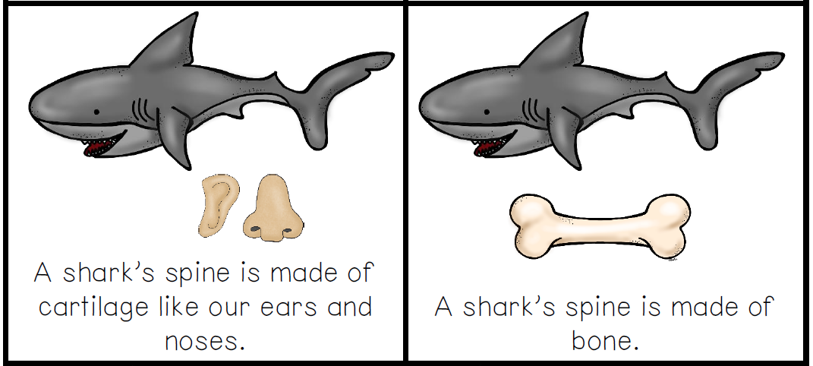
Writing
I can use past experiences to make connections with stories.
Step 2
Sort the information below by writing them into the correct column.

Slide 7
Writing
I can use past experiences to make connections with stories.
Step 3
Click the video to see which facts were in the text and which facts were not in the text.
How did you do? Did you comprehend the book well? Were there some answers that surprised you?

Slide 8
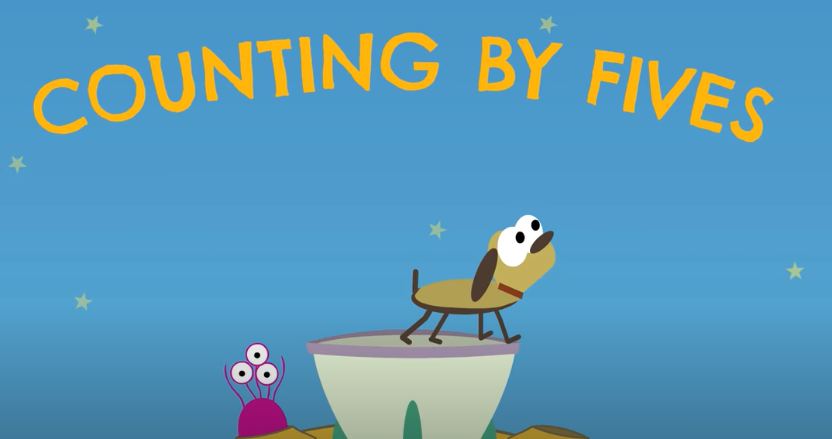
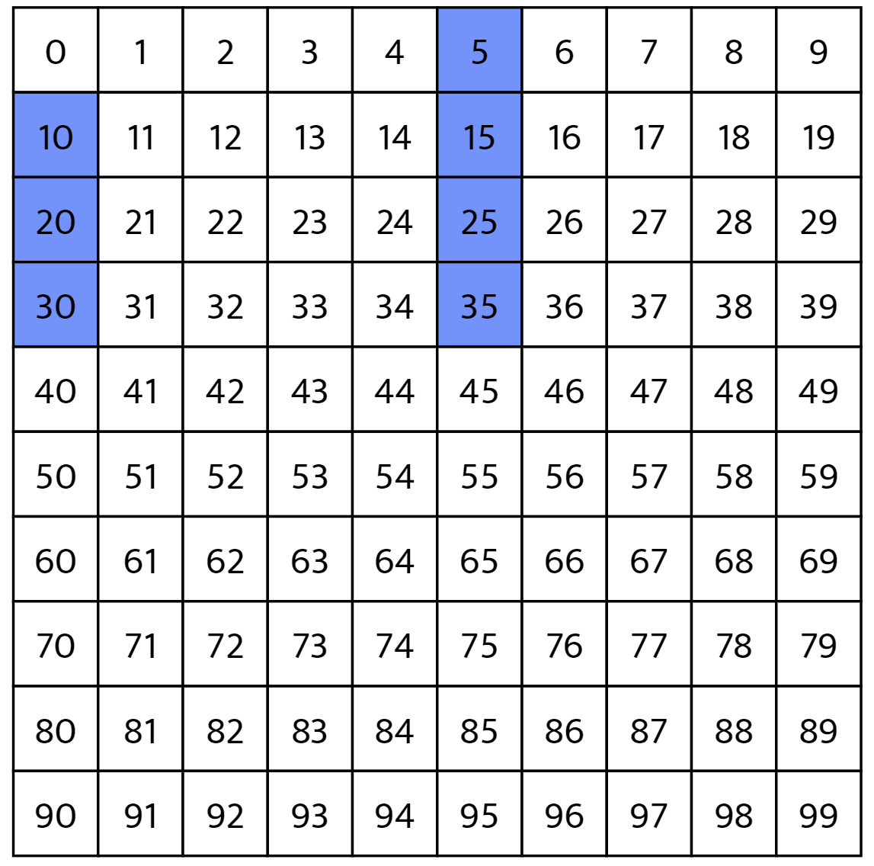
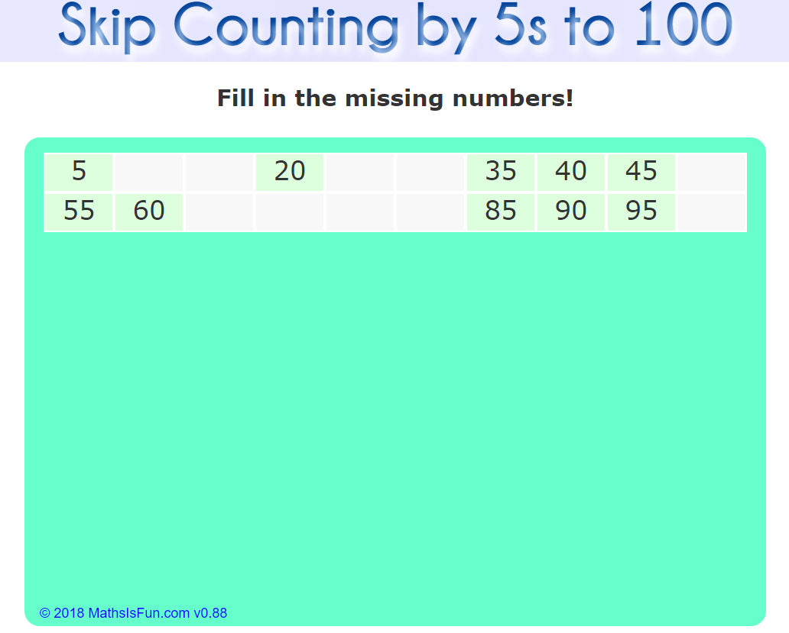
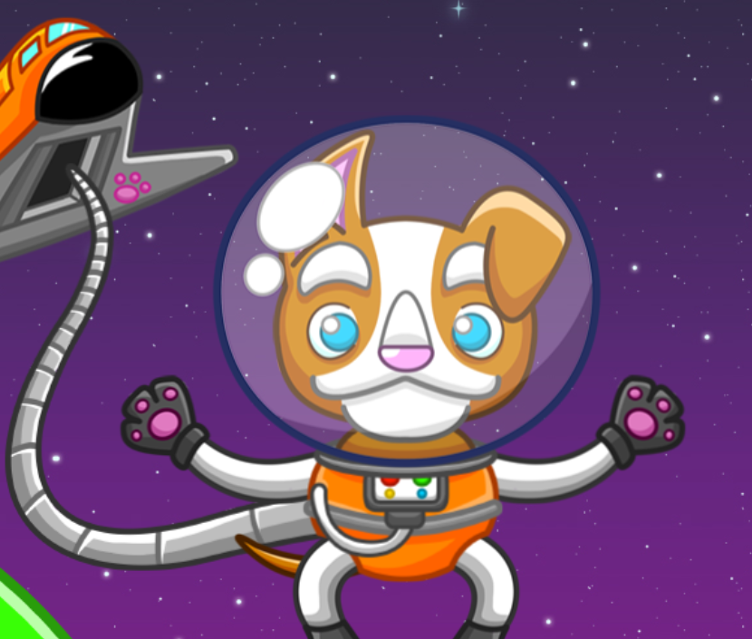
Math
I can say the number sequence counting by 5s.
Step 1
Click the video to learn more about counting by 5s.
Step 2
Use the number chart to count by 5s.
Do you notice a pattern?
Step 3
Practice counting by 5s.
Answer the questions by counting by 5s.

Slide 9
Daily Physical Activity
Choose one (or more) activities for your DPA.
GoNoodle
Fresh Start Fitness
Maximo
Calming Down
Mrs. McIntyre DPA

