Slide 1
BRAICO’s Class 1/2
Thursday, May 28, 2020

Slide 2
Table of Contents
Morning Message
Word Work
Reading
Writing
Math
Daily Physical Activity

Slide 3
Morning Message
Hello Kiddos,
Happy Thursday! It is always a good idea to ask yourself when reading a story, “Why is the author writing this?”. In reading, let’s find some words that end in ‘y’ but sound like ‘e’. We will be researching and writing about our favourite shark. In Math, we will be looking at odd and even numbers.
Happy Learning,
Mr. Braico

Slide 4
Reading
I can apply a variety of strategies to help solve words.
Step 1
Click and watch the video.
Step 2
Read a book from home or on RAZ kids.
Find any ‘y’ words that sound like ‘e’ in your book. Remember if you get to a tricky word – flip the vowel sound like ‘Flippy the Dolphin’.
Step 3
Share your words you found with a parent or share it with Mr. Braico in an email or on your ClassDojo portfolio.

Slide 5
Writing
I can record ideas and information in ways that make sense.
Step 1
Head to Online Resource Centre by clicking here.
User: LA33
Password: 7434
Go to PebbleGo Science.
Step 2
Search sharks and then click one to learn all about it.
Step 3
Open a Word document called “All About Sharks”. As the author, you will inform readers about at least 3 things you learned about your shark.

Slide 6
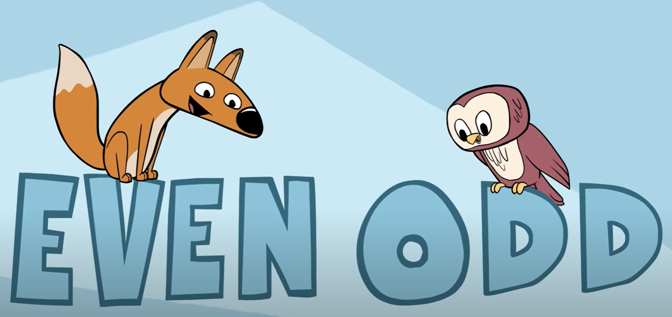
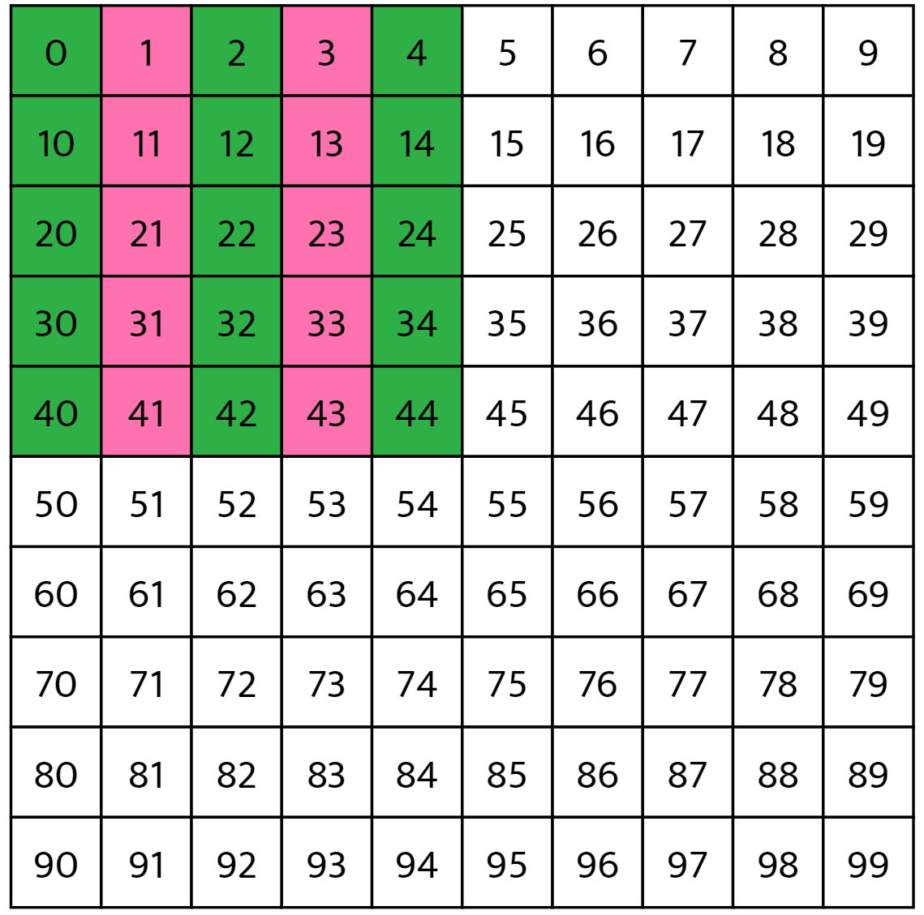
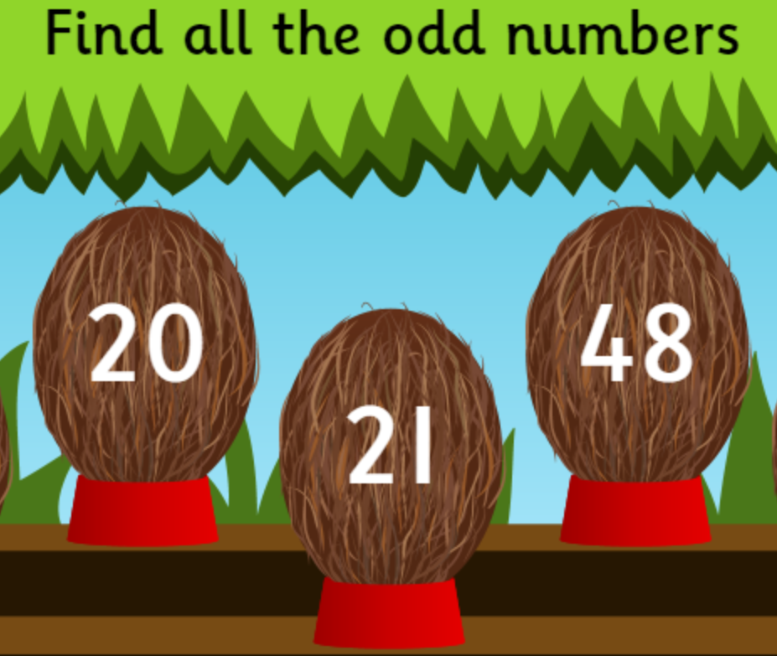
Math
I can demonstrate if a number is odd or even.
Step 1
Click the video to learn more about odd and even numbers.
Step 2
Use the number chart. Make all odd numbers one colour and all even numbers another colour.
Do you notice a pattern?
Step 3
Throw stones at the odd or even number coconuts.
Answer the questions about odd and even numbers.

Slide 7
Daily Physical Activity
Choose one (or more) activities for your DPA.
GoNoodle
Fresh Start Fitness
Maximo
Calming Down
Mrs. McIntyre DPA

