Slide 1
BRAICO’s Class 1/2
Wednesday, May 27, 2020

Slide 2
Table of Contents
Morning Message
Word Work
Reading
Writing
Math
Daily Physical Activity

Slide 3
Morning Message
Hello Kiddos,
Happy Wednesday! I hope you were able to figure out what facts were in the book and which ones were not. Today, let’s look at words that end in ‘y’ that sound like ‘i’ in our reading, find the author’s purpose in Surprising Sharks, and count by 10s.
Happy Learning,
Mr. Braico

Slide 4
Reading
I can apply a variety of strategies to help solve words.
Step 1
Click and watch the video.
Step 2
Read a book from home or on RAZ kids.
Find any ‘y’ words that sound like ‘i’ in your book. Remember if you get to a tricky word – flip the vowel sound like ‘Flippy the Dolphin’.
Step 3
Share your words you found with a parent or share it with Mr. Braico in an email or on your ClassDojo portfolio.

Slide 5
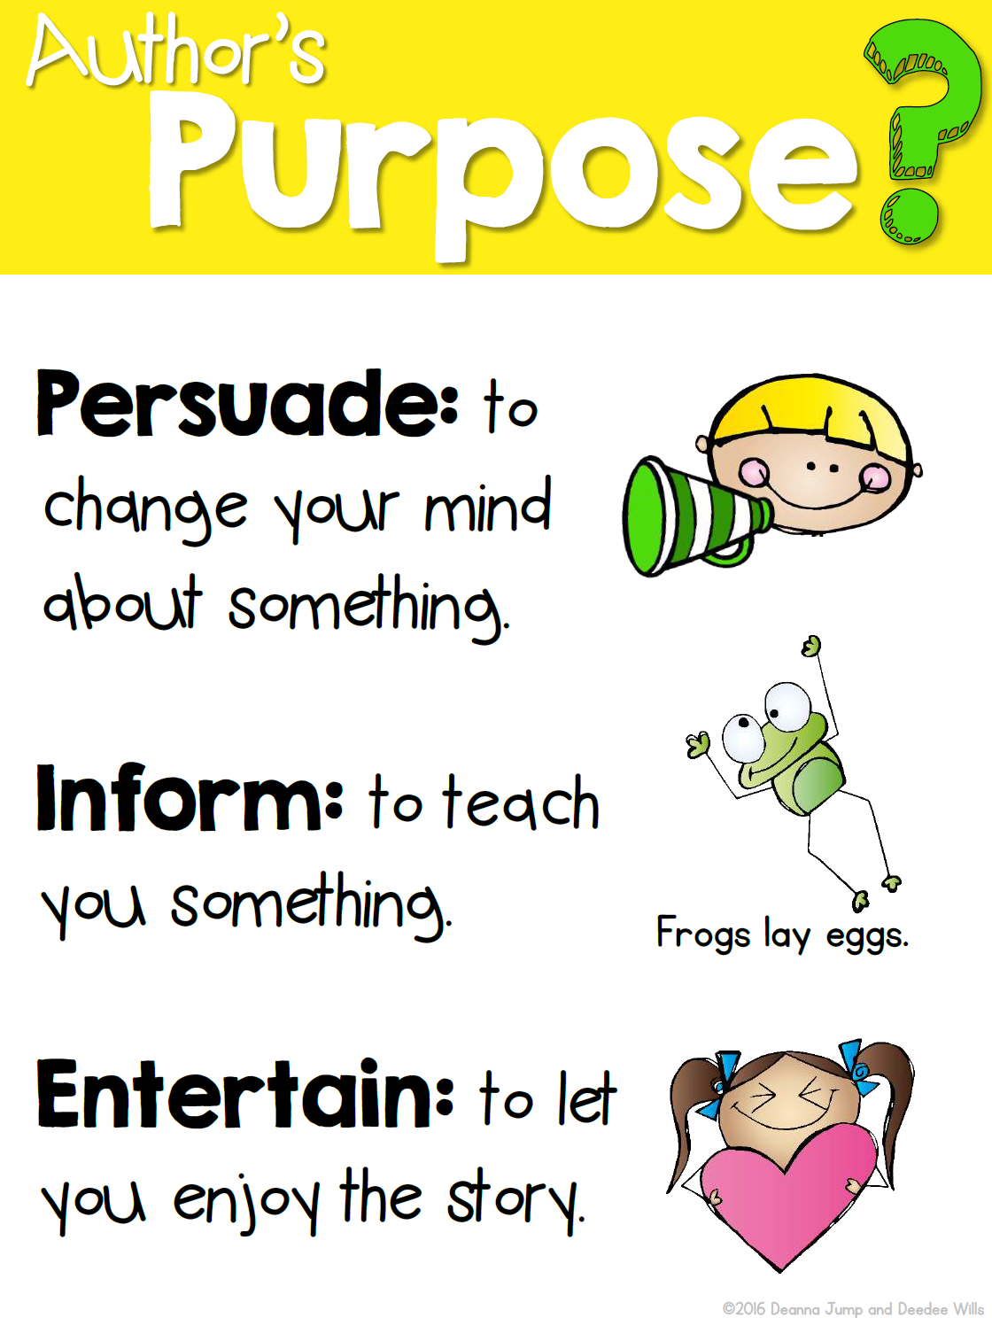
Writing
I can identify the main idea of a story.
Step 1
Today we will be figuring out what the authors purpose of writing Surprising Sharks was.
Click the video to listen to Mrs. Biesbroek read Surprising Sharks.
Step 2
Think of why the author wrote this book. Was it to persuade? Was it to inform? Was it to entertain?
Step 3
Open a Word Document called “Sharks – Purpose”. Write down why you thought the author wrote the book? What do you think she wanted you to know?

Slide 6
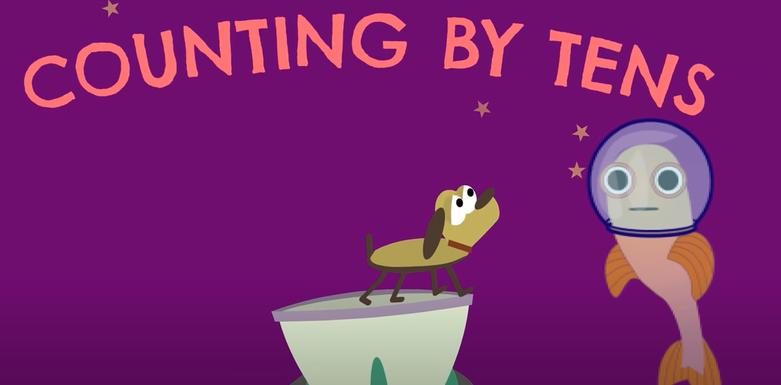
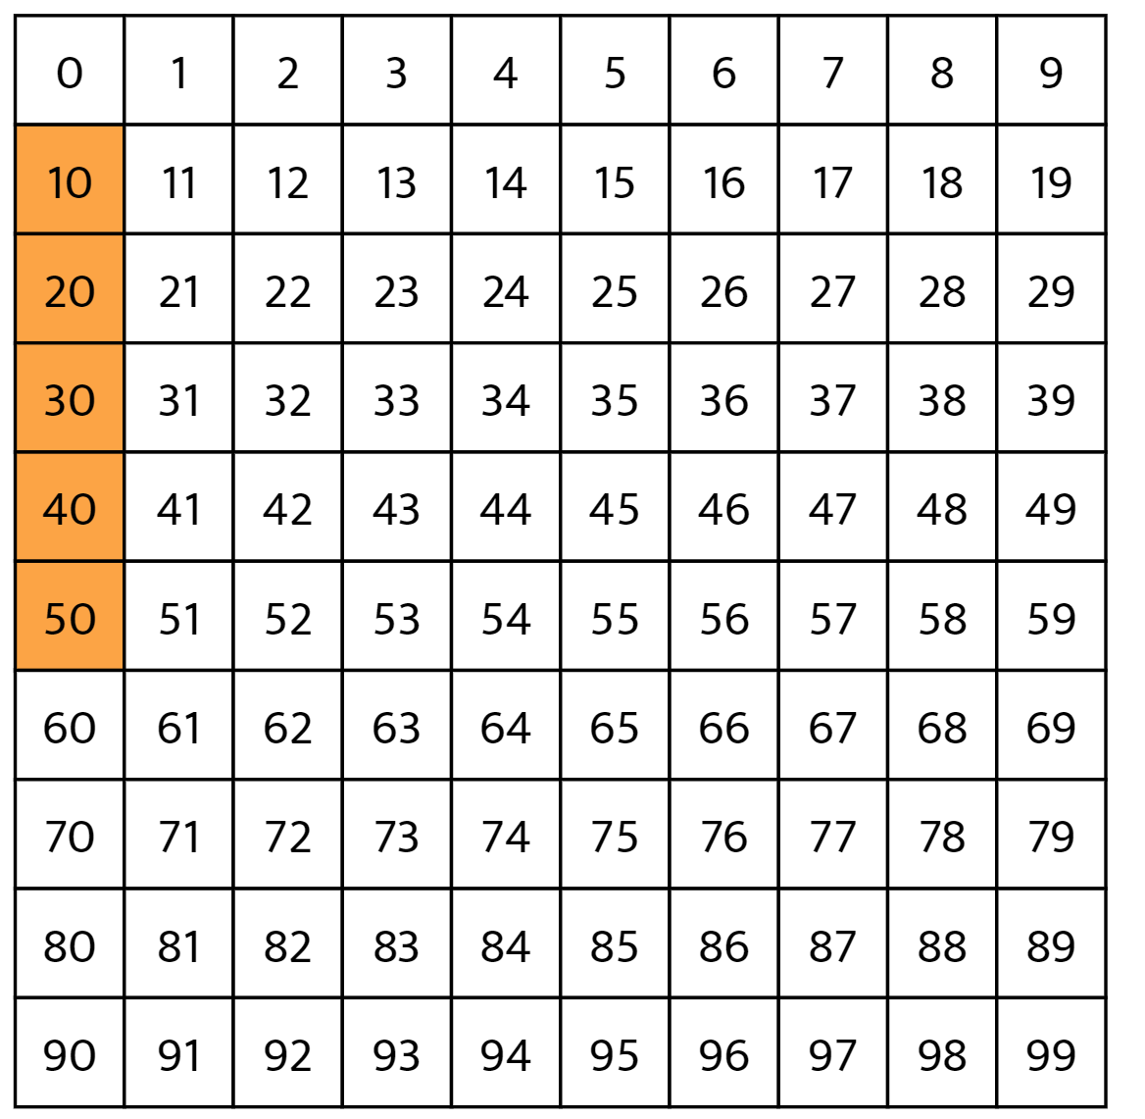
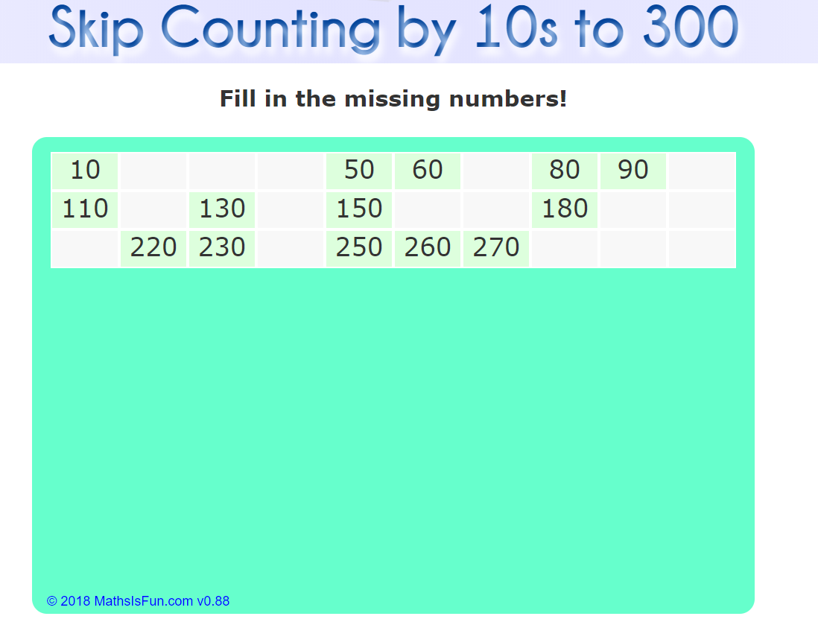
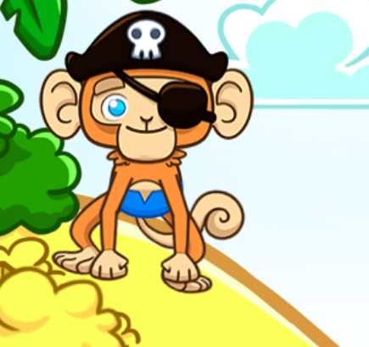
Math
I can say the number sequence counting by 10s.
Step 1
Click the video to learn more about counting by 10s.
Step 2
Use the number chart to count by 10s.
Do you notice a pattern?
Step 3
Practice counting by 10s.
Answer the questions by counting by 10s.

Slide 7
Daily Physical Activity
Choose one (or more) activities for your DPA.
GoNoodle
Fresh Start Fitness
Maximo
Calming Down
Mrs. McIntyre DPA

