Slide 1
BRAICO’s Class 1/2
Monday, May 25, 2020

Slide 2
Table of Contents
Morning Message
Word Work
Reading
Writing
Math
Daily Physical Activity

Slide 3
Morning Message
Hello Kiddos,
Happy Monday! I hope you had a great weekend. This week, we are going to look at some tricky letter sounds, we start with silent ‘e’, we will read a story called Surprising Sharks and build on our schemas, we improve our counting skills by counting by 2s.
Happy Learning,
Mr. Braico

Slide 4
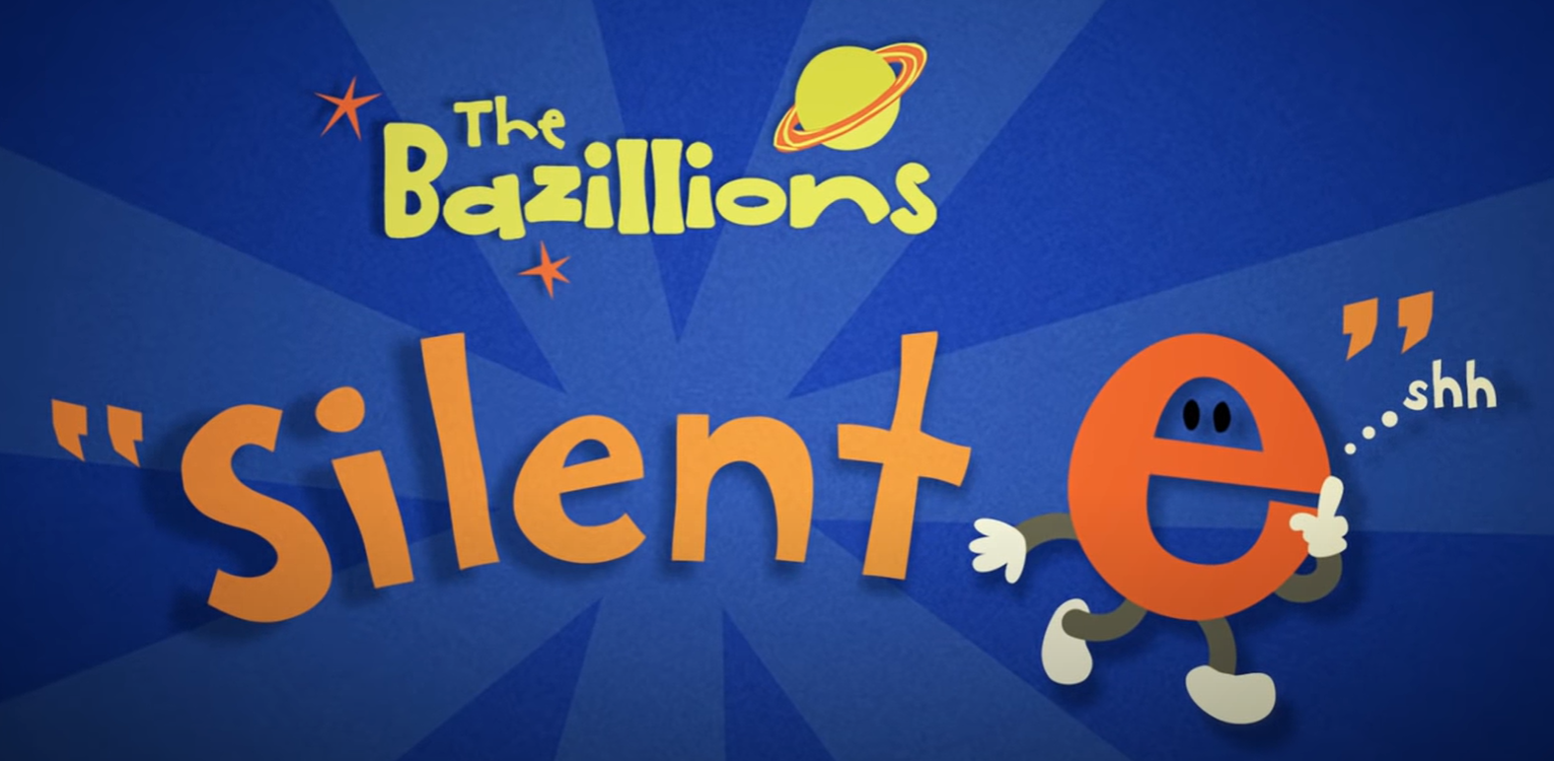
Reading
I can apply a variety of strategies to help solve words.
Step 1
Click and watch the video.
Step 2
Read a book from home or on RAZ kids.
Find any silent ‘e’ words in your book. Remember if you get to a tricky word – flip the vowel sound like ‘Flippy the Dolphin’.
Step 3
Share your words you found with a parent or share it with Mr. Braico in an email or on your ClassDojo portfolio.

Slide 5
Writing
I can use past experiences to make connections with stories.
Step 1
Today we will be building new information on to our schemas.
Before you watch the video, open a Word Document and title it “Sharks - Schema” and write what you already know about Sharks.
Step 2
Click the video to listen to Mrs. Biesbroek read Surprising Sharks.
Step 3
After the video, in your Word document, write down all you learned about Sharks from the story.

Slide 6
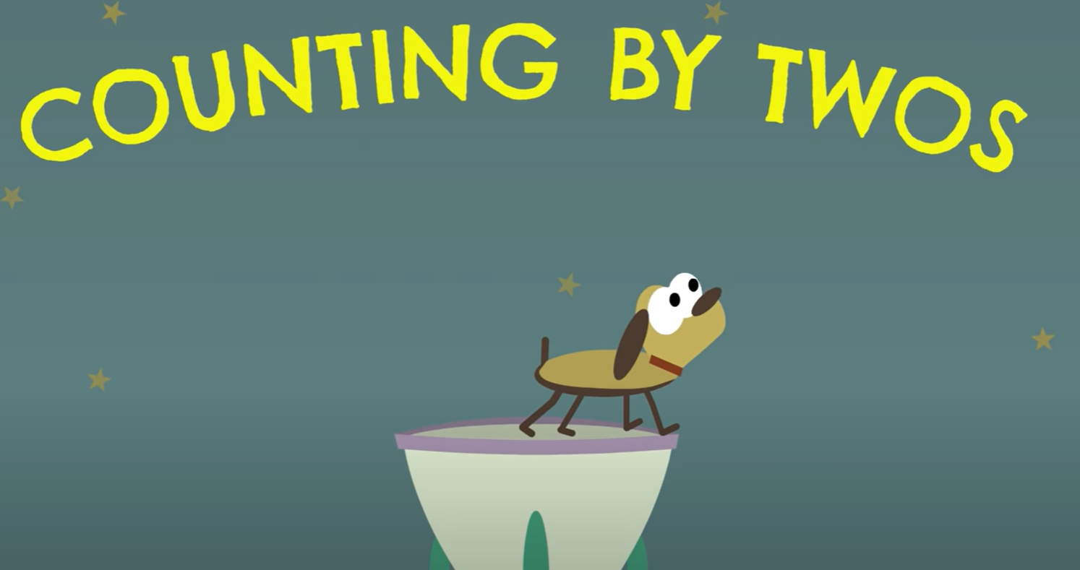
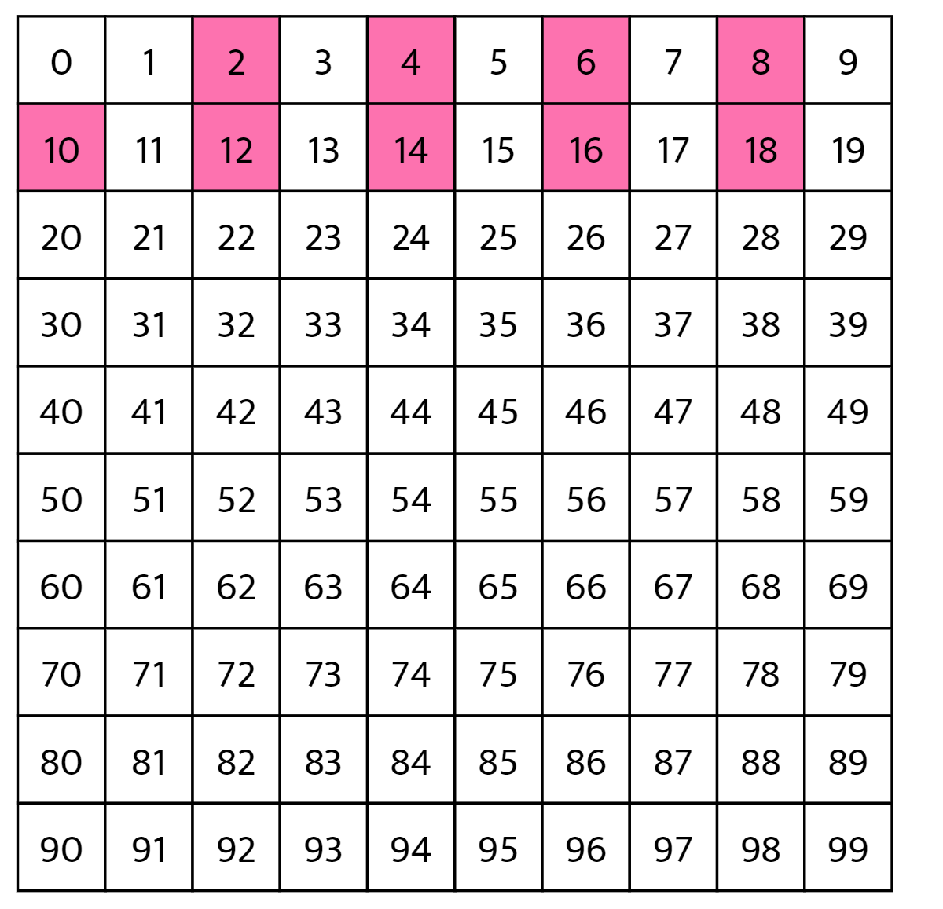
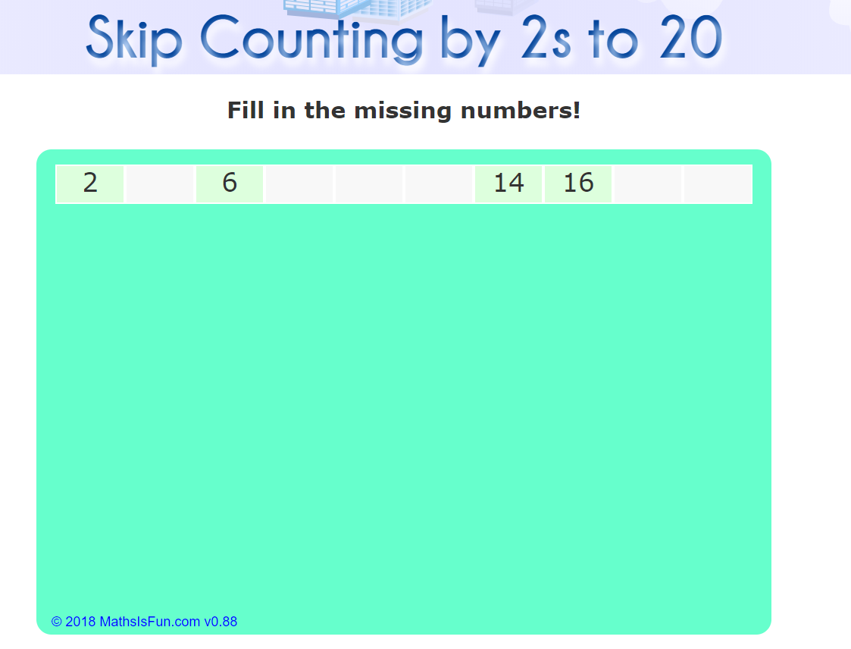
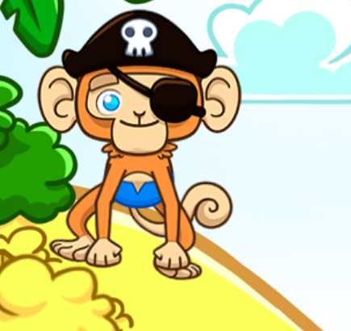
Math
I can say the number sequence counting by 2s.
Step 1
Click the video to learn more about counting by 2s.
Step 2
Use the number chart to count by 2s.
Do you notice a pattern?
Step 3
Practice counting by 2s.
Answer the questions by counting by 2s.

Slide 7
Daily Physical Activity
Choose one (or more) activities for your DPA.
GoNoodle
Fresh Start Fitness
Maximo
Calming Down
Mrs. McIntyre DPA

