Slide 1
BRAICO’s Class 1/2
Friday, May 29, 2020

Slide 2
Table of Contents
Morning Message
Word Work
Reading
Writing
Math
Daily Physical Activity

Slide 3
Morning Message
Hello Kiddos,
Happy Friday! I am looking forward to reading all about the sharks you researched yesterday. Today, we will look for ‘ay’ words that sound like ‘a’ in our reading. We research another shark of our choice and write about it. In Math, we will be finding patterns through counting. Also, have a great weekend.
Happy Learning,
Mr. Braico

Slide 4
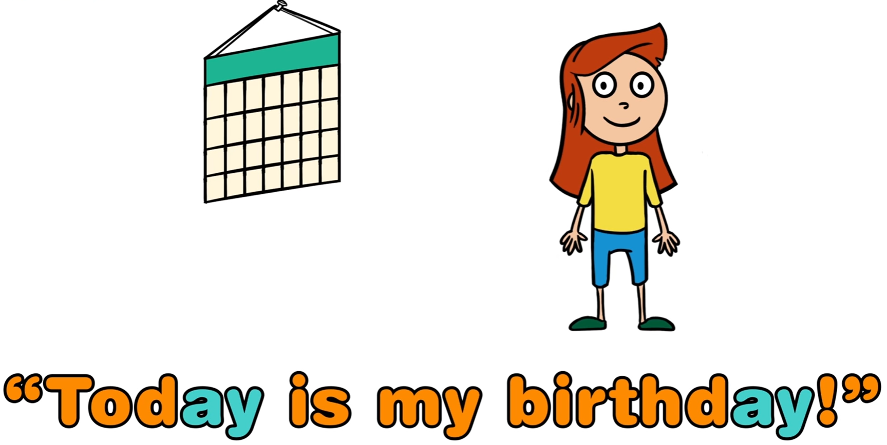
Reading
I can apply a variety of strategies to help solve words.
Step 1
Click and watch the video.
Step 2
Read a book from home or on RAZ kids.
Find any ‘ay’ words that sound like ‘a’ in your book. Remember if you get to a tricky word – flip the vowel sound like ‘Flippy the Dolphin’.
Step 3
Share your words you found with a parent or share it with Mr. Braico in an email or on your ClassDojo portfolio.

Slide 5
Writing
I can record ideas and information in ways that make sense.
Step 1
Head to Online Resource Centre by clicking here.
User: LA33
Password: 7434
Go to PebbleGo Science.
Step 2
Search sharks and then click on another type of shark to learn all about it.
Step 3
Open your Word document called “All About Sharks”. Make sure to inform your readers about the Body, Habitat, Food, and Life Cycle of your Sharks.

Slide 6
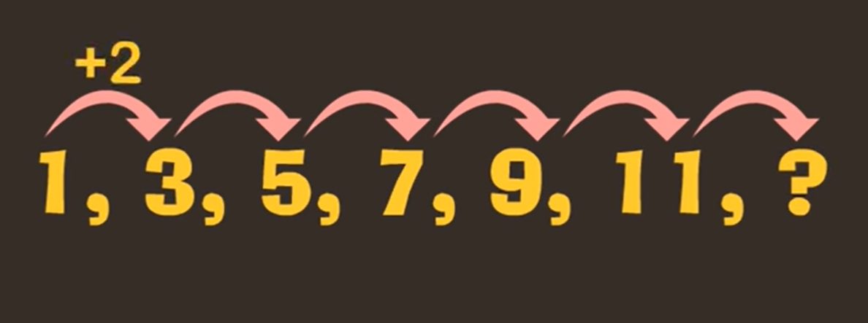
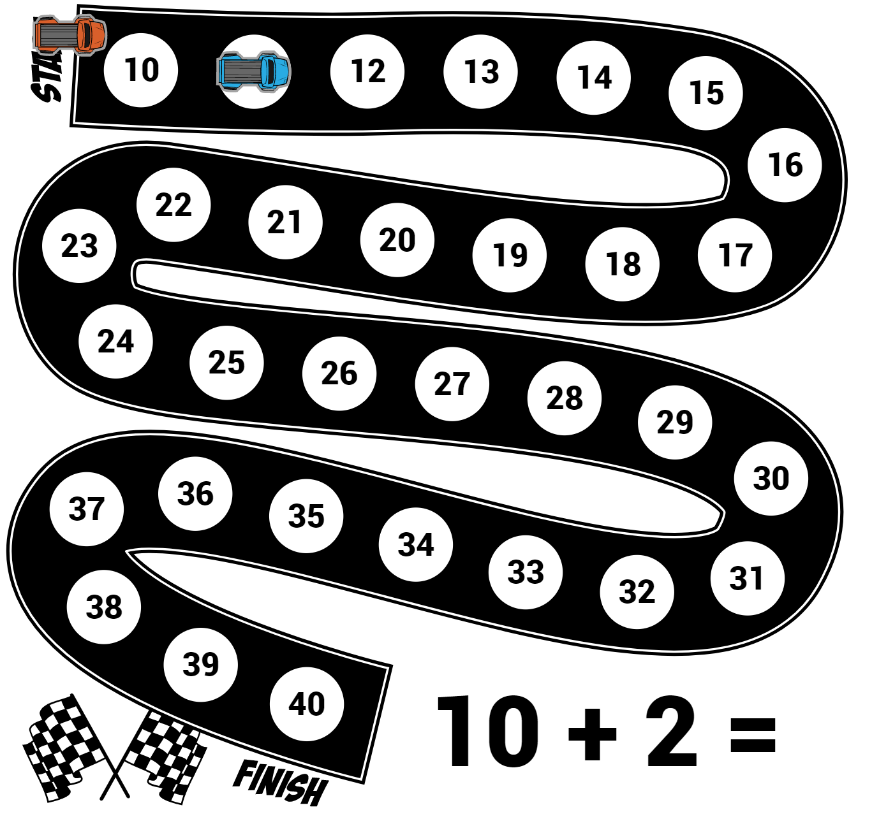
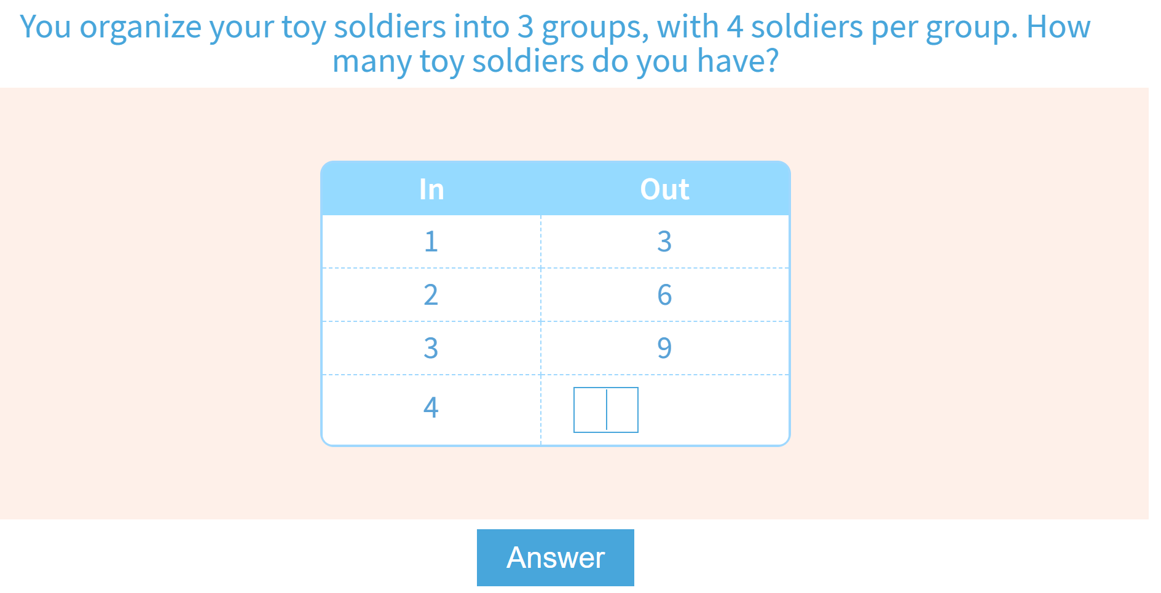
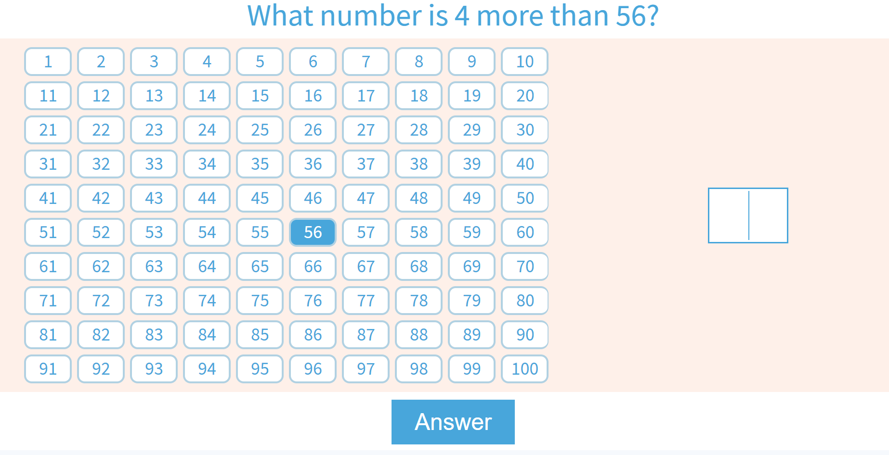
Math
I can identify numerical patterns.
Step 1
Click the video to learn more about number patterns.
Step 2
Use your skip counting skills to find the pattern.
Step 3
Solve these number pattern problems.
Use the number chart to solve the number pattern problems.

Slide 7
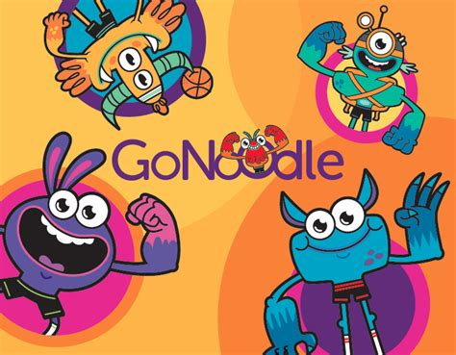
Daily Physical Activity
Choose one (or more) activities for your DPA.
GoNoodle
Fresh Start Fitness
Maximo
Calming Down
Mrs. McIntyre DPA

