Slide 1
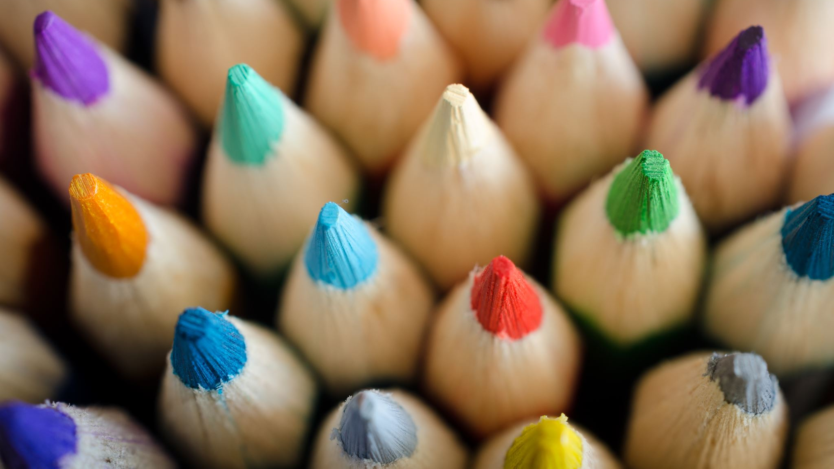
BRAICO’s Class 1/2
Tuesday, May 19, 2020

Slide 2
Table of Contents
Morning Message
Word Work
Reading
Writing
Math
Daily Physical Activity

Slide 3
Morning Message
Hello Kiddos,
Happy Tuesday! I hope you had a great “long weekend”. This week we will focus on silent letters. These are letters that we should say in words but don’t, such as ‘kn’. We learn more about plants when we read a story called A Backyard Garden, we make some writing observations by looking at some growing plants and practice solving word problems.
Happy Learning,
Mr. Braico

Slide 4
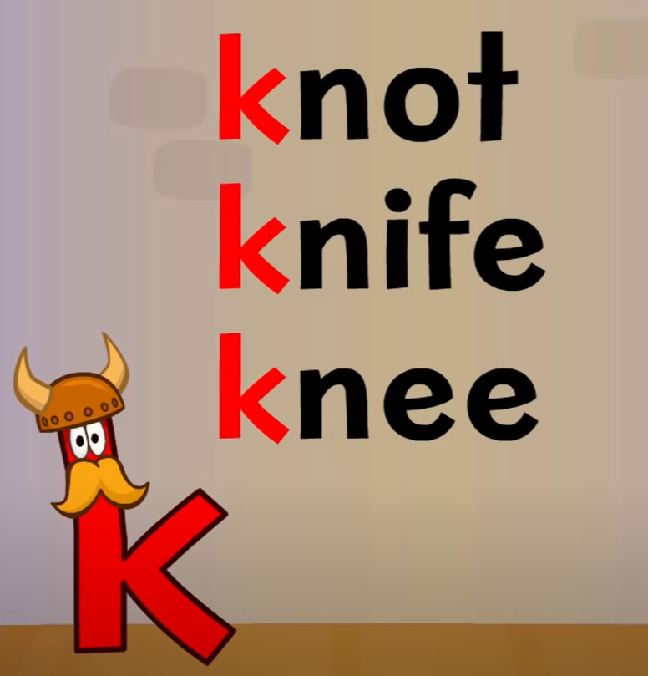
Word Work
I can apply a variety of strategies to help solve words.
Step 1
Click and watch the video.
Step 2
Read a book from home or on RAZ kids.
Find any ‘kn’ words in your book. Remember when ‘k’ and ‘n’ are together, we just say the ‘n’ sound.
Step 3
Share your words you found with a parent or share it with Mr. Braico in an email or on your ClassDojo portfolio.

Slide 5
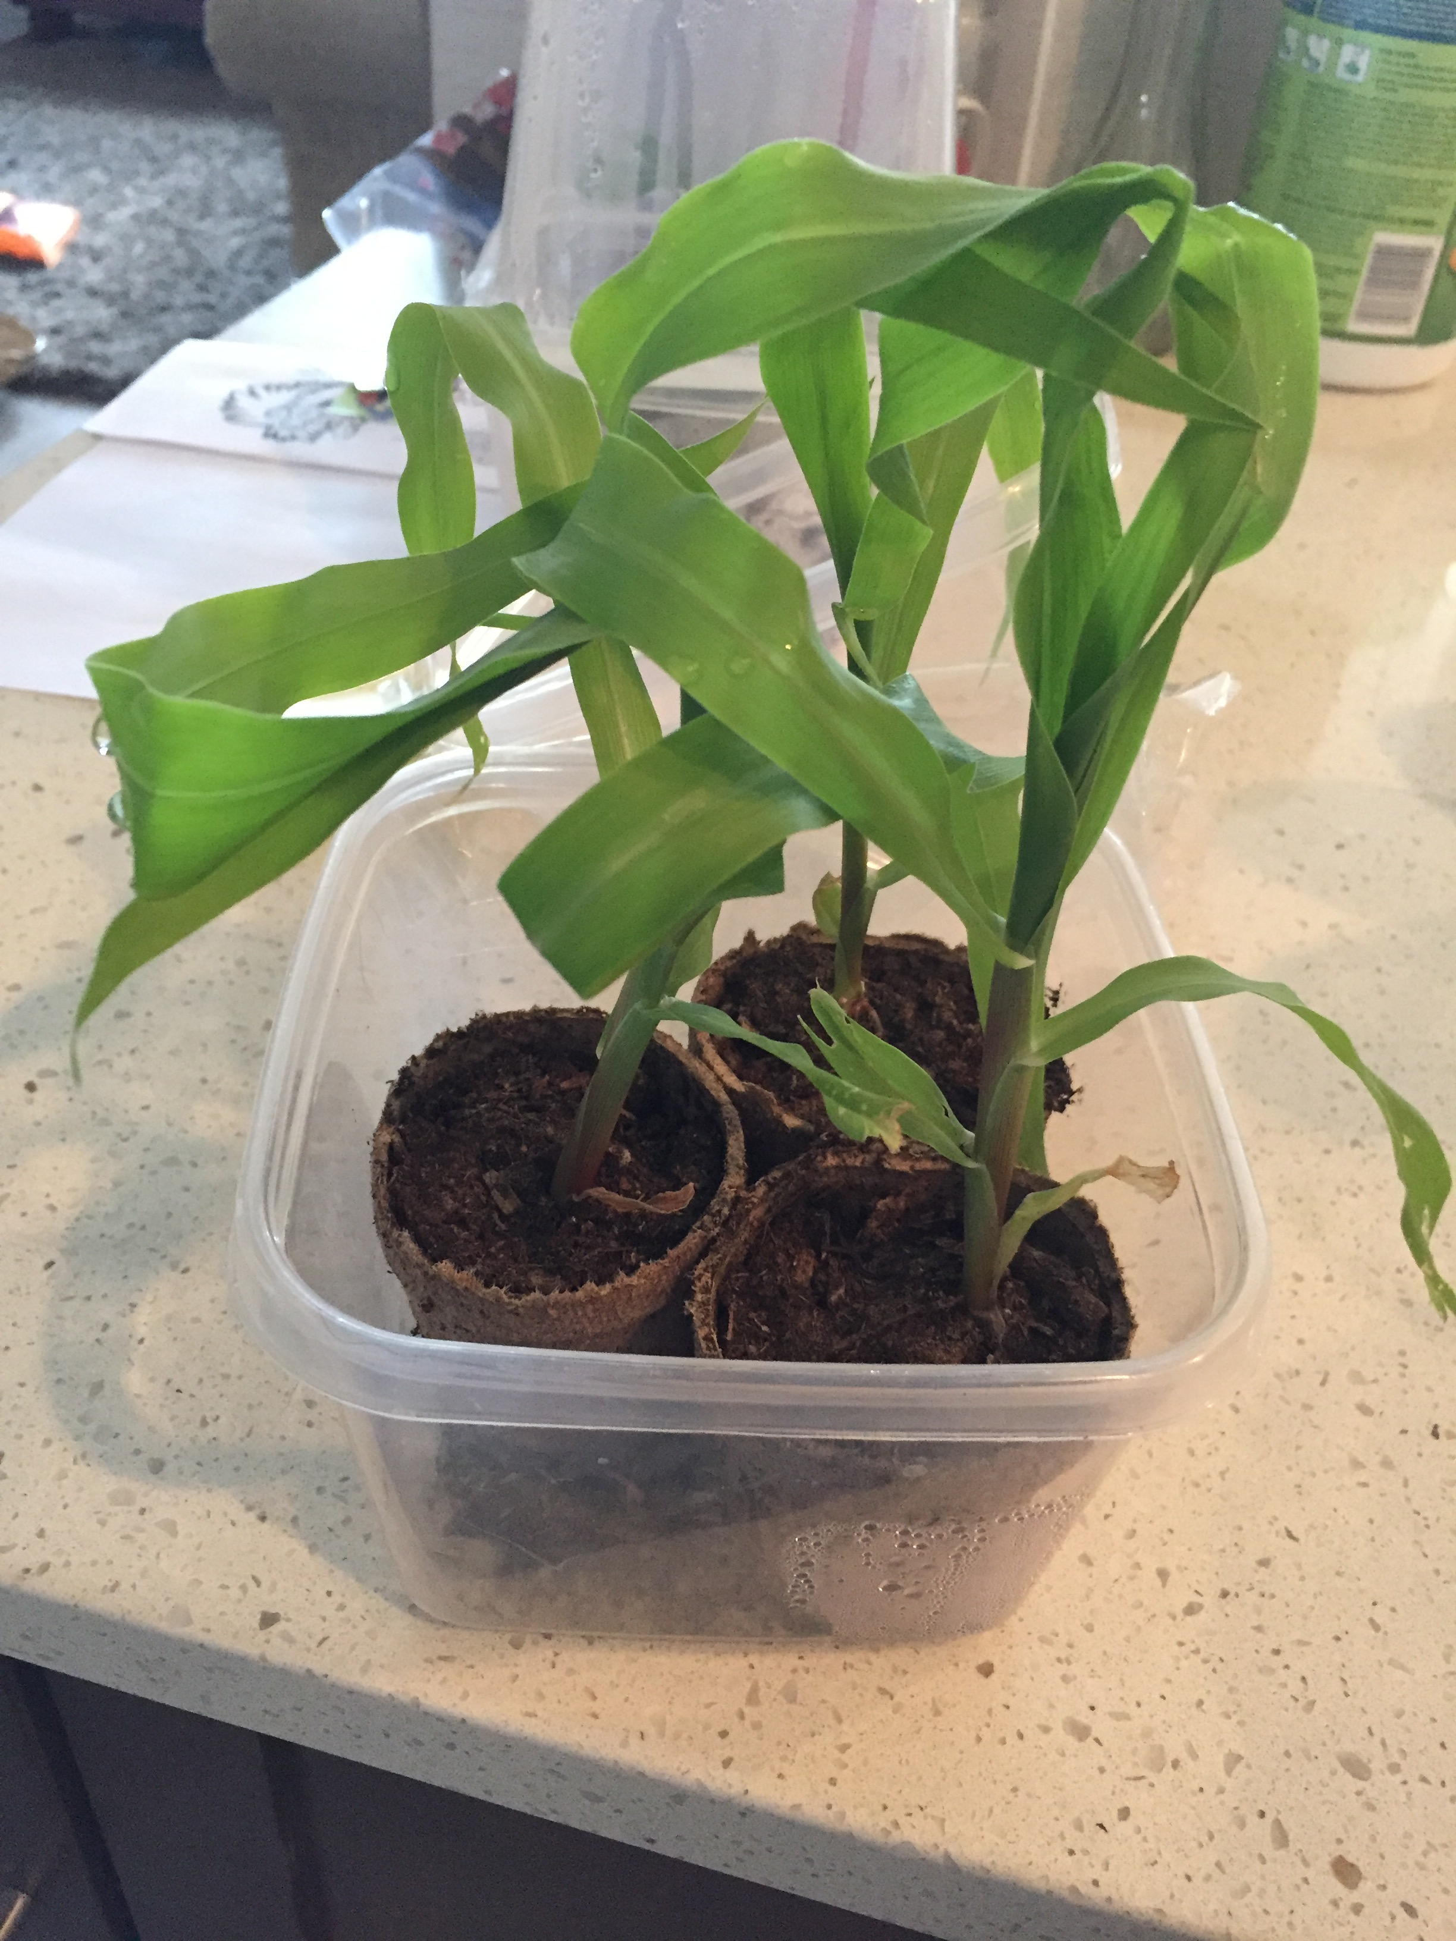
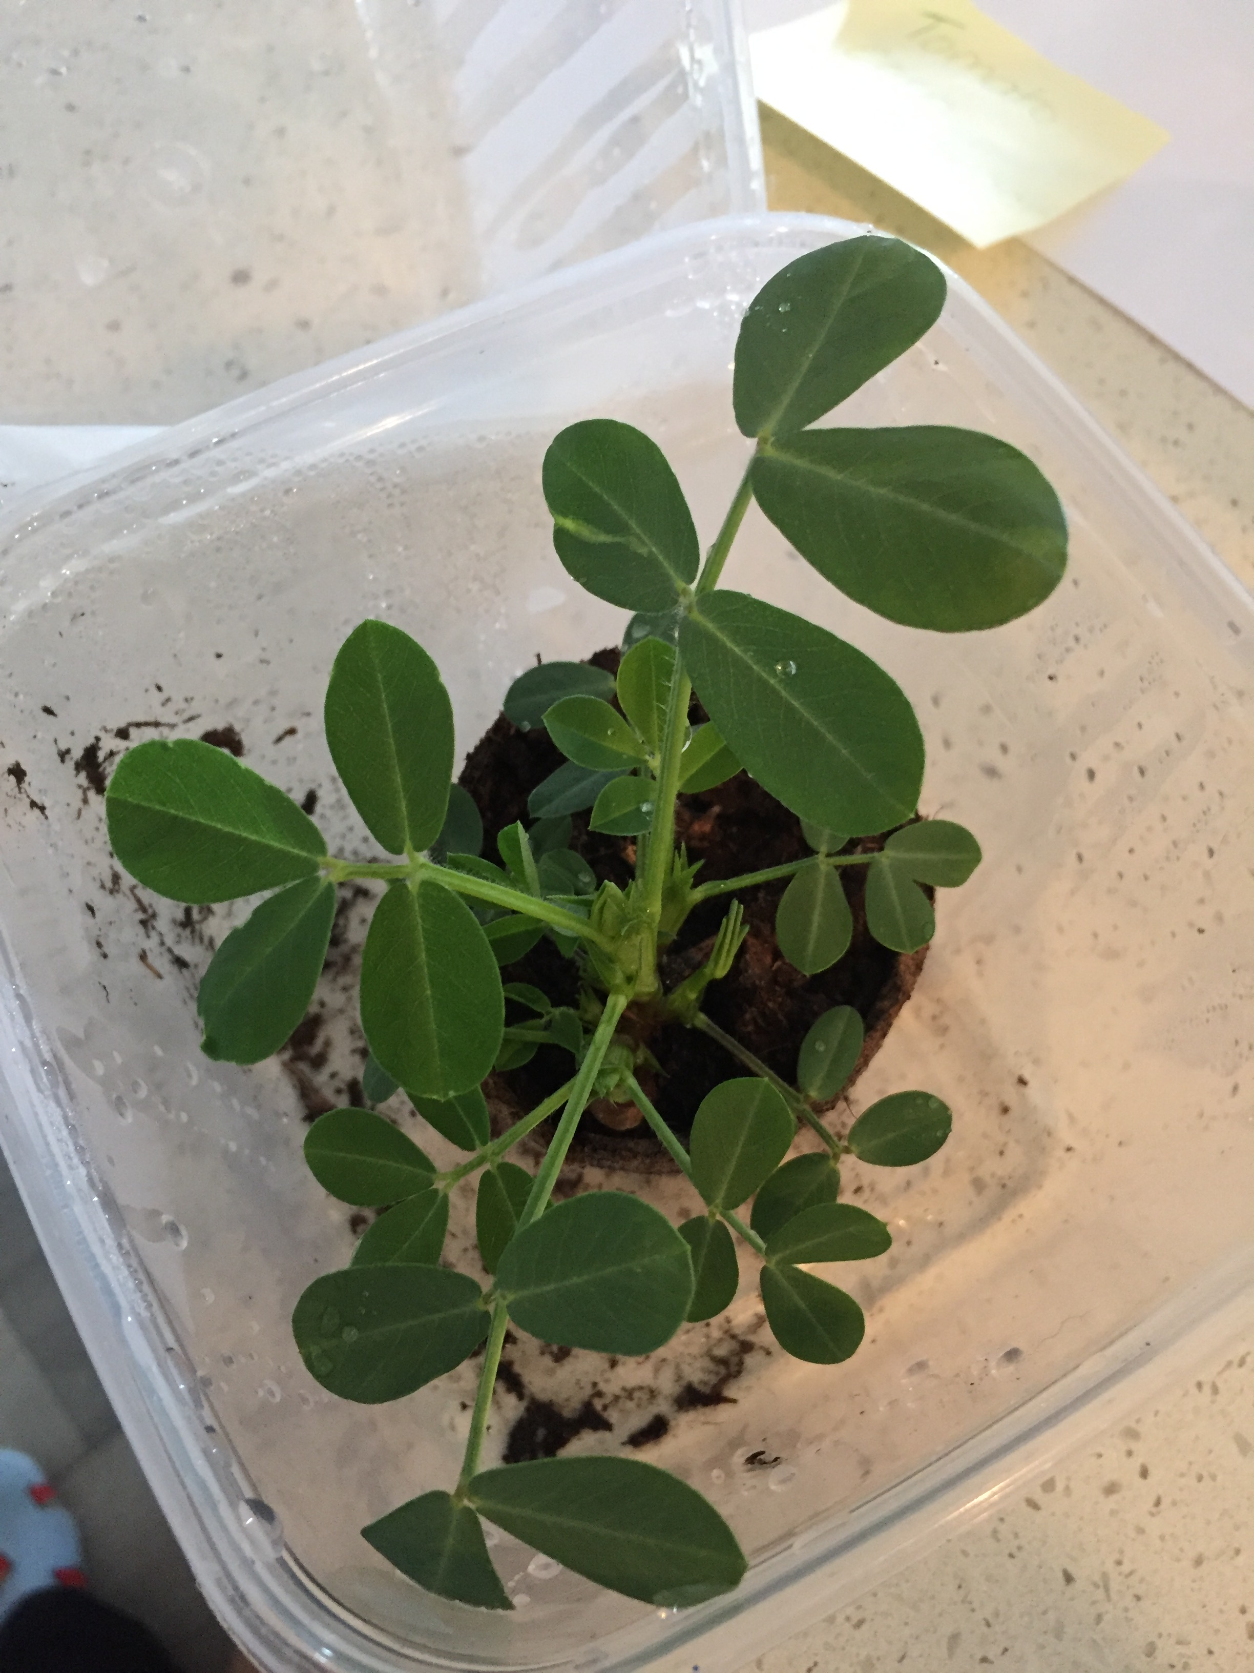
Can you Guess What the Plant is?

Slide 6
Was your Prediction Correct?
Corn
Peanut

Slide 7
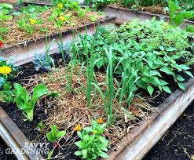
Reading
I can share personal experiences related to a story.
Step 1
Click and watch the video of Mrs. Biesbroek reading “A Backyard Garden”. How do you relate to this story? Have you ever planted a garden or a seed before?
Step 2
Think about what plants need to grow in a garden.
Step 3
Share with a parent or sibling about what goes into planting a garden. Tell them 3-5 key facts from the story. What did you learn?

Slide 8
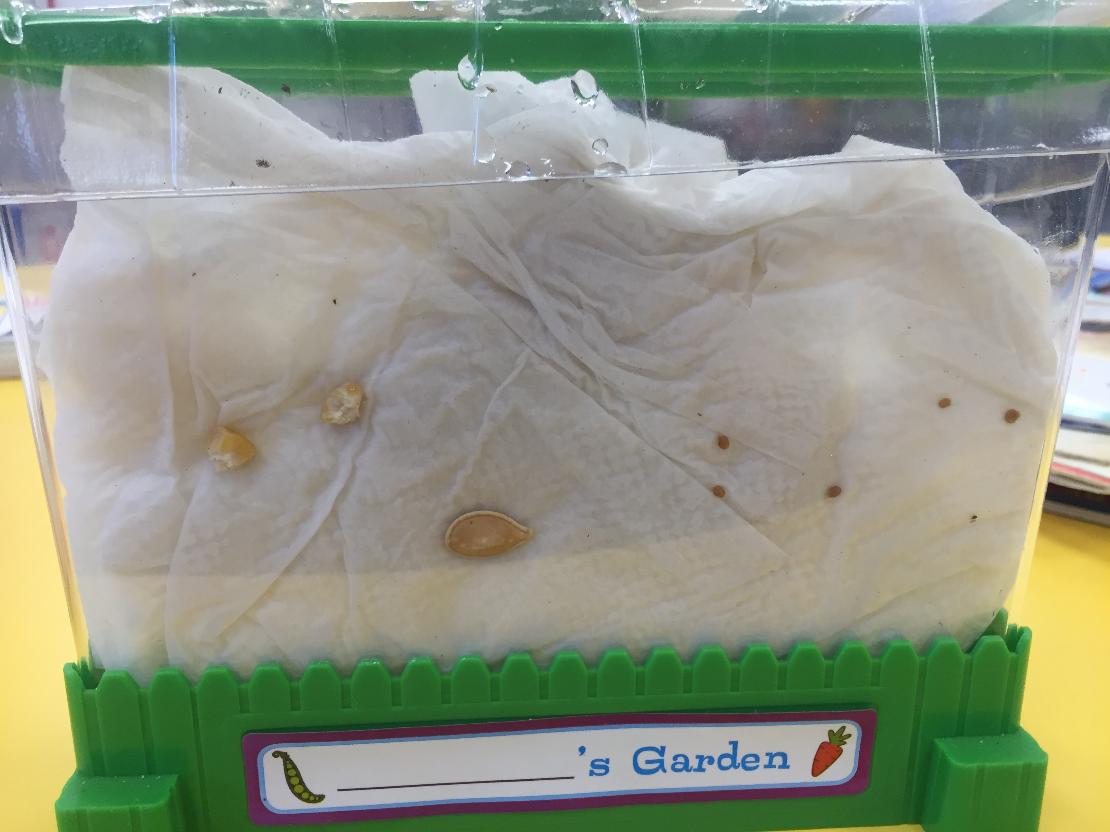
Writing
I can describe my observations of objects.
Step 1
Click the video to learn more about observations.
Step 2
This week we will be observing and documenting how a seed grows. We have planted 3 different seeds (2 corn, 1 pumpkin, 5 little tomato seeds) a few weeks ago to observe each day.
Over the course of the next 4 days, write down your observations in a Word document. Please remember to save your work. Write 3 observations you noticed from the pictures.

Slide 9
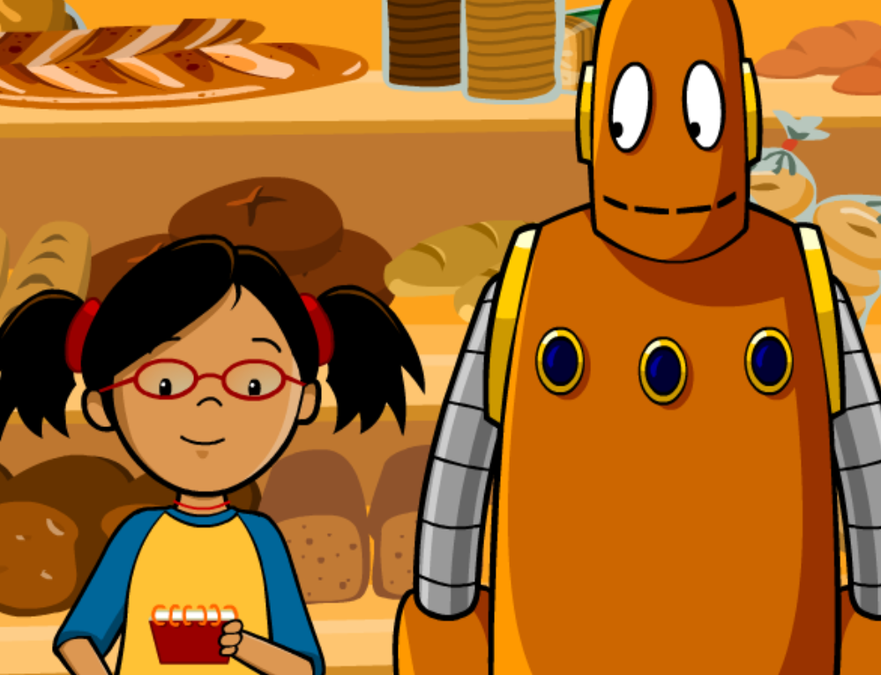
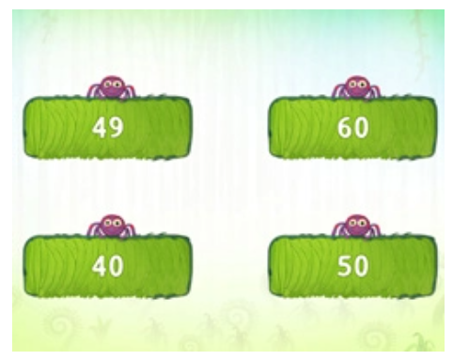
Math
I can solve problems that involve addition.
Step 1
Click the video to learn more about solving word problems.
User: westminster1
Password: westie1
Step 2
Do the EASY or HARD quiz found under the video.
Step 3
Try these addition word problems.
Click Sign In → Class → JUMJUU → find name → Password: 1234
Solve this word problem: Mr. Braico saw 8 black cars and 2 red cars drive by. How many cars did he see altogether? - Draw a picture on ClassDojo.

Slide 10
Daily Physical Activity
Choose one (or more) activities for your DPA.
GoNoodle
Fresh Start Fitness
Maximo
Calming Down
Mrs. McIntyre DPA

