Slide 1
BRAICO’s Class 1/2
Friday, May 22, 2020

Slide 2
Table of Contents
Morning Message
Word Work
Reading
Writing
Math
Daily Physical Activity

Slide 3
Morning Message
Hello Kiddos,
Happy Friday! Last day of observations of our plants. They grew so much! Today we look at the ‘gh’ silent letters, we think of making our own gardens and what to put it in after reading A Backyard Garden, make our final observations, and choose operations to solve word problems. Have a great weekend!
Happy Learning,
Mr. Braico

Slide 4
Word Work
I can apply a variety of strategies to help solve words.
Step 1
Click and watch the video.
Step 2
Read a book from home or on RAZ kids.
Find any ‘gh’ words in your book. Remember, if ‘g’ and ‘h’ together at the beginning of a word, we just say the ‘g’ sound. If the ‘h’ sound doesn’t make sense, try the short ‘o’ sound in other words.
Step 3
Share your words you found with a parent or share it with Mr. Braico in an email or on your ClassDojo portfolio.

Slide 5
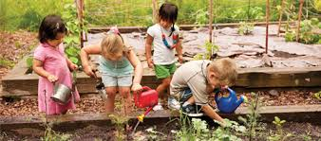
Reading
I can express my ideas resulting from an experience from a story.
Step 1
Click and watch the video about the plant life cycle.
Step 2
Click and watch the video of Mrs. Biesbroek reading “A Backyard Garden”. Think about a time you have planted a garden. If you have never planted a garden, think about what you might want to plant in your garden.
Step 3
Share with a parent or sibling about how you might plant a garden. Remember from the story, what do you need to start a garden? What might you want to plant? What do you remember from the plant life cycle? Put your plan into action!! (Ask your parents first).

Slide 6
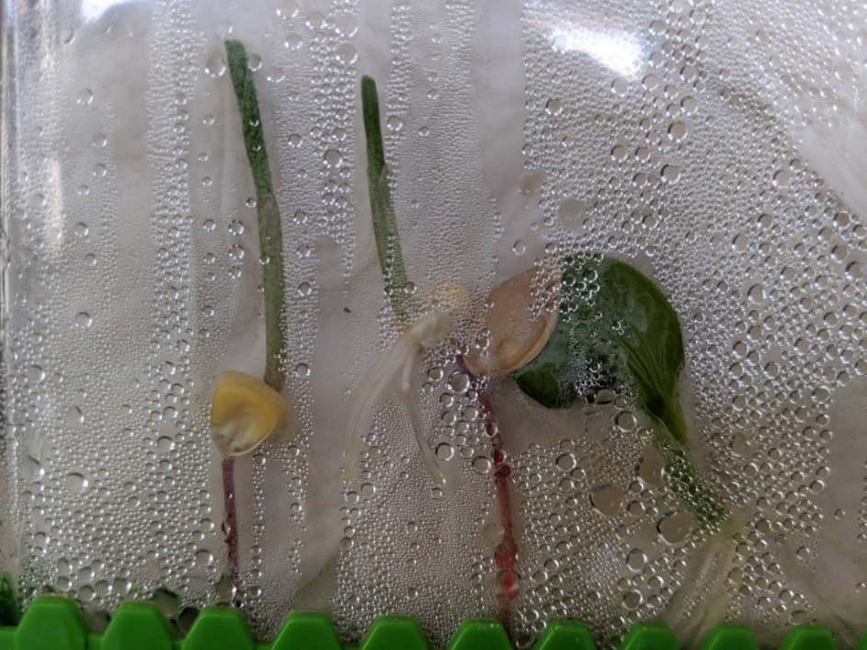
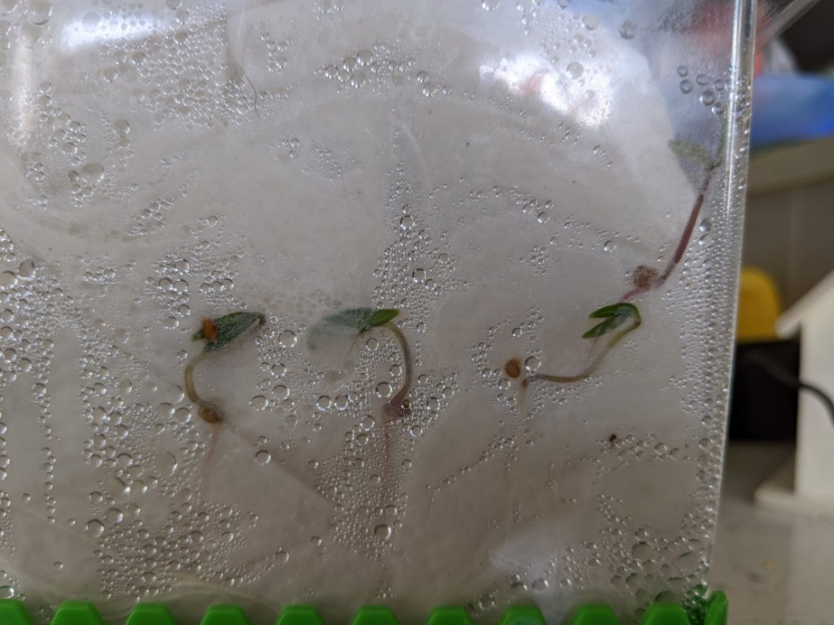
Writing
I can describe my observations of objects.
Step 1
Day 4 - Take a look at the picture today, what have you noticed? What has changed from yesterday?
Step 2
Write down 3 observations you noticed from the pictures into your Word document. Please remember to save your work.

Slide 7
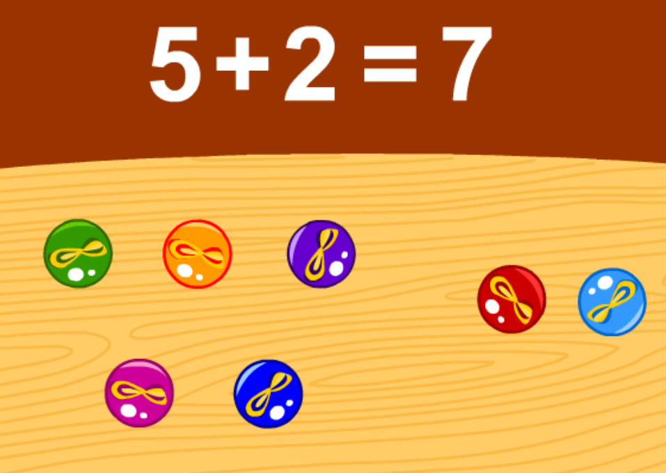
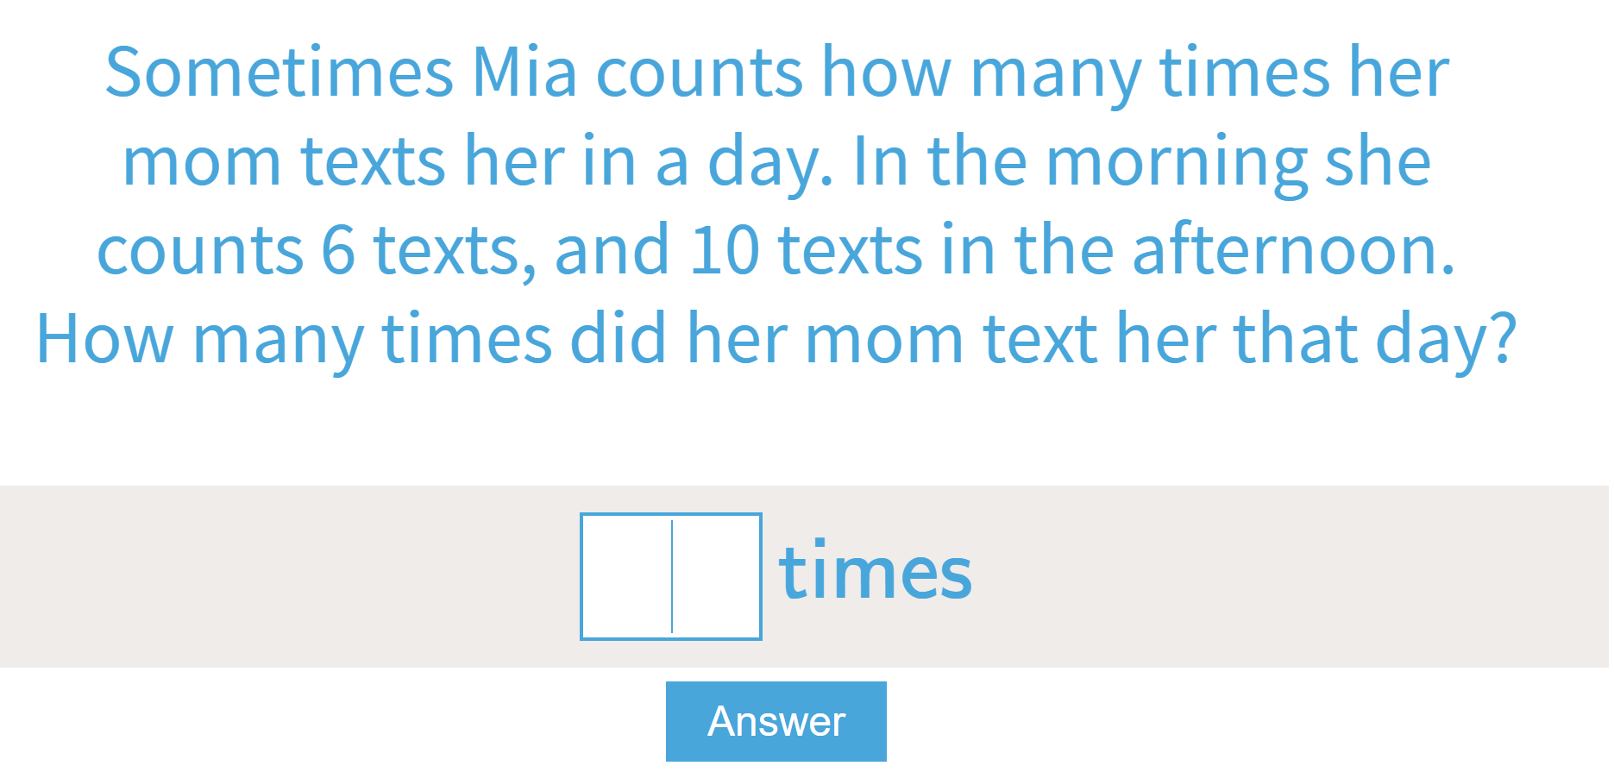
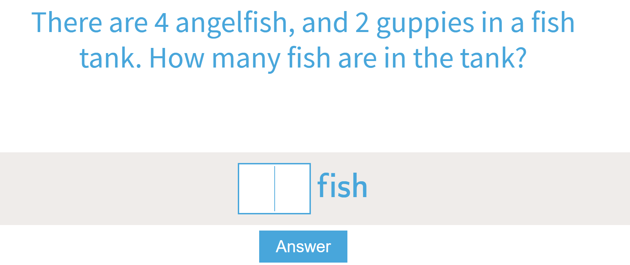
Math
I can solve problems that involve addition and subtraction.
Step 1
Click the video to learn more about choosing operations to solve word problems.
User: westminster1
Password: westie1
Step 2
Do the EASY or HARD quiz found under the video.
Step 3
Listen to the sentence to help solve the word problem.
Need more of a challenge? Solve these word problems.

Slide 8
Daily Physical Activity
Choose one (or more) activities for your DPA.
GoNoodle
Fresh Start Fitness
Maximo
Calming Down
Mrs. McIntyre DPA

