Slide 1
BRAICO’s Class 1/2
Wednesday, May 20, 2020

Slide 2
Table of Contents
Morning Message
Word Work
Reading
Writing
Math
Daily Physical Activity

Slide 3
Morning Message
Hello Kiddos,
Happy Wednesday! How many of you have grown a garden before? What was in it? Our silent letters for today are ‘mb’, we read A Backyard Garden again and learn about compost, we continue making observations of our plants and we solve addition word problems.
Happy Learning,
Mr. Braico

Slide 4
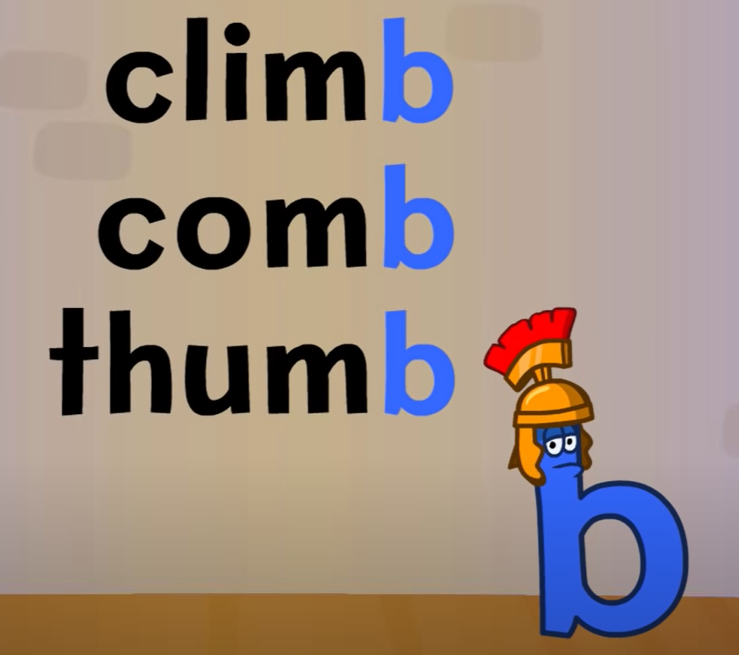
Word Work
I can apply a variety of strategies to help solve words.
Step 1
Click and watch the video.
Step 2
Read a book from home or on RAZ kids.
Find any words ending in ‘mb’ in your book. Remember if ‘m’ and ‘b’ are together, we just say the ‘m’ sound.
Step 3
Share your words you found with a parent or share it with Mr. Braico in an email or on your ClassDojo portfolio.

Slide 5
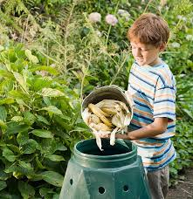
Reading
I can retell important aspects of a story.
Step 1
Click and watch the video of Mrs. Biesbroek reading “A Backyard Garden”. Focus on what Compost is.
Step 2
Click and watch the video about compost. Answer what composts are? What do they do? What you can put into a compost?
Step 3
Share with a parent or sibling about what a Compost is. Tell them 3-5 key facts you learned from the story.

Slide 6
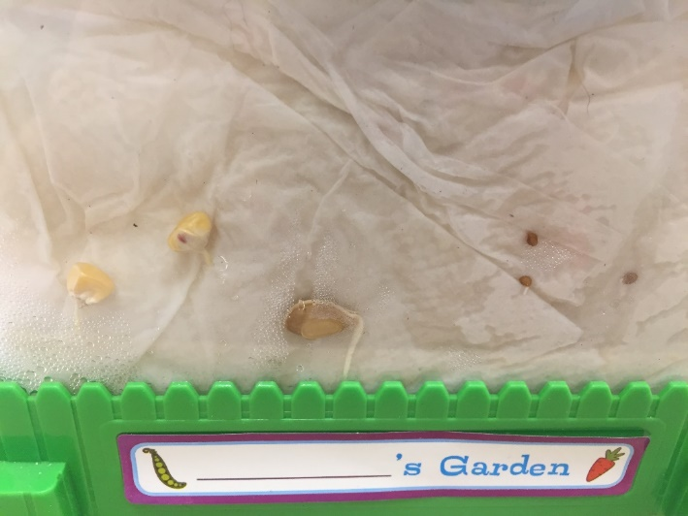
Writing
I can describe my observations of objects.
Step 1
Day 2 - Take a look at the picture today, what have you noticed? What has changed from yesterday?
Step 2
Write down 3 observations you noticed from the pictures into your Word document. Please remember to save your work.

Slide 7
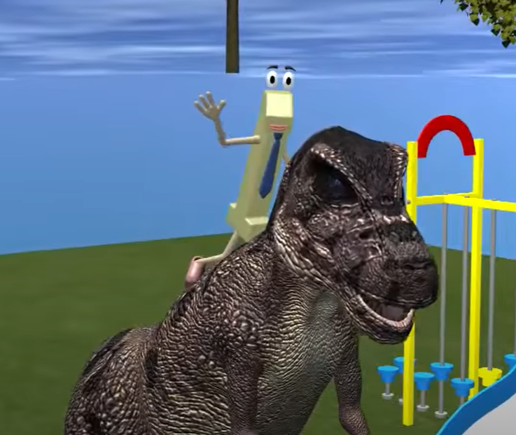
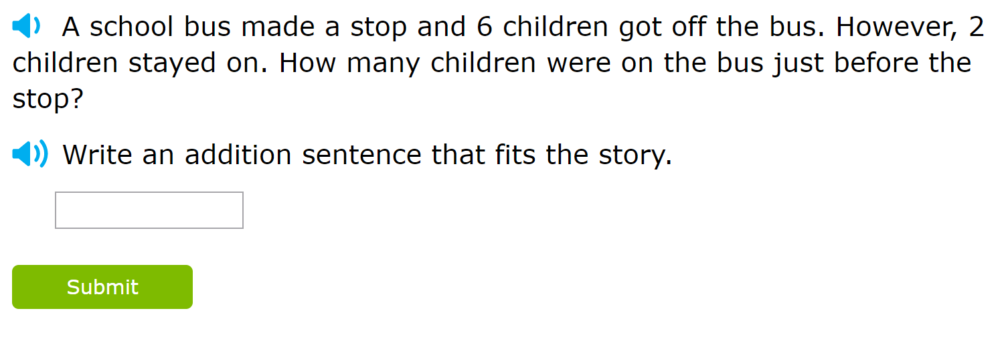
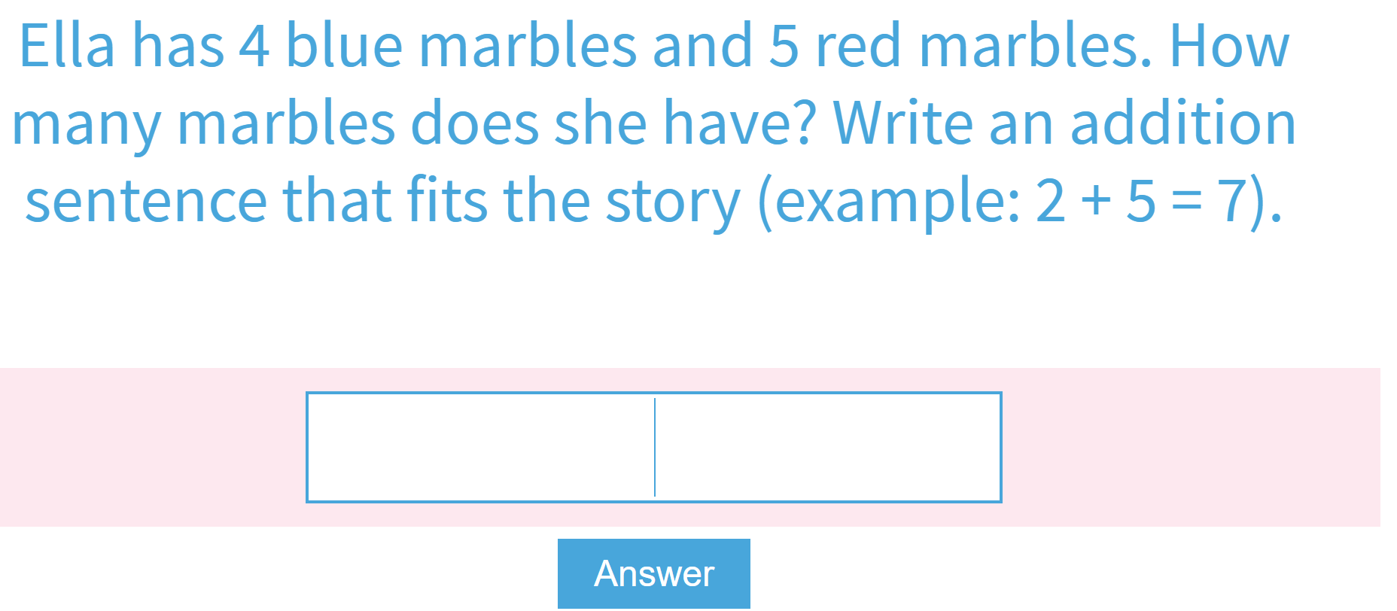
Math
I can solve problems that involve addition.
Step 1
Click the video to learn more about solving addition word problems.
Step 2
Build a model to answer the word problems.
Step 3
Use the clues to help solve the word problems.
Listen to the sentence to solve the word problem.

Slide 8
Daily Physical Activity
Choose one (or more) activities for your DPA.
GoNoodle
Fresh Start Fitness
Maximo
Calming Down
Mrs. McIntyre DPA

