Slide 1
BRAICO’s Class 1/2
Wednesday, May 13, 2020

Slide 2
Table of Contents
Morning Message
Reading
Writing
Math
Daily Physical Activity

Slide 3
Morning Message
Hello Kiddos,
Happy Wednesday! I hope you made a connection between the Three Dinosaurs and the Three Bears stories. Today, let’s look for ‘sp’ words in our reading, listen to Goldilocks and the Three Dinosaurs and make an inference, and we will learn about pictographs.
Happy Learning,
Mr. Braico

Slide 4
Reading
I can apply a variety of strategies to help solve words.
Step 1
Click and watch the video.
Step 2
Read a book from home or on RAZ kids.
Find any ‘sp’ words in your book. Remember if you get to a tricky word, skip it, read the rest and go back – like Skippy Frog.
Step 3
Share your words you found with a parent or share it with Mr. Braico in an email or on your ClassDojo portfolio.

Slide 5
Writing
I can express thoughts related to events and characters in the book.
Step 1
Click the video to listen to Mr. Braico read Goldilocks and the Three Dinosaurs.
Step 2
Today we will make an inference about the story. Do you think the dinosaurs have read Goldilocks and the Three Bears? Tell me 3 reasons why you think yes or no.
Step 3
Create a Word Document called “Goldilocks – Inference” and write down your answer of if you think the dinosaurs have read Goldilocks and the Three Bears.

Slide 6
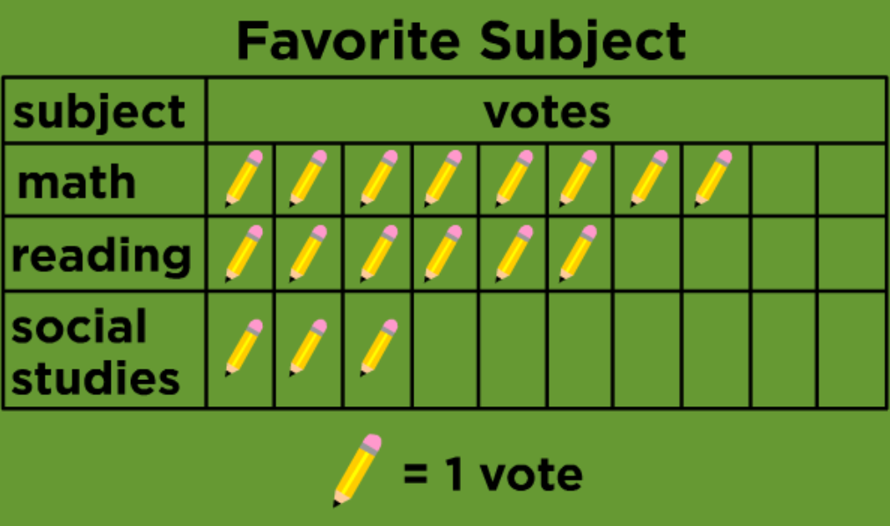
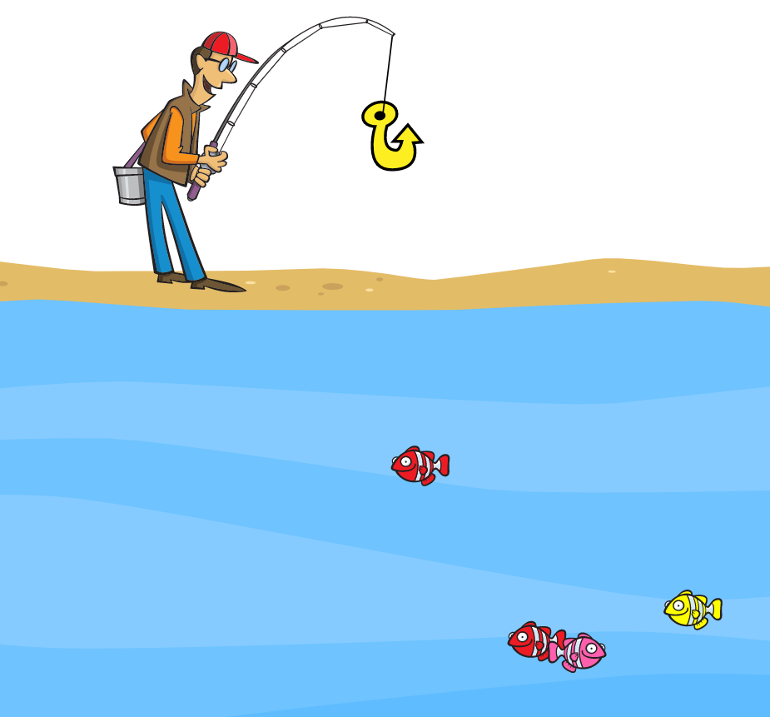
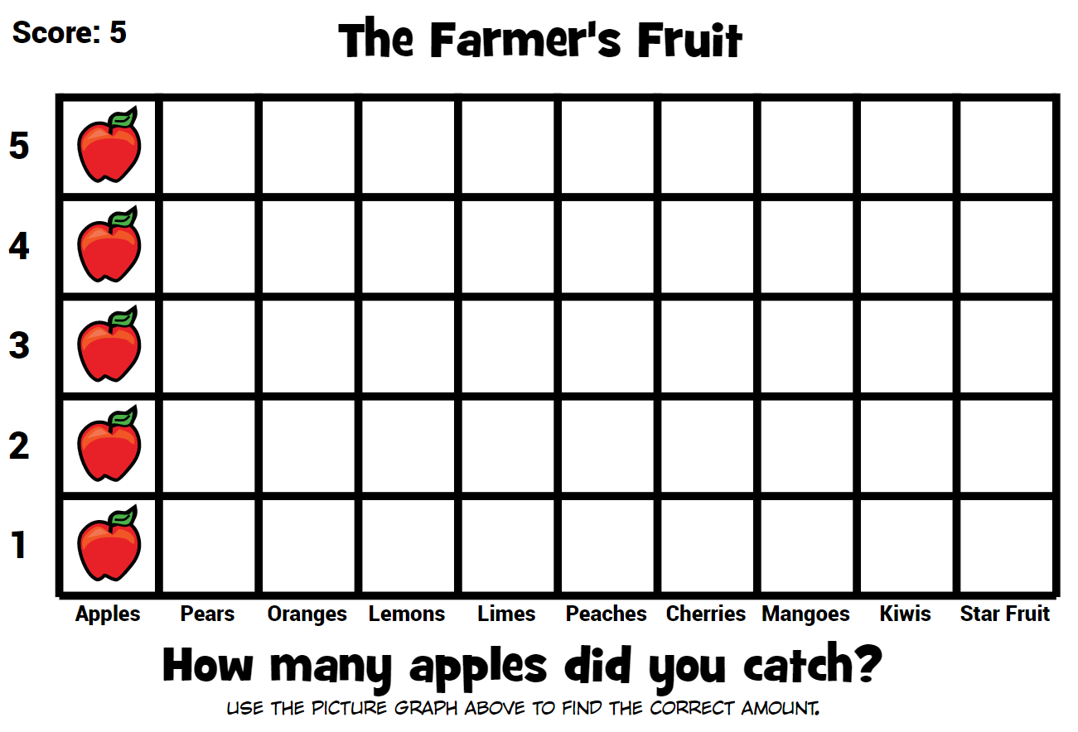
Math
I can construct and interpret graphs to solve problems.
Step 1
Click the video to learn more about pictorgraphs.
User: westminster1
Password: westie1
Step 2
Do the EASY or HARD quiz found under the video.
Step 3
Catch the fish and use the data to answer the questions.
Catch the fruit and use the data to answer the questions

Slide 7
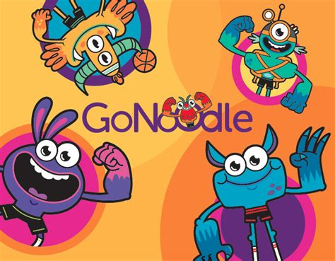
Daily Physical Activity
Choose one (or more) activities for your DPA.
GoNoodle
Fresh Start Fitness
Maximo
Calming Down
Mrs. McIntyre DPA

