Slide 1
BRAICO’s Class 1/2
Monday, May 11, 2020

Slide 2
Table of Contents
Morning Message
Reading
Writing
Math
Daily Physical Activity

Slide 3
Morning Message
Hello Kiddos,
Happy Monday! I hope you had a great weekend and you spoiled your Mom’s with some extra love. This week, we will look at ‘S’ blends, we start with ‘sc’, we will read a story called Goldilocks and the Three Dinosaurs and make a prediction, and we will be looking at managing data using a tally chart.
Happy Learning,
Mr. Braico

Slide 4
Reading
I can apply a variety of strategies to help solve words.
Step 1
Click and watch the video.
Step 2
Read a book from home or on RAZ kids.
Find any ‘sc’ words in your book. Remember if you get to a tricky word, skip it, read the rest and go back – like Skippy Frog.
Step 3
Share your words you found with a parent or share it with Mr. Braico in an email or on your ClassDojo portfolio.

Slide 5
Writing
I can make predictions to draw conclusions of a story.
Step 1
Click the video to listen to Mr. Braico read Goldilocks and the Three Dinosaurs. Today we will be making a prediction.
Step 2
Watch until Mr. Braico says PAUSE. Goldilocks discovered the bowls of pudding. What do you predict will happen next?
Open a Word Document and title it “Goldilocks – Prediction” and add your prediction.
Step 3
Continue the video and see if your prediction was correct.
Write down if you were correct or if you were surprised. What actually happened in the story?

Slide 6
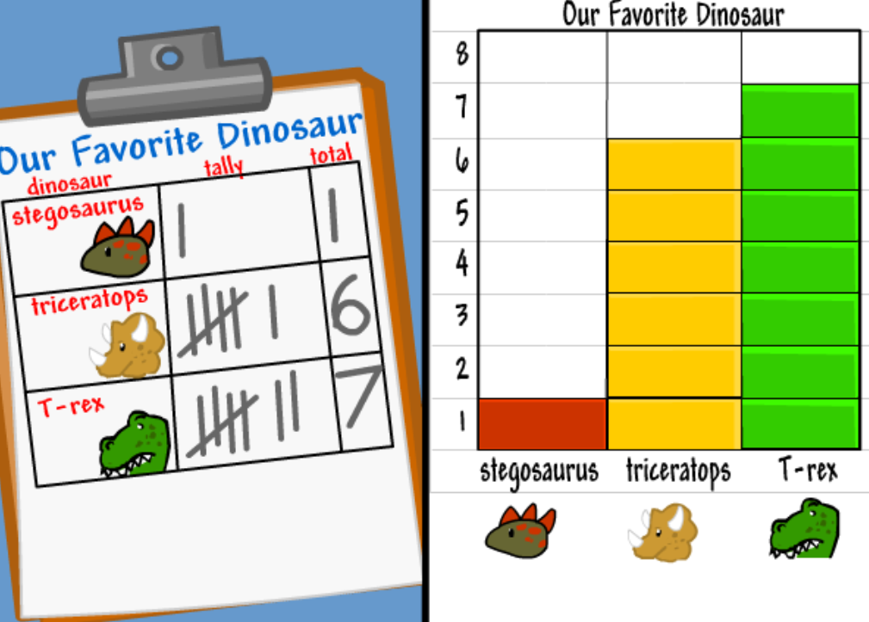
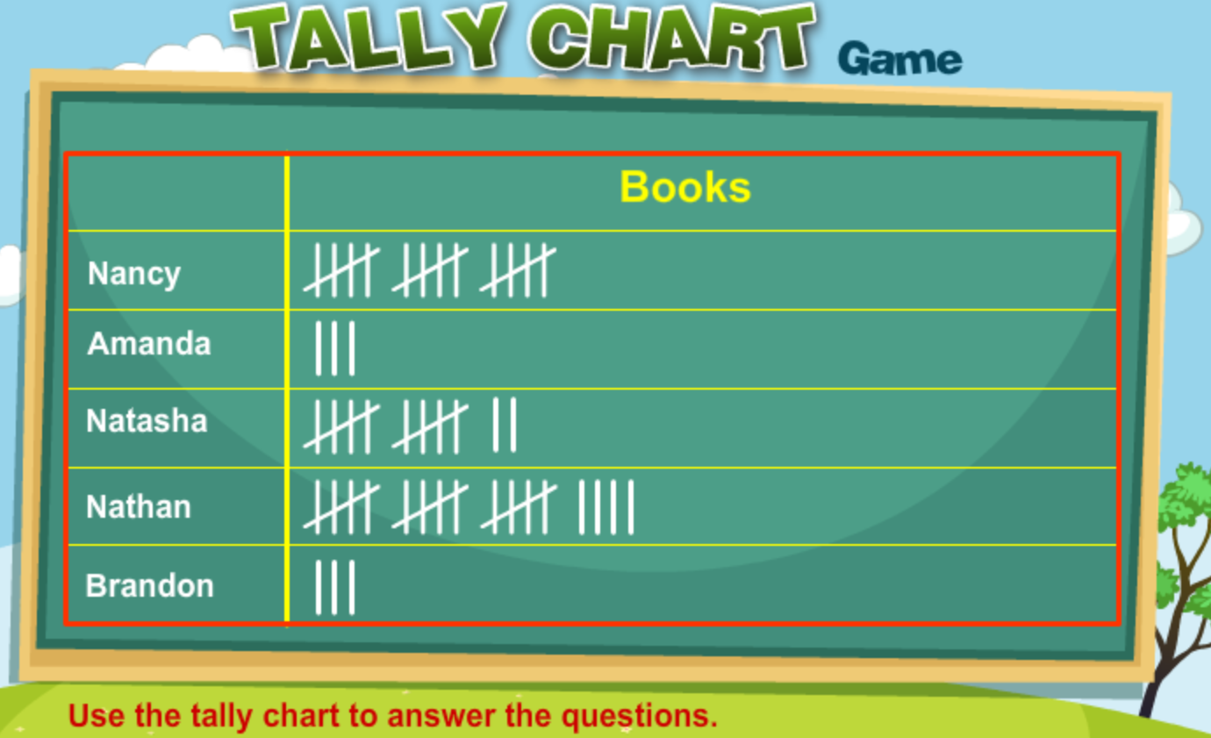
Math
I can construct and interpret graphs to solve problems.
Step 1
Click the video to learn more about tally charts and bar graphs.
User: westminster1
Password: westie1
Step 2
Do the EASY or HARD quiz found under the video.
Step 3
Use the chart to answer the questions.
Make a tally chart of the different colour of cars you see outside your house. Each time that car colour drives by, give it a tally. Do this for 10 minutes. Post a picture of your chart on ClassDojo.

Slide 7
Daily Physical Activity
Choose one (or more) activities for your DPA.
GoNoodle
Fresh Start Fitness
Maximo
Calming Down
Mrs. McIntyre DPA

