Slide 1
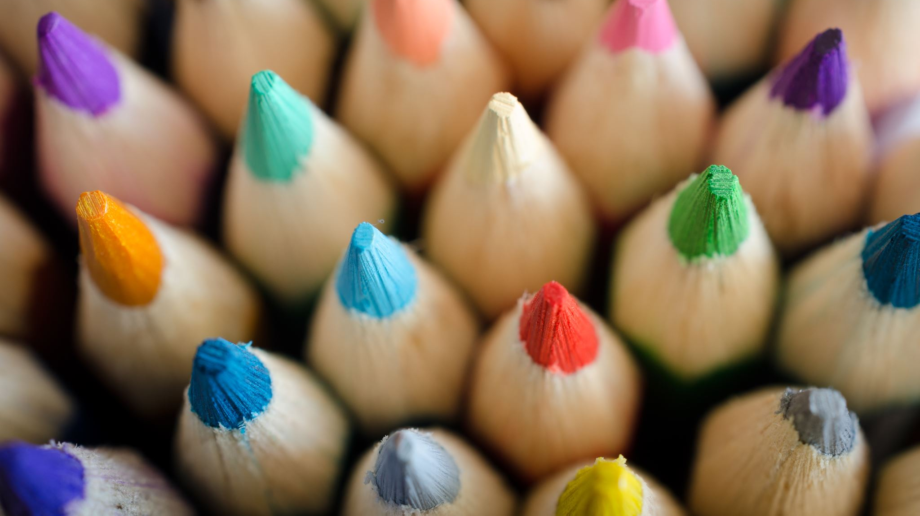
BRAICO’s Class 1/2
Thursday, May 14, 2020

Slide 2
Table of Contents
Morning Message
Reading
Writing
Math
Daily Physical Activity

Slide 3
Morning Message
Hello Kiddos,
Happy Thursday! I think the Three Dinosaurs read the Three Bears. They were acting vey suspicious. Let’s find some ‘st’ words in our reading today, listen to Goldilocks and the Three Dinosaurs and tell me your favourite part, and let’s look at line graphs.
Happy Learning,
Mr. Braico

Slide 4
Reading
I can apply a variety of strategies to help solve words.
Step 1
Click and watch the video.
Step 2
Read a book from home or on RAZ kids.
Find any ‘st’ words in your book. Remember if you get to a tricky word, skip it, read the rest and go back – like Skippy Frog.
Step 3
Share your words you found with a parent or share it with Mr. Braico in an email or on your ClassDojo portfolio.

Slide 5
Writing
I can explain why an event from a story was my personal favourite.
Step 1
Click the video to listen to Mr. Braico read Goldilocks and the Three Dinosaurs.
Step 2
Today, we will write an opinion about the story. Tell me about your favourite part of the story and why.
Step 3
Create a Word document called “Goldilocks – Opinion”. Share your favourite part of the story and why.

Slide 6
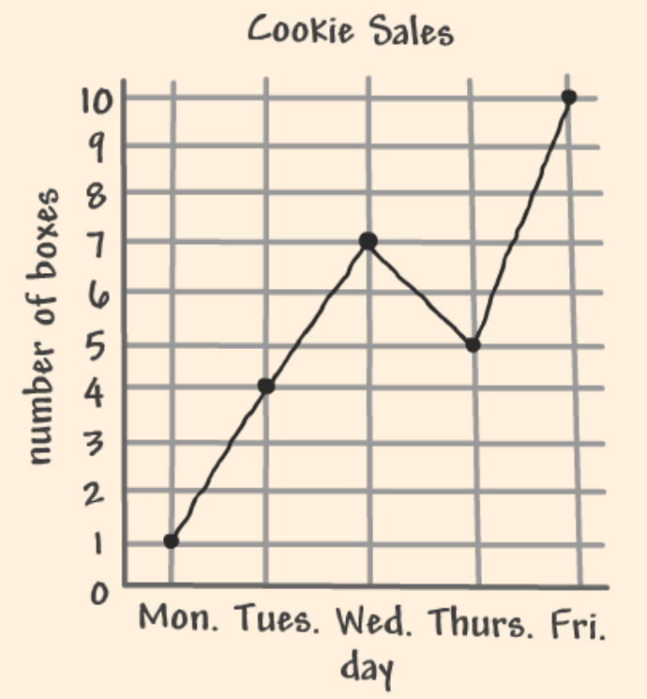
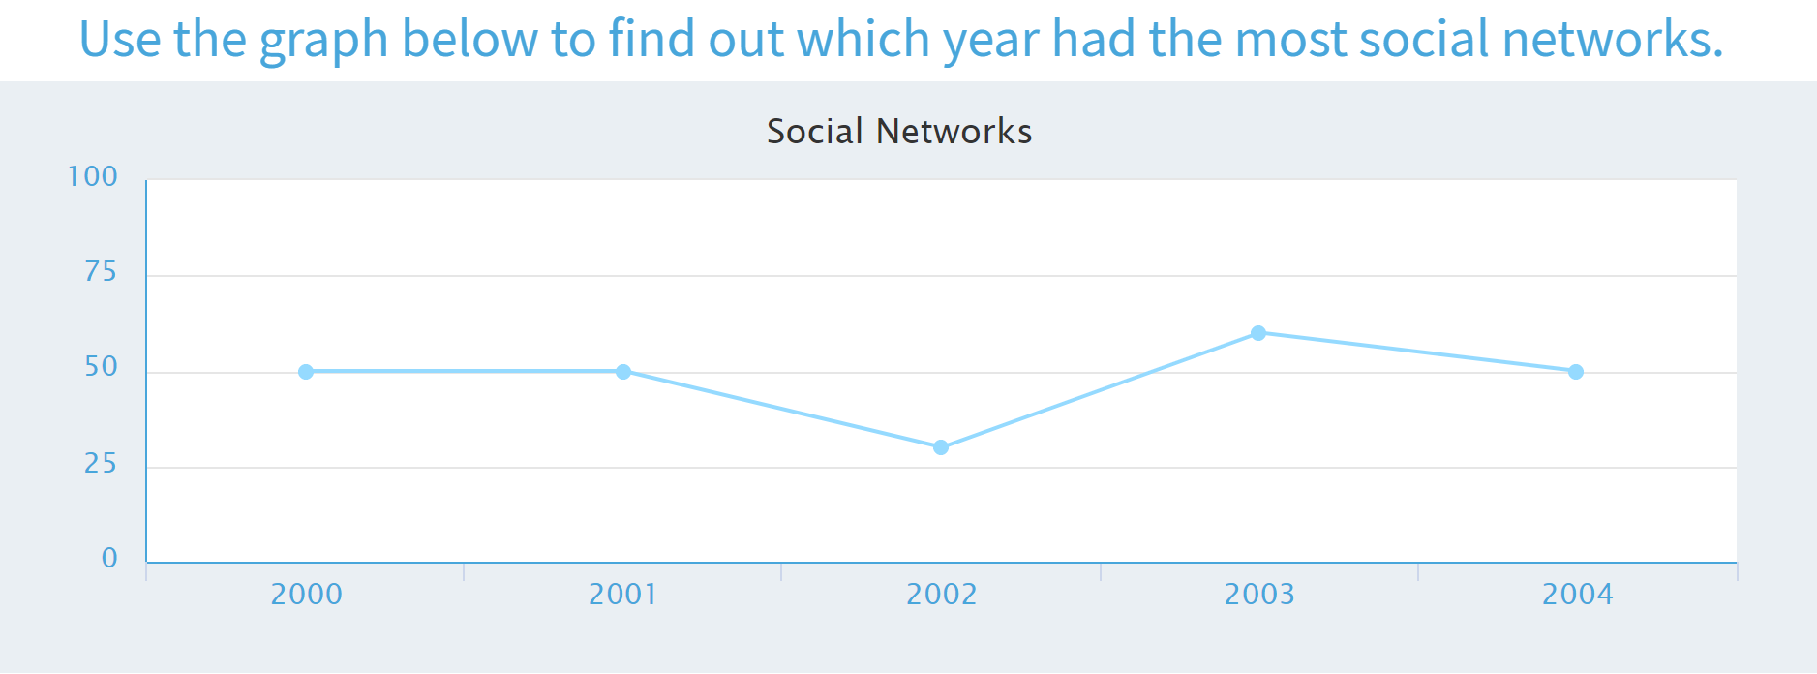
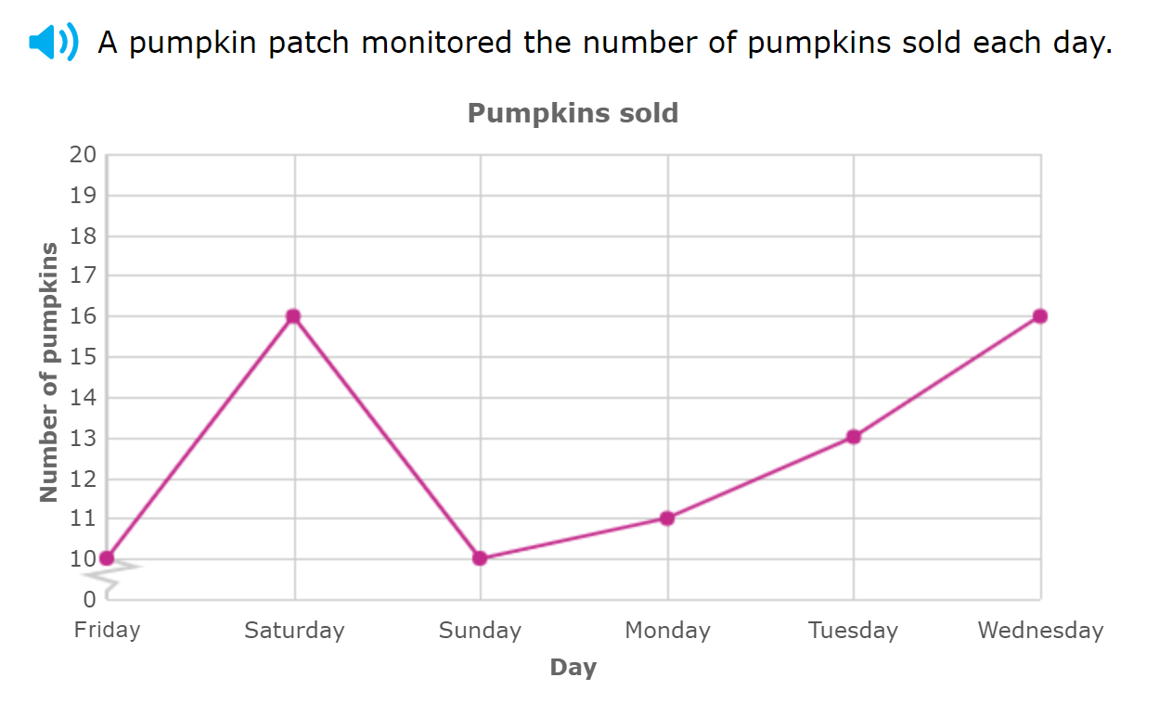
Math
I can construct and interpret graphs to solve problems.
Step 1
Click the video to learn more about line graphs.
User: westminster1
Password: westie1
Step 2
Do the EASY or HARD quiz found under the video.
Step 3
Use the data to solve the problems.
Interpret the data on the line graphs.

Slide 7
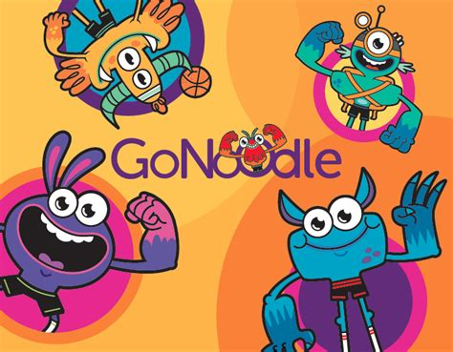
Daily Physical Activity
Choose one (or more) activities for your DPA.
GoNoodle
Fresh Start Fitness
Maximo
Calming Down
Mrs. McIntyre DPA

