Slide 1
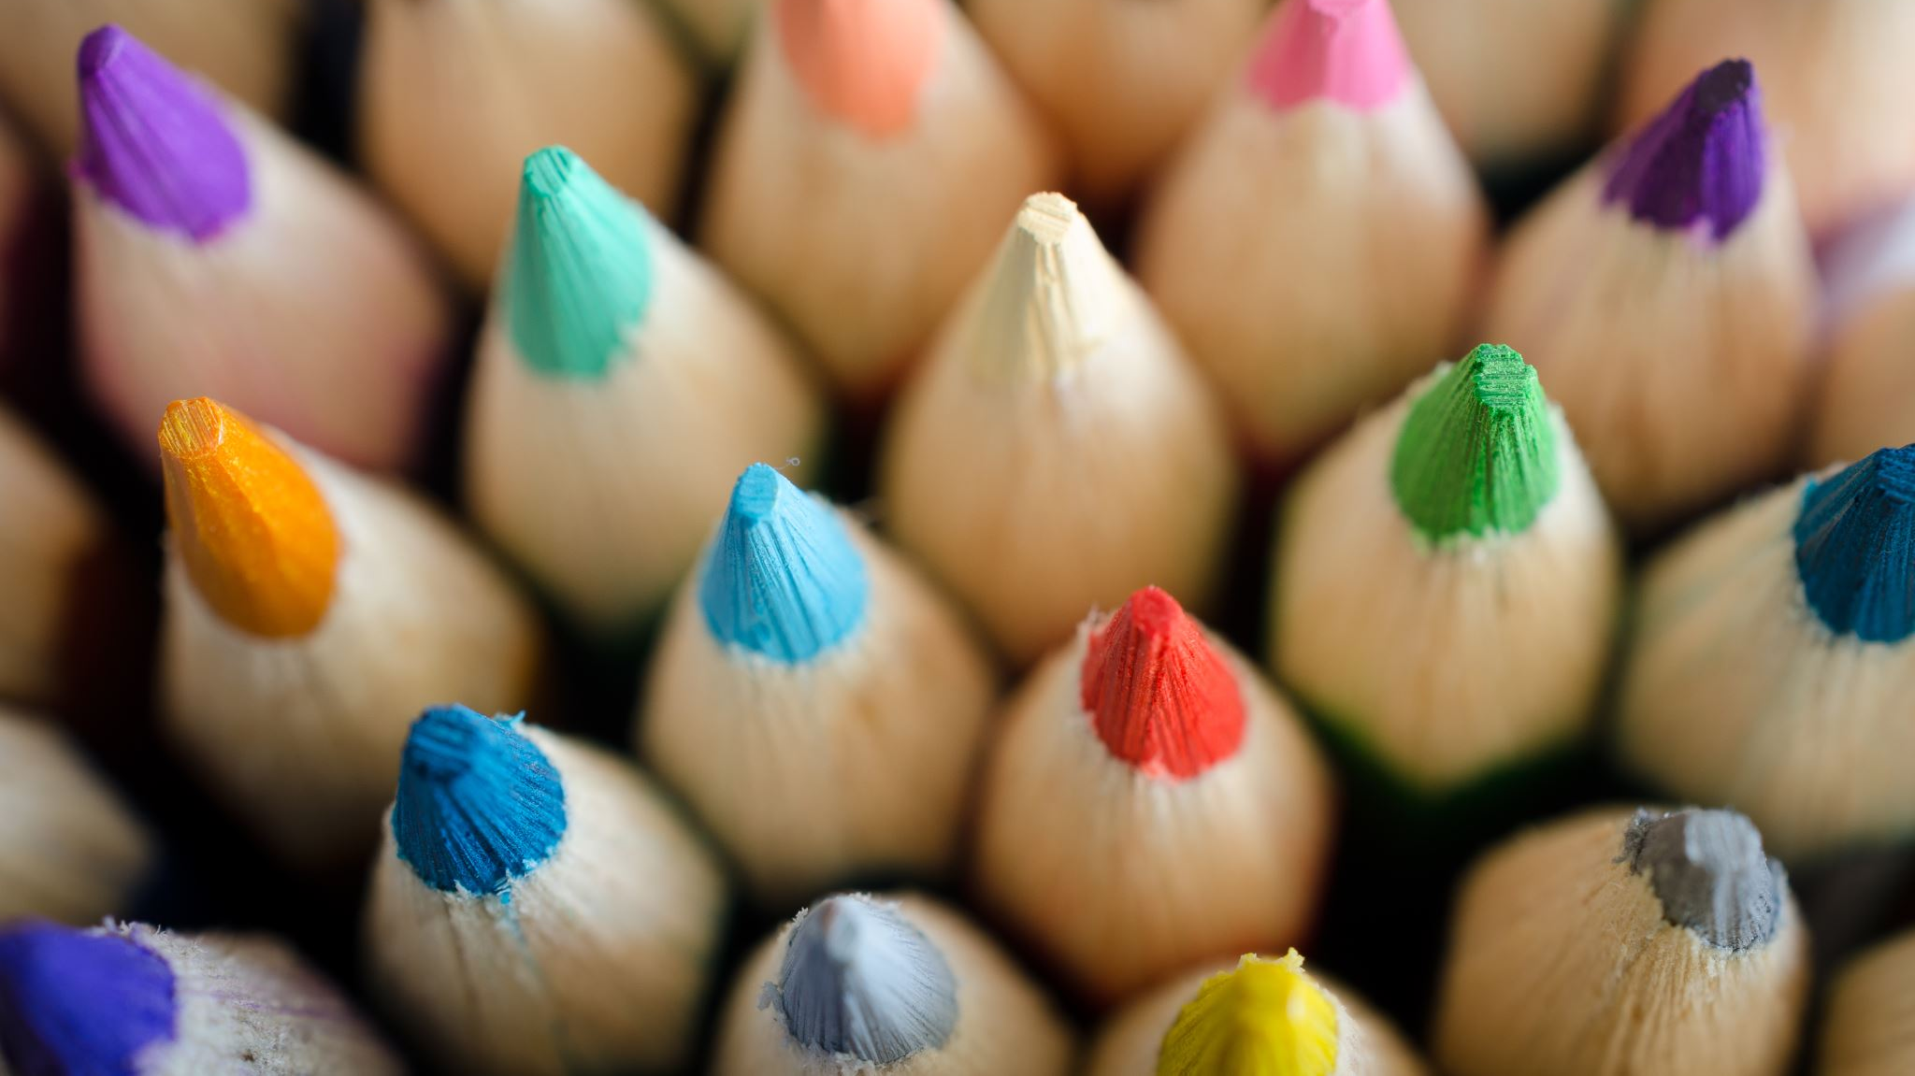
BRAICO’s Class 1/2
Tuesday, May 12, 2020

Slide 2
Table of Contents
Morning Message
Reading
Writing
Math
Daily Physical Activity

Slide 3
Morning Message
Hello Kiddos,
Happy Tuesday! Did you enjoy the story? How was your prediction? We will look for ‘sn’ words in our reading today, listen to Goldilocks and the Three Dinosaurs and make a connection to another story, and we continue managing data, this time using a bar graph.
Happy Learning,
Mr. Braico

Slide 4
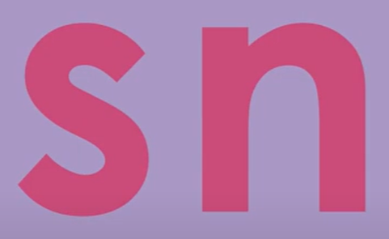
Reading
I can apply a variety of strategies to help solve words.
Step 1
Click and watch the video.
Step 2
Read a book from home or on RAZ kids.
Find any ‘sn’ words in your book. Remember if you get to a tricky word, skip it, read the rest and go back – like Skippy Frog.
Step 3
Share your words you found with a parent or share it with Mr. Braico in an email or on your ClassDojo portfolio.

Slide 5
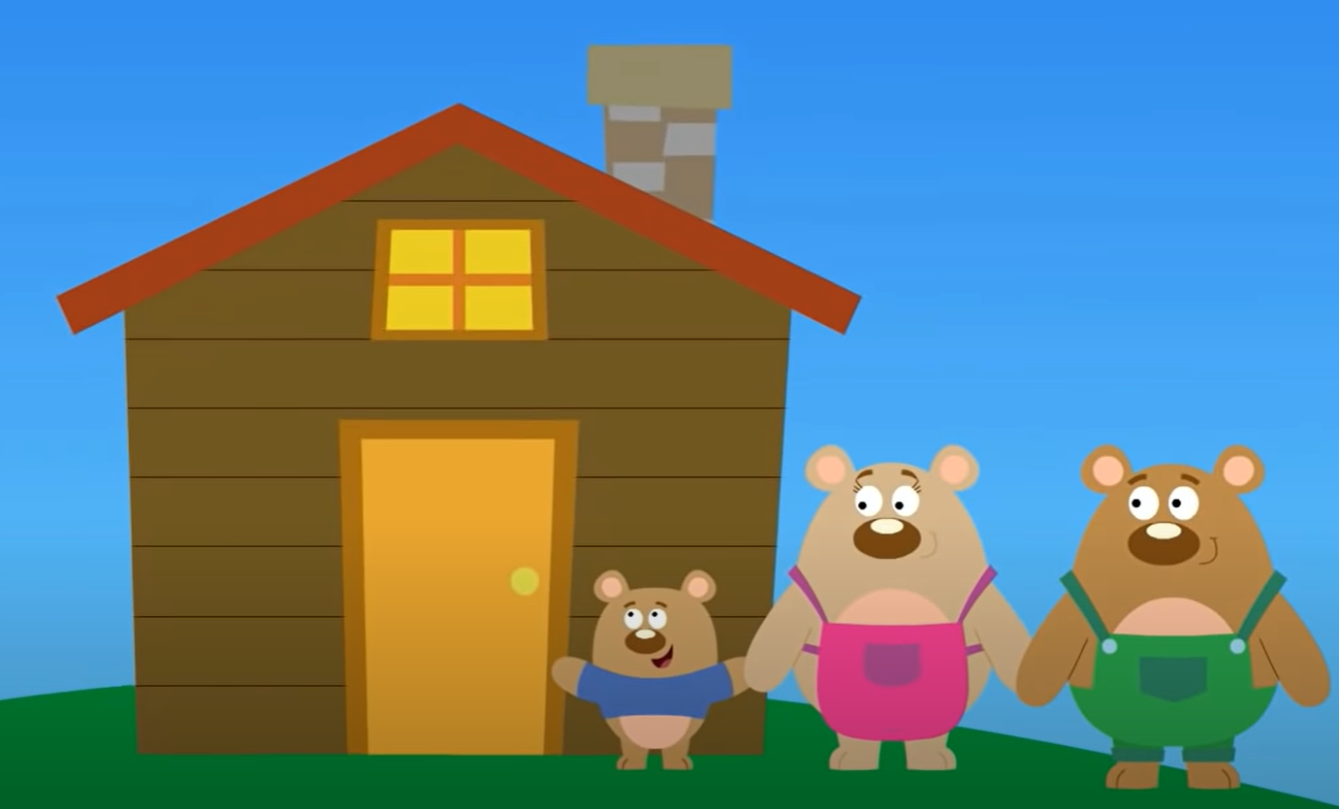
Writing
I can use past experiences to make a connection to other stories.
Step 1
Click the video to listen to Mr. Braico read Goldilocks and the Three Dinosaurs.
Then watch the video of Goldilocks and the Three Bears.
Step 2
Today, we will make a connection to stories. How is this book similar to Goldilocks and the Three Bears? How are they different?
Step 3
Start a new word document called “Goldilocks – Connection”. Write at least 2 similarities and 2 differences between the books.

Slide 6
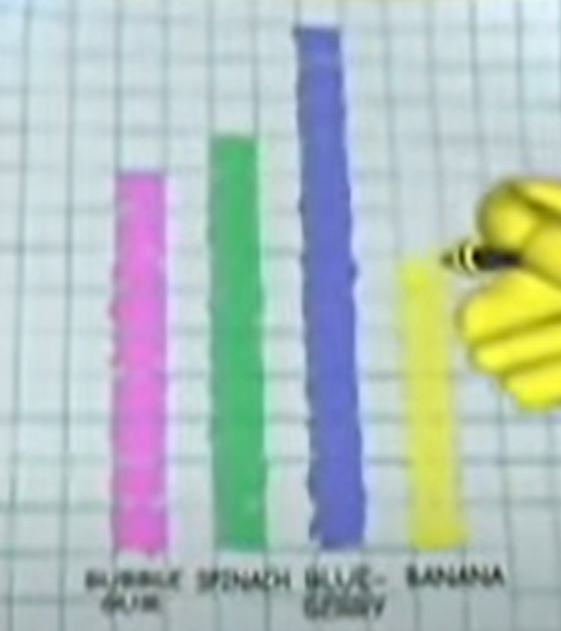
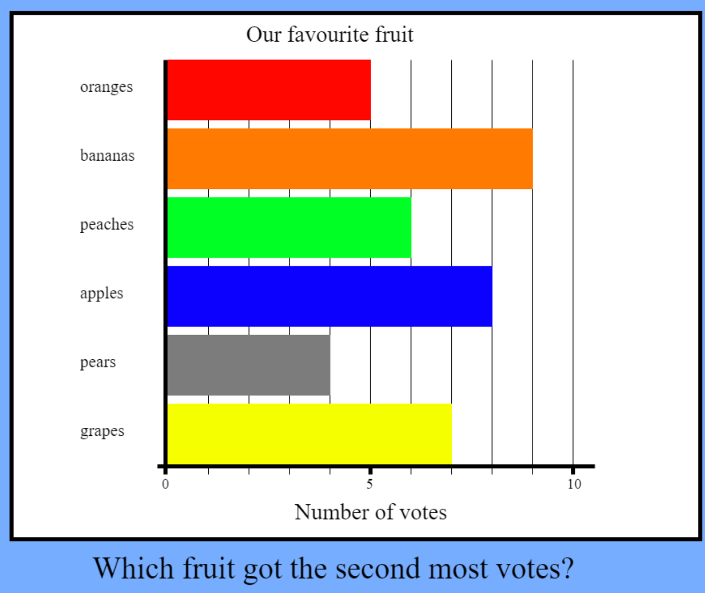
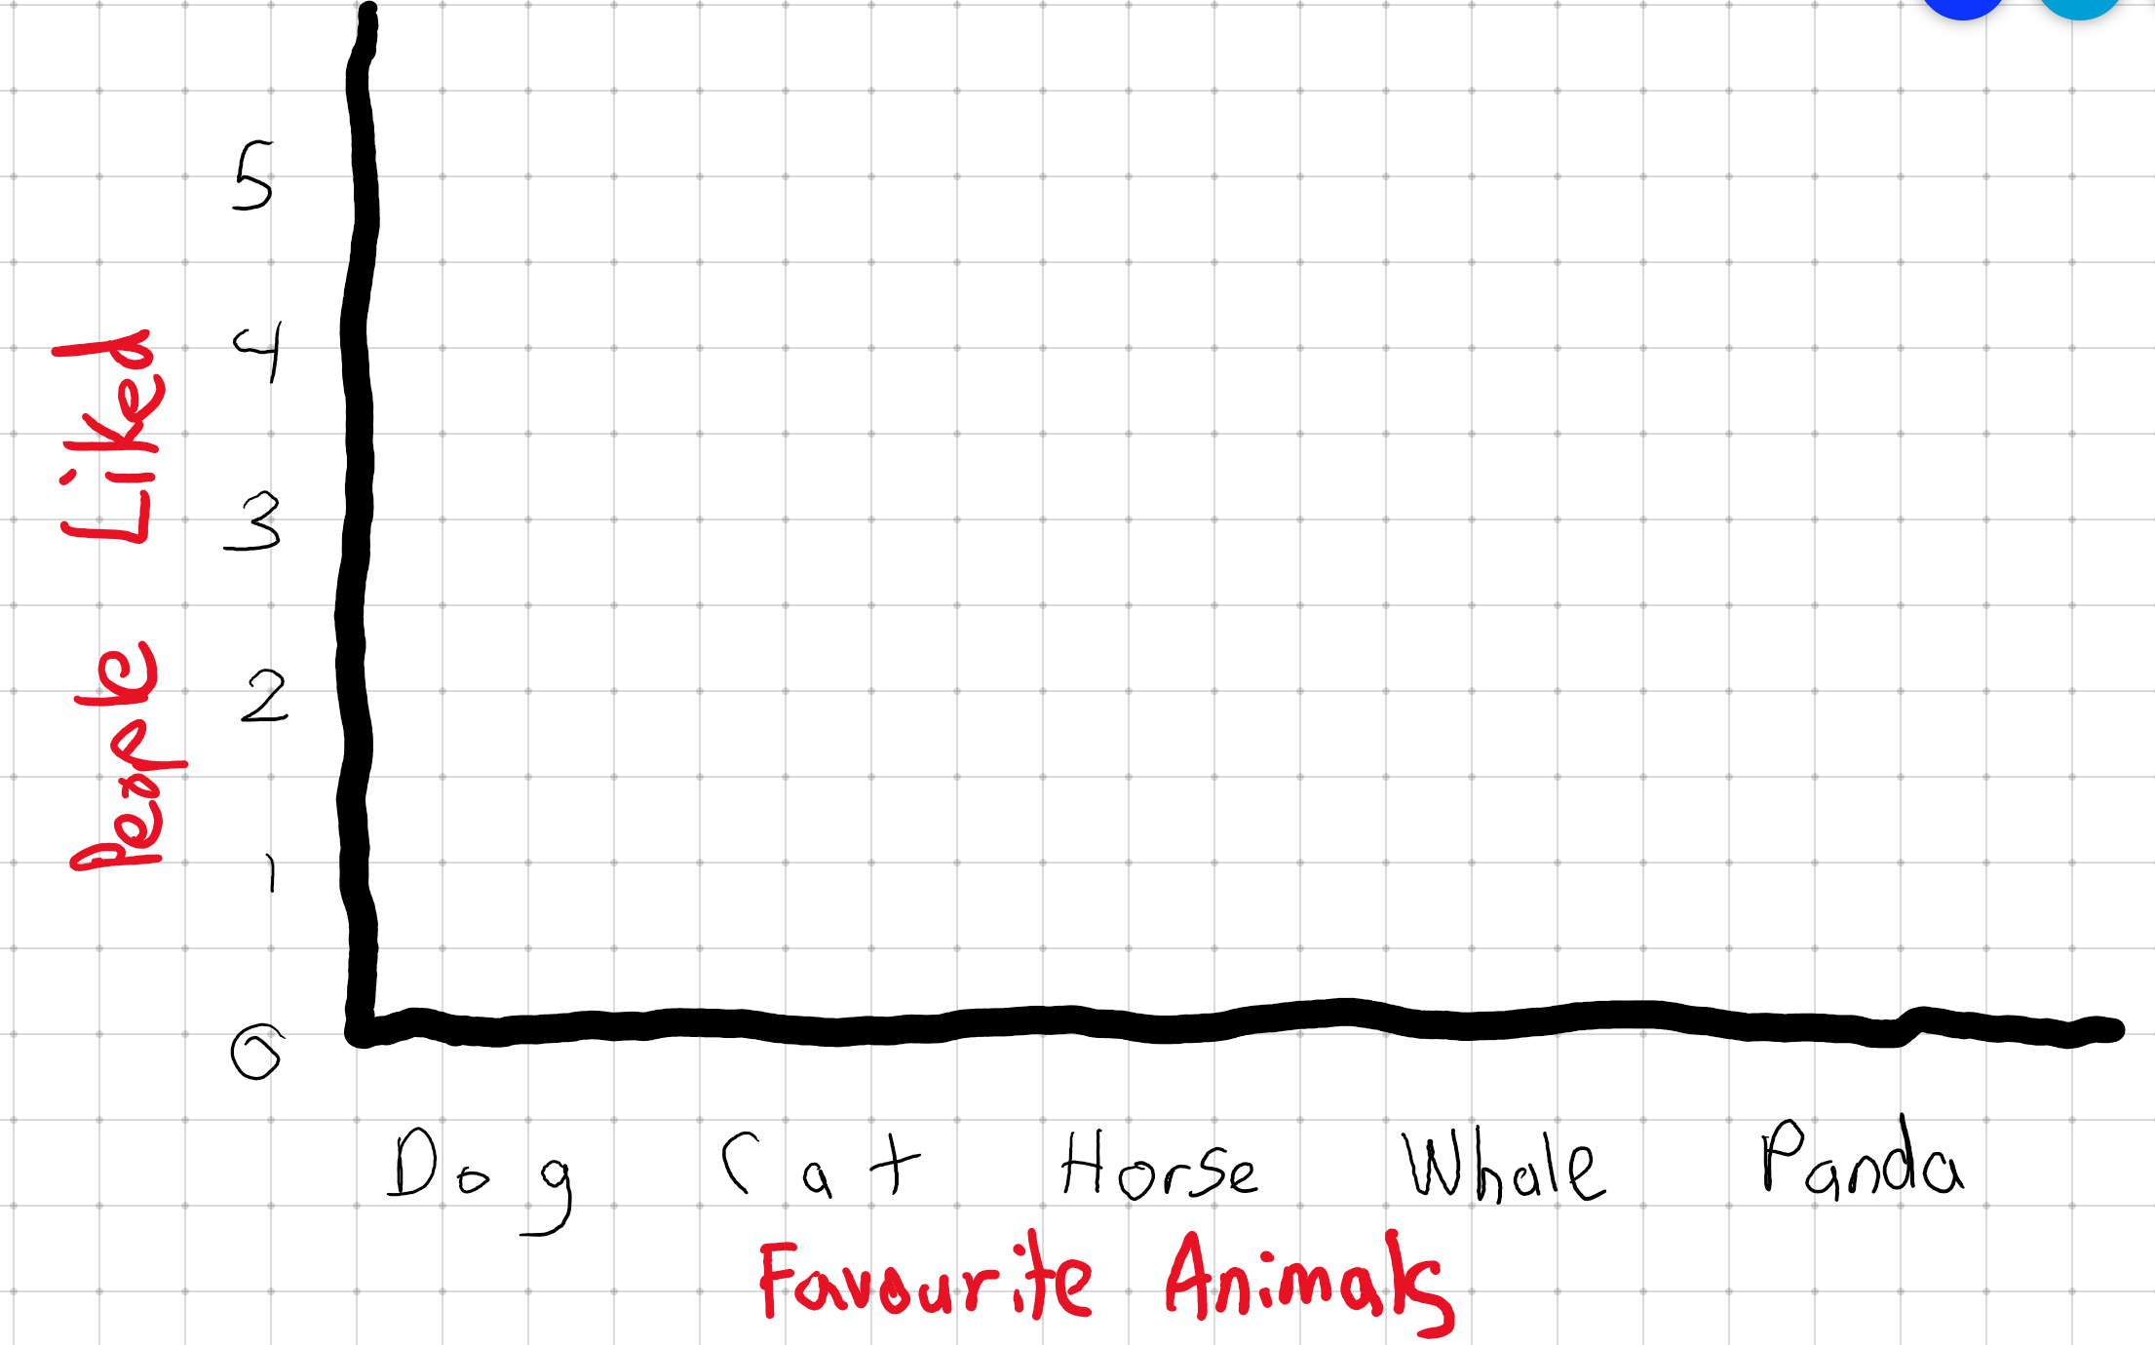
Math
I can construct and interpret graphs to solve problems.
Step 1
Click the video to learn why making a bar graph is useful.
Step 2
Use the data in the graph to solve the problems.
Use the graph to help solve the problems.
Step 3
Make a bar graph with the information of favourite animals.
Dog – 5 Cat – 4 Horse – 4 Whale – 1 Panda – 5
Use the graph to the left as an example to help you complete yours.

Slide 7
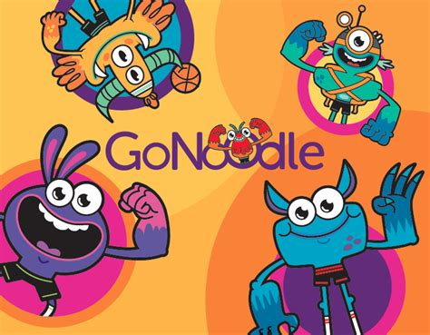
Daily Physical Activity
Choose one (or more) activities for your DPA.
GoNoodle
Fresh Start Fitness
Maximo
Calming Down
Mrs. McIntyre DPA

