Slide 1
Braico’s Class 1/2
Thursday, May 7, 2020

Slide 2
Table of Contents
Morning Message
Reading
Writing
Math
Daily Physical Activity

Slide 3
Morning Message
Hello Kiddos,
Happy Friday! I hope you were able to practice those regrouping addition skills. They come in handy in the later grades. Today we will be looking at the ‘tr’ double consonant blend, we will check our comprehension about Enemy Pie, and we will practice subtraction with regrouping. If you celebrate, to all the Mother’s and special women in our lives HAPPY MOTHER’S DAY! We love you!
Happy Learning,
Mr. Braico

Slide 4
Reading
I can apply a variety of strategies to help solve words.
Step 1
Click and watch the video.
Step 2
Read a book from home or on RAZ kids.
Find any ‘tr’ words in your book. Remember to always keep trying like Tryin’ Lion and solve those tricky words – don’t quit.
Step 3
Share your words you found with a parent or share it with Mr. Braico in an email or on your ClassDojo portfolio.

Slide 5
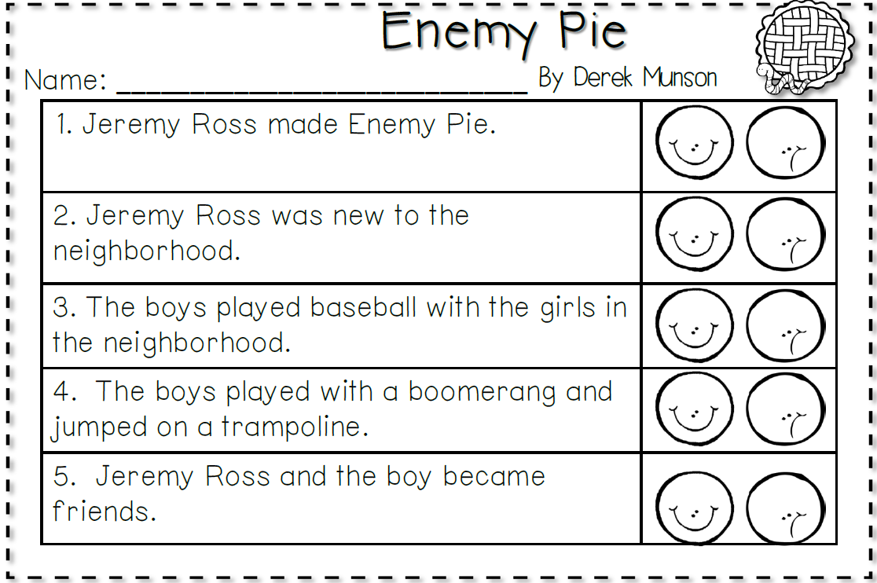
Writing
Step 1
Click the video and listen to Mrs. Biesbroek read Enemy Pie.
Step 2
Read and answer the questions from the comprehension quiz to see how well you remember Enemy Pie.

Slide 6
Writing
Step 3
Click the video and see the answers to the comprehension quiz. How did you do?

Slide 7
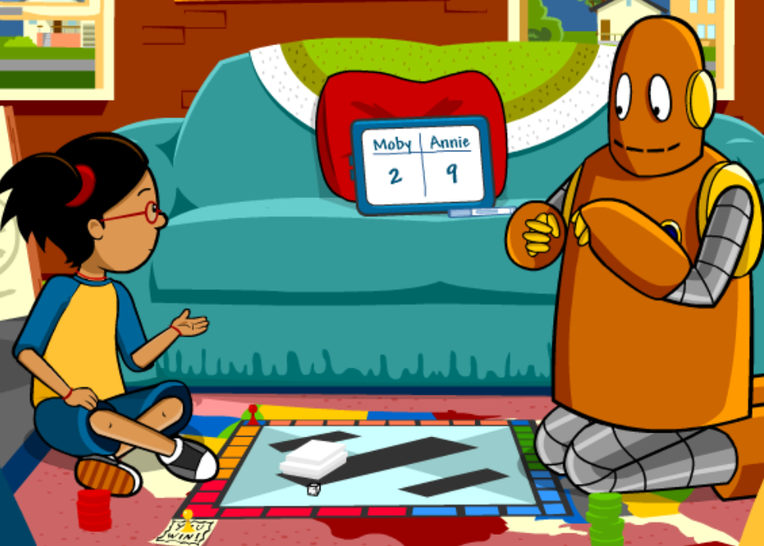
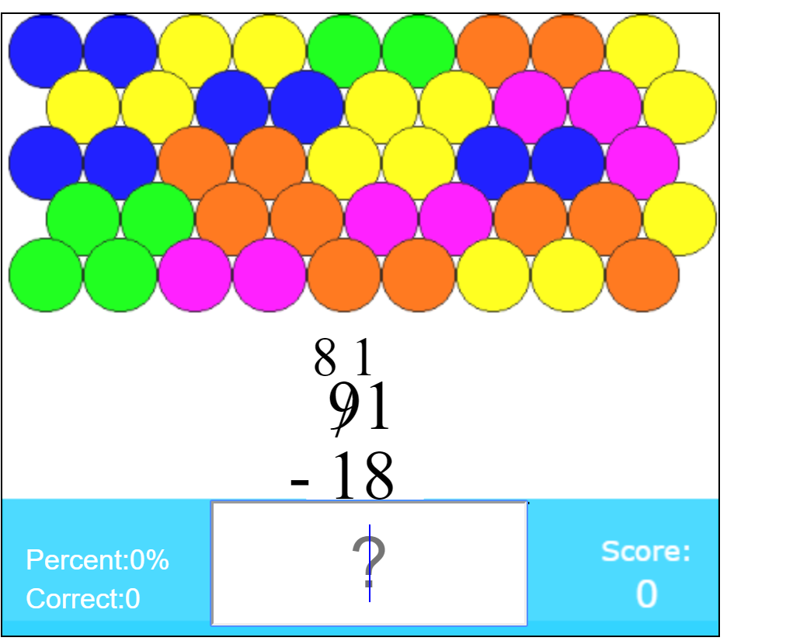
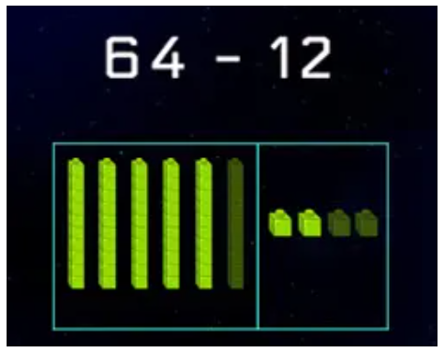
Math
I can show an understanding of subtracting numbers.
Step 1
Click the video to learn more about subtracting with regrouping.
User: westminster1
Password: westie1
Step 2
Do the EASY or HARD quiz found under the video.
Step 3
Practice your subtraction regrouping skills.
Subtract 2-digit numbers by 2-digit numbers.
Click Sign In → Class → JUMJUU → find name → Password: 1234

Slide 8
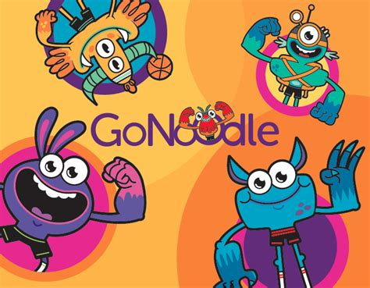
Daily Physical Activity
Choose one (or more) activities for your DPA.
GoNoodle
Fresh Start Fitness
Maximo
Calming Down
Mrs. McIntyre DPA

