Slide 1
Braico’s Class 1/2
Wednesday, May 6, 2020

Slide 2
Table of Contents
Morning Message
Reading
Writing
Math
Daily Physical Activity

Slide 3
Morning Message
Hello Kiddos,
Happy Wednesday! I hope you were able to find a connection to Enemy Pie yesterday. Today we will be looking at the ‘dr’ consonant blend, we will read Enemy Pie again and make an inference on the story, and we will practice our place value skills again in Math.
Happy Learning,
Mr. Braico

Slide 4
Reading
I can apply a variety of strategies to help solve words.
Step 1
Click and watch the video.
Step 2
Read a book from home or on RAZ kids.
Find any ‘dr’ words in your book. Remember to always keep trying like Tryin’ Lion and solve those tricky words – don’t quit.
Step 3
Share your words you found with a parent or share it with Mr. Braico in an email or on your ClassDojo portfolio.

Slide 5
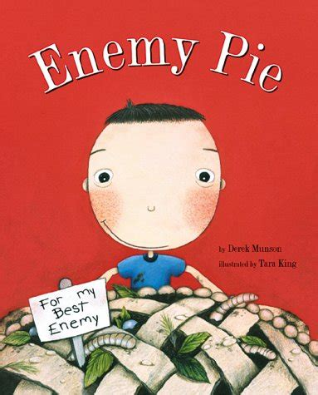
Writing
I can express thoughts related to events and characters in the book.
Step 1
Click the video and listen to Mrs. Biesbroek read Enemy Pie.
Step 2
Today, we will make an inference about the story. Why do you think Dad suggested he go play with Jeremy?
Step 3
Create a Word document called “Enemy Pie – Inference” and write down your answer of why you thought the Dad suggested the boy go play with Jeremy.

Slide 6
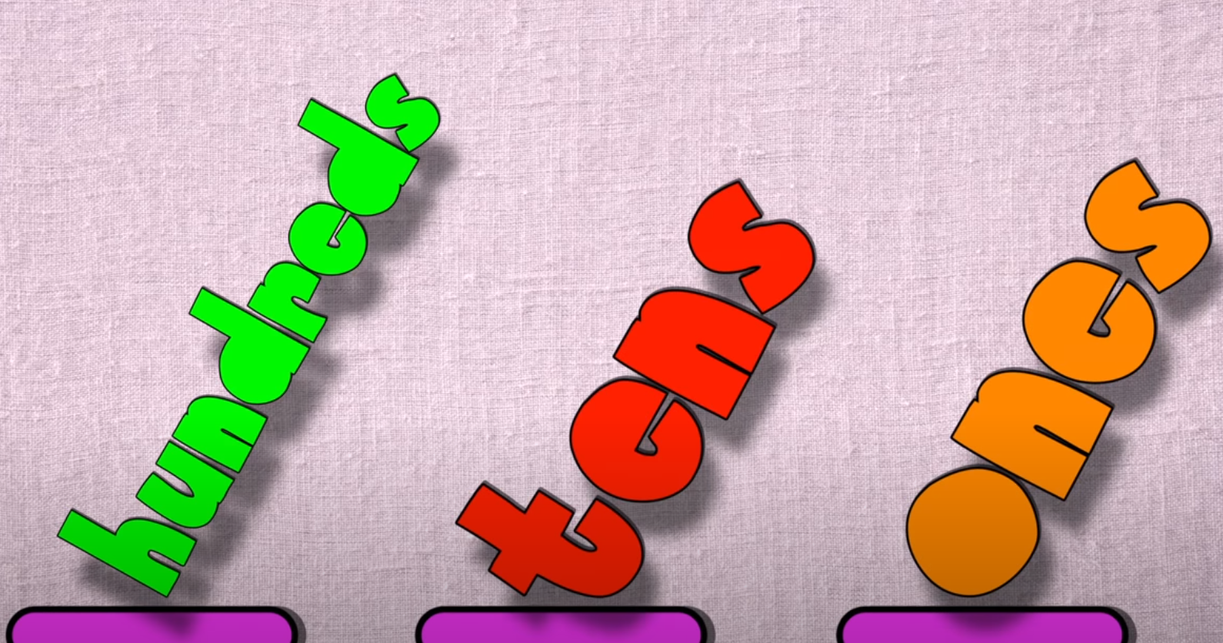
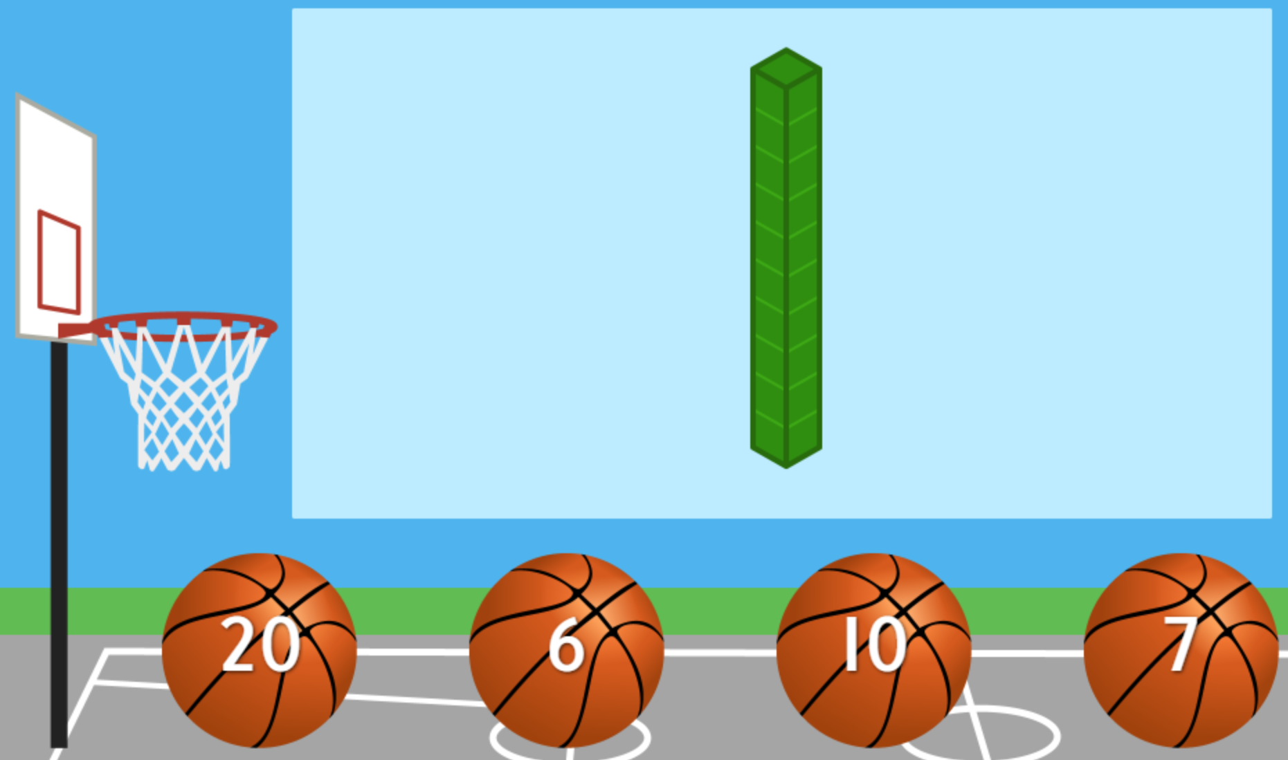
Math
I can show the place value of numerals to 100.
Step 1
Click the video to learn more about comparing numbers.
Step 2
Find the number the base ten block represents.
Step 3
Represent the number 47 using objects found around your house as base ten blocks. For example, 10s could be markers, and 1s could be lids.
Take a picture and put it on your ClassDojo portfolio.

Slide 7
Daily Physical Activity
Choose one (or more) activities for your DPA.
GoNoodle
Fresh Start Fitness
Maximo
Calming Down
Mrs. McIntyre DPA

