Slide 1
Braico’s Class 1/2
Thursday, May 7, 2020

Slide 2
Table of Contents
Morning Message
Reading
Writing
Math
Daily Physical Activity

Slide 3
Morning Message
Hello Kiddos,
Happy Thursday! Inferences are tricky, but I know you all worked hard on finding one. Today we will be looking at the ‘gr’ double consonant blend, we will be making an opinion from the story Enemy Pie, and we will work on some addition with regrouping.
Happy Learning,
Mr. Braico

Slide 4
Reading
I can apply a variety of strategies to help solve words.
Step 1
Click and watch the video.
Step 2
Read a book from home or on RAZ kids.
Find any ‘gr’ words in your book. Remember to always keep trying like Tryin’ Lion and solve those tricky words – don’t quit.
Step 3
Share your words you found with a parent or share it with Mr. Braico in an email or on your ClassDojo portfolio.

Slide 5
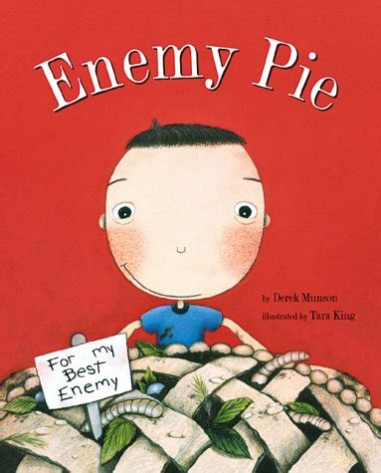
Writing
I can explain why an event from a story was my personal favourite.
Step 1
Click the video and listen to Mrs. Biesbroek read Enemy Pie.
Step 2
Today, we will write an opinion about the story. Do you think it was fair for Dad to trick him into playing with Jeremy? Or tell me about your favourite part of the story and why.
Step 3
Create a Word document called “Enemy Pie – Opinion”. Answer if you thought it was fair for Dad to trick the boy into playing with Jeremy or share your favourite part of the story.

Slide 6
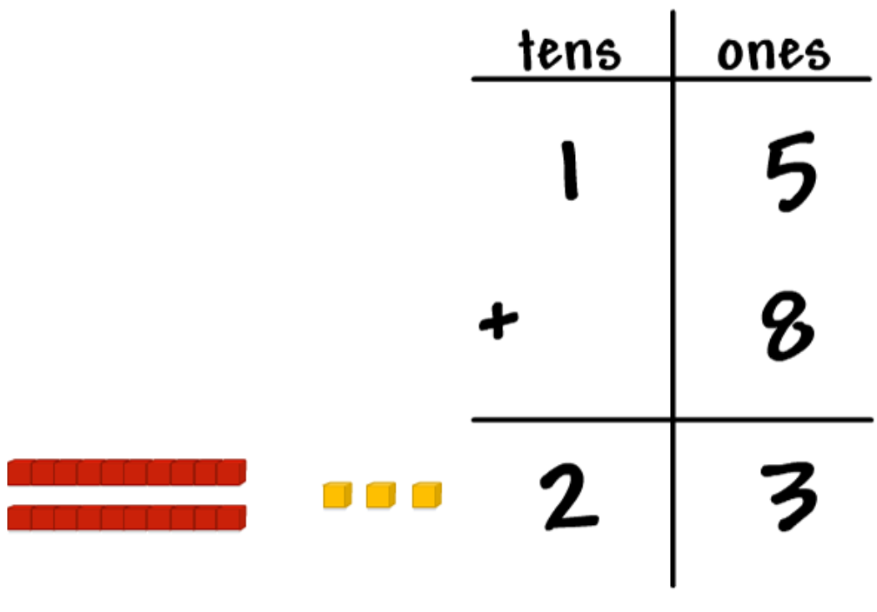
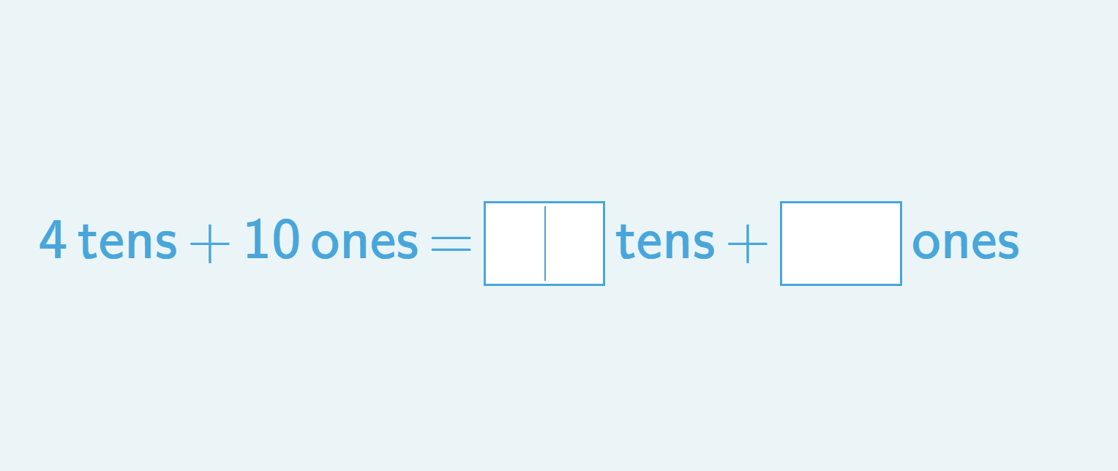
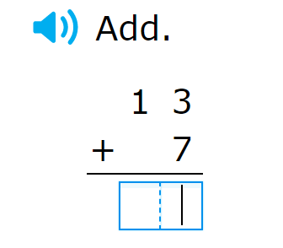
Math
I can show an understanding of adding numbers.
Step 1
Click the video to learn more about adding with regrouping.
User: westminster1
Password: westie1
Step 2
Do the EASY or HARD quiz found under the video.
Step 3
Write the number to add the 10s and 1s.
Answer the addition problems with regrouping.

Slide 7
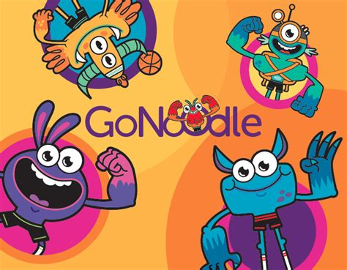
Daily Physical Activity
Choose one (or more) activities for your DPA.
GoNoodle
Fresh Start Fitness
Maximo
Calming Down
Mrs. McIntyre DPA

