Slide 1
Braico’s Class 1/2
Tuesday, May 5, 2020

Slide 2
Table of Contents
Morning Message
Reading
Writing
Math
Daily Physical Activity

Slide 3
Morning Message
Hello Kiddos,
Happy Tuesday! How did your predictions go? Were you surprised? Today we will be looking at the ‘cr’ consonant blend, we will read Enemy Pie again and we will make connections to the story, and we will practice our place value skills in Math.
Happy Learning,
Mr. Braico

Slide 4
Reading
I can apply a variety of strategies to help solve words.
Step 1
Click and watch the video.
Step 2
Read a book from home or on RAZ kids.
Find any ‘cr’ words in your book. Remember to always keep trying like Tryin’ Lion and solve those tricky words – don’t quit.
Step 3
Share your words you found with a parent or share it with Mr. Braico in an email or on your ClassDojo portfolio.

Slide 5
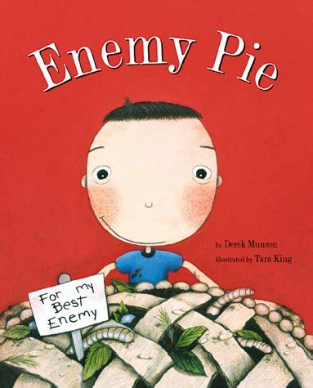
Writing
I can use past experiences to make a connection to the meaning of a story.
Step 1
Click the video and listen to Mrs. Biesbroek read Enemy Pie.
Step 2
Today, we will make a connection to the story. What would you do to make a friend?
Step 3
Start a new word document called “Enemy Pie – Connection”. Write at least 3 sentences explaining what you would do to make a new friend.

Slide 6
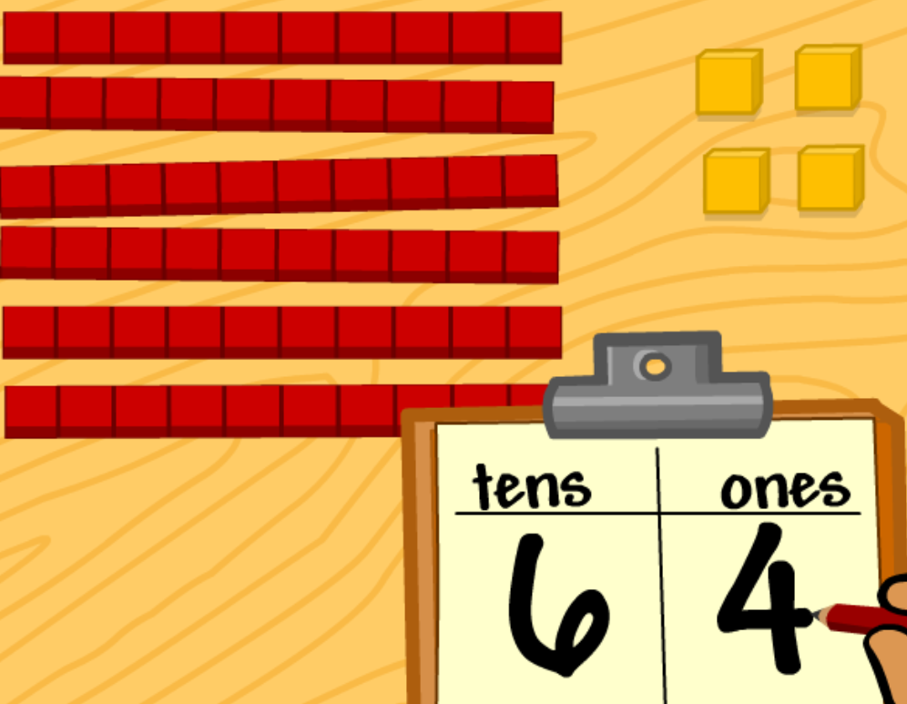
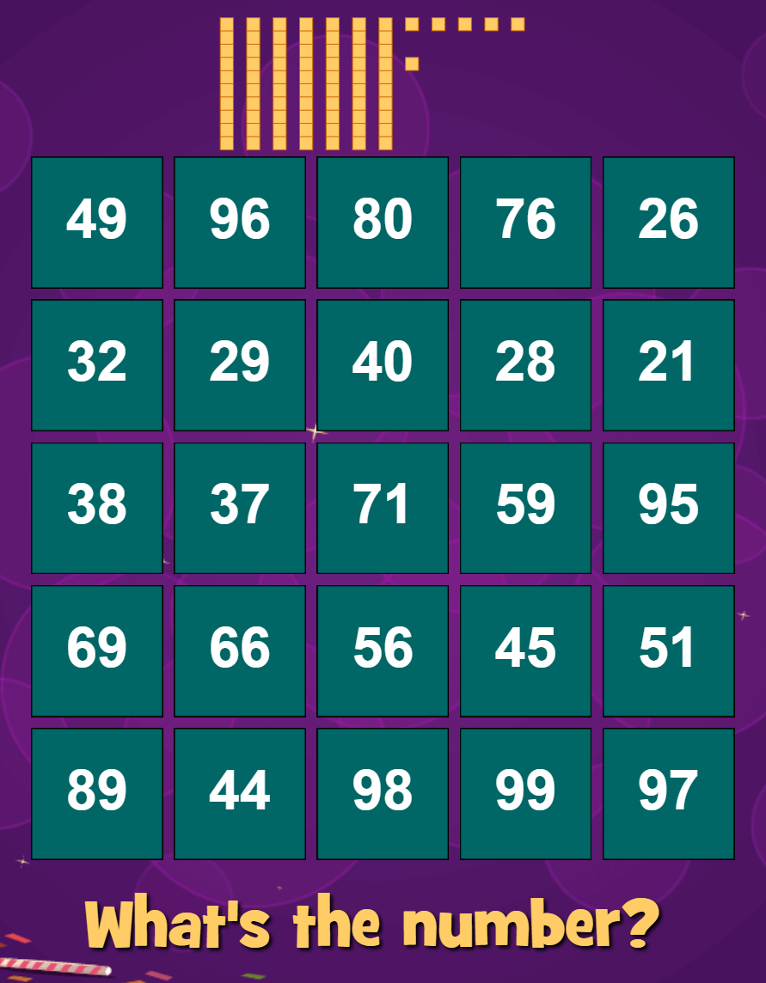
Math
I can show the place value of numerals to 100.
Step 1
Click the video to learn more about comparing numbers.
User: westminster1
Password: westie1
Step 2
Do the EASY or HARD quiz found under the video.
Step 3
Find the number the base ten blocks are making.

Slide 7
Daily Physical Activity
Choose one (or more) activities for your DPA.
GoNoodle
Fresh Start Fitness
Maximo
Calming Down
Mrs. McIntyre DPA

