Slide 1
BRAICO’s Class 1/2
Monday, May 4, 2020

Slide 2
Table of Contents
Morning Message
Reading
Writing
Math
Daily Physical Activity

Slide 3
Morning Message
Hello Kiddos,
Happy Star Wars Day! May the 4th be With You. Hope you had a great weekend. We will look at double consonant blends again this week, we start with ‘br’, we will read a story called Enemy Pie and make predictions, and we will be comparing numbers in Math.
Happy Learning,
Mr. Braico

Slide 4
Reading
I can apply a variety of strategies to help solve words.
Step 1
Click and watch the video.
Step 2
Read a book from home or on RAZ kids.
Find any ‘br’ words in your book. Remember to always keep trying like Tryin’ Lion and solve those tricky words – don’t quit.
Step 3
Share your words you found with a parent or share it with Mr. Braico in an email or on your ClassDojo portfolio.

Slide 5
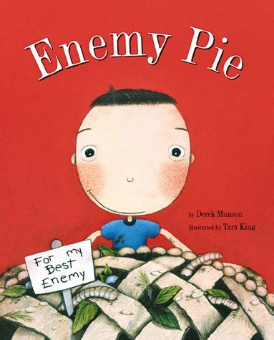
Writing
I can make predictions to draw conclusions of a story.
Step 1
Click and watch Mrs. Biesbroek read Enemy Pie. Today we will be making a prediction.
Step 2
Watch the first video. Jeremy Ross and the boy seem to be having fun. What do you predict will happen next?
Open a Word Document and title it “Enemy Pie – Prediction” and add your prediction.
Step 3
Watch the second video and see if your prediction was correct.
Write down if you were correct or if you were surprised. What actually happened in the story?

Slide 6
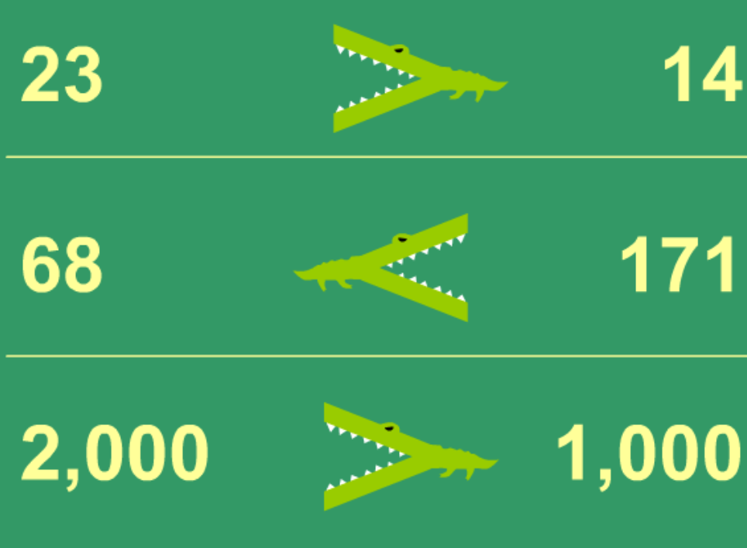
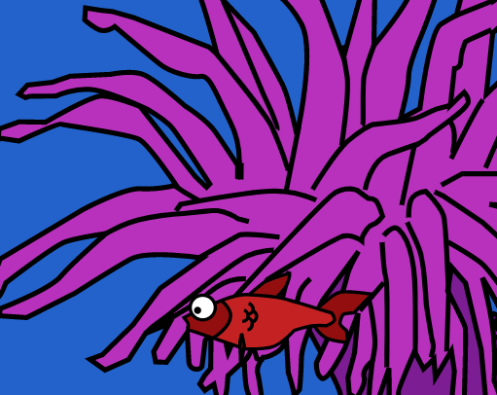
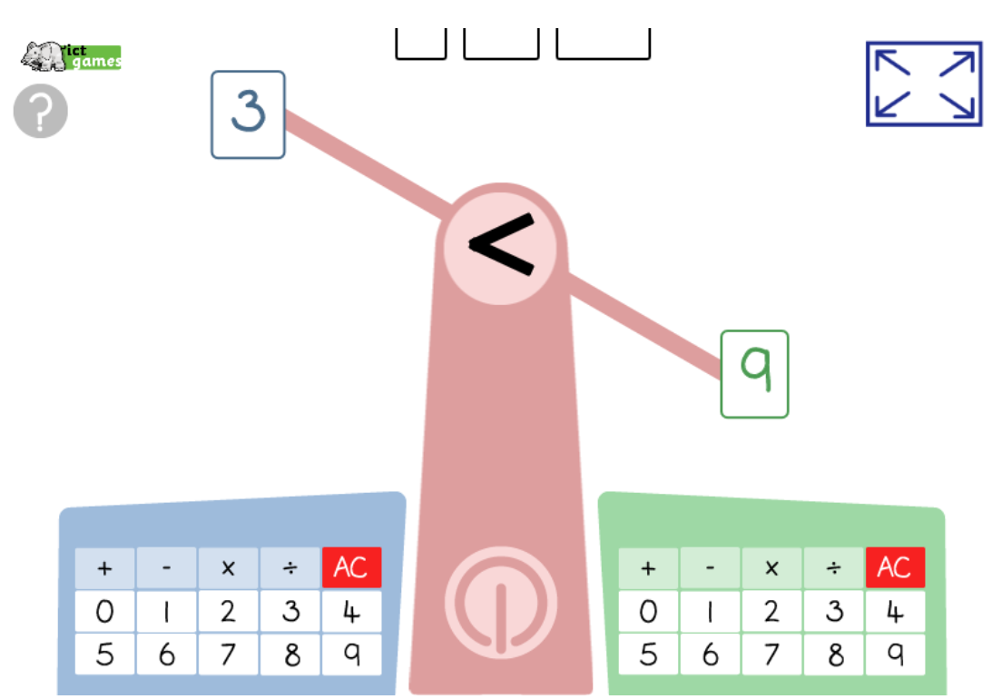
Math
I can compare and order numbers.
Step 1
Click the video to learn more about comparing numbers.
User: westminster1
Password: westie1
Step 2
Do the EASY or HARD quiz found under the video.
Step 3
Feed the fish the greater amount of food.
Compare numbers using the scale.

Slide 7
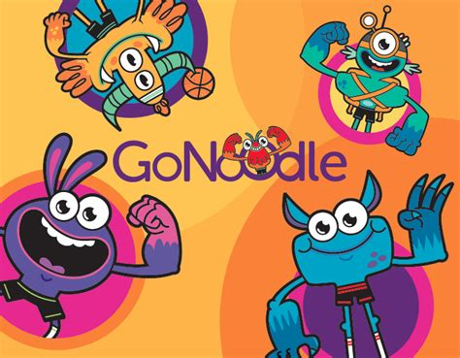
Daily Physical Activity
Choose one (or more) activities for your DPA.
GoNoodle
Fresh Start Fitness
Maximo
Calming Down
Mrs. McIntyre DPA

