Slide 1
BRAICO’s Class 1/2
Friday, May 1, 2020

Slide 2
Table of Contents
Morning Message
Word Work
Reading
Writing
Math
Daily Physical Activity

Slide 3
Morning Message
Hello Kiddos,
Happy Friday! It’s almost the weekend and we are almost done our ‘My Story’ writing. Today we will be looking at the ‘sl’ double consonant, we will read and edit a little story, we will also be editing our ‘My Story’ narrative writing, and we will be learning about measuring mass using grams and kilograms.
Happy Learning,
Mr. Braico

Slide 4
Word Work
I can apply a variety of strategies to help solve words.
Step 1
Click and watch the video.
Step 2
Read a book from home or on RAZ kids.
Find any ‘sl’ words in your book. Remember to put your lips together to get ready for the sounds using Lips the Fish.
Step 3
Share your words you found with a parent or share it with Mr. Braico in an email or on your ClassDojo portfolio.
dan.braico@lethsd.ab.ca

Slide 5
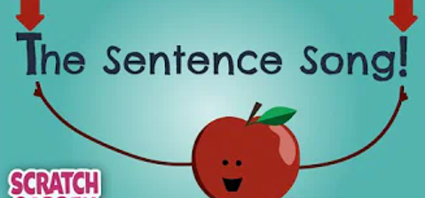
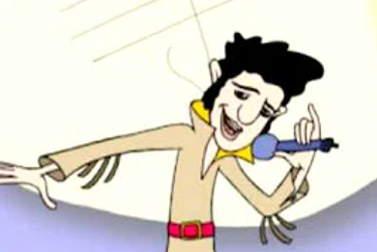
Reading
I check for capital letters, punctuation and errors in spelling.
Step 1
Click and watch the video about making sentences.
Click and watch the video about spacing.
Click and watch the video about upper and lower case.

Slide 6
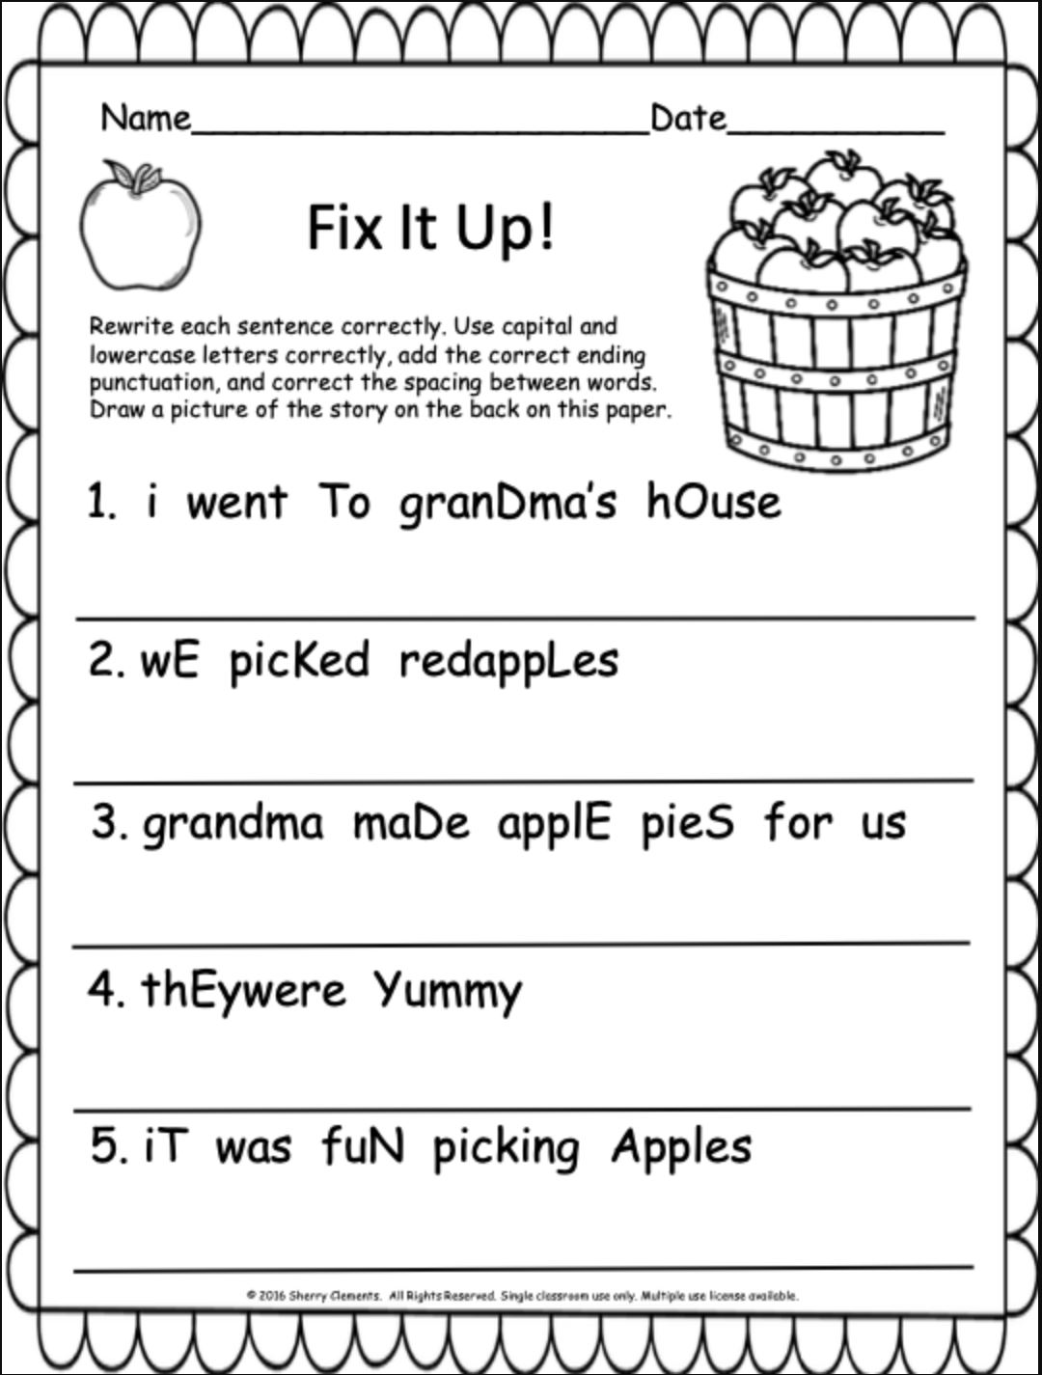
Reading
Step 2
There are some errors in these sentences. Fix the sentences so that they make sense. Remember to look for capitals, spacing and punctuation.
Step 3
After you fixed the sentences, read them to a parent or sibling or to Mr. Braico on your ClassDojo portfolio.

Slide 7
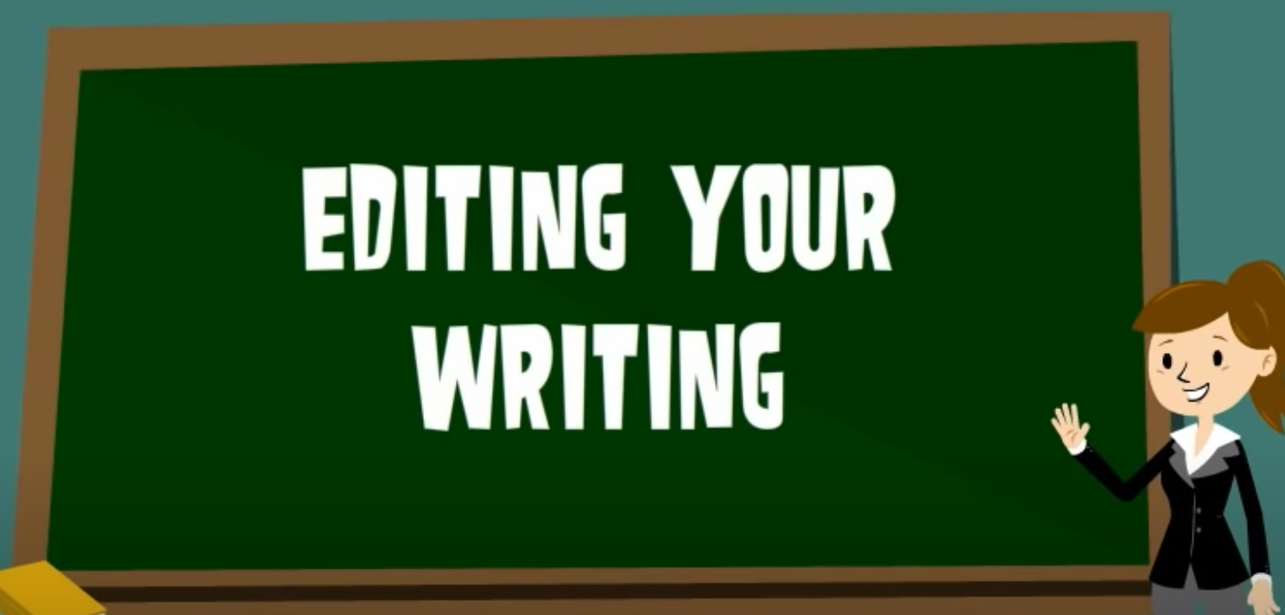
Writing
I can check for capital letters, punctuation and errors in spelling.
Step 1
Click the video to learn more about editing stories.
Step 2
Today, we will be looking back at our writing. We will make sure our readers are able to read and understand our writing by editing our work.
Step 3
Open the “My Story” document. Fix up any errors with capitals, spacing, spelling and punctuation. Remember to save your work. Send your work to Mr. Braico.
dan.braico@lethsd.ab.ca

Slide 8
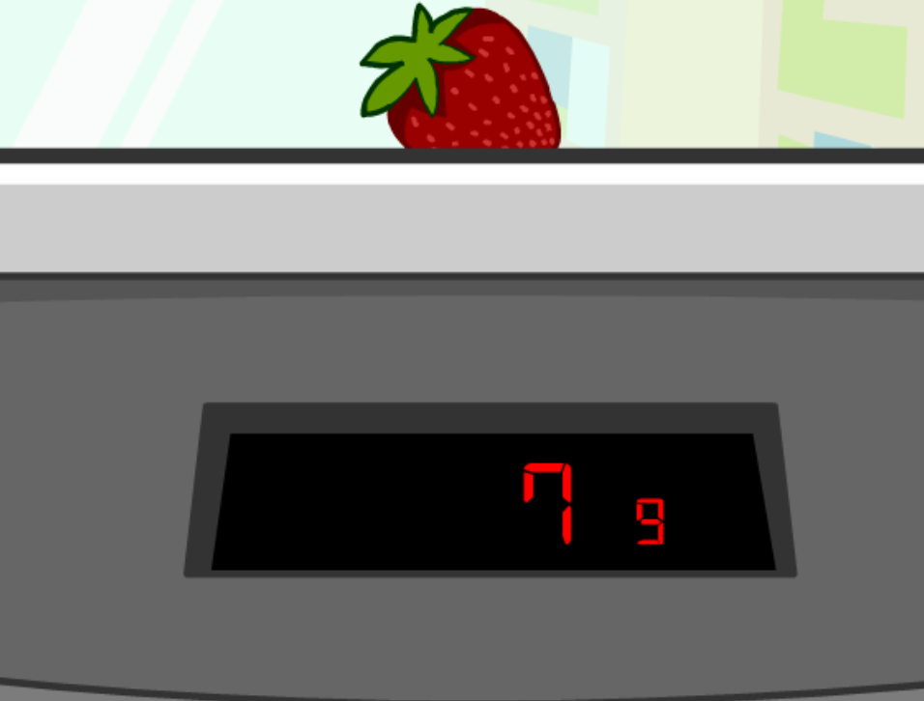
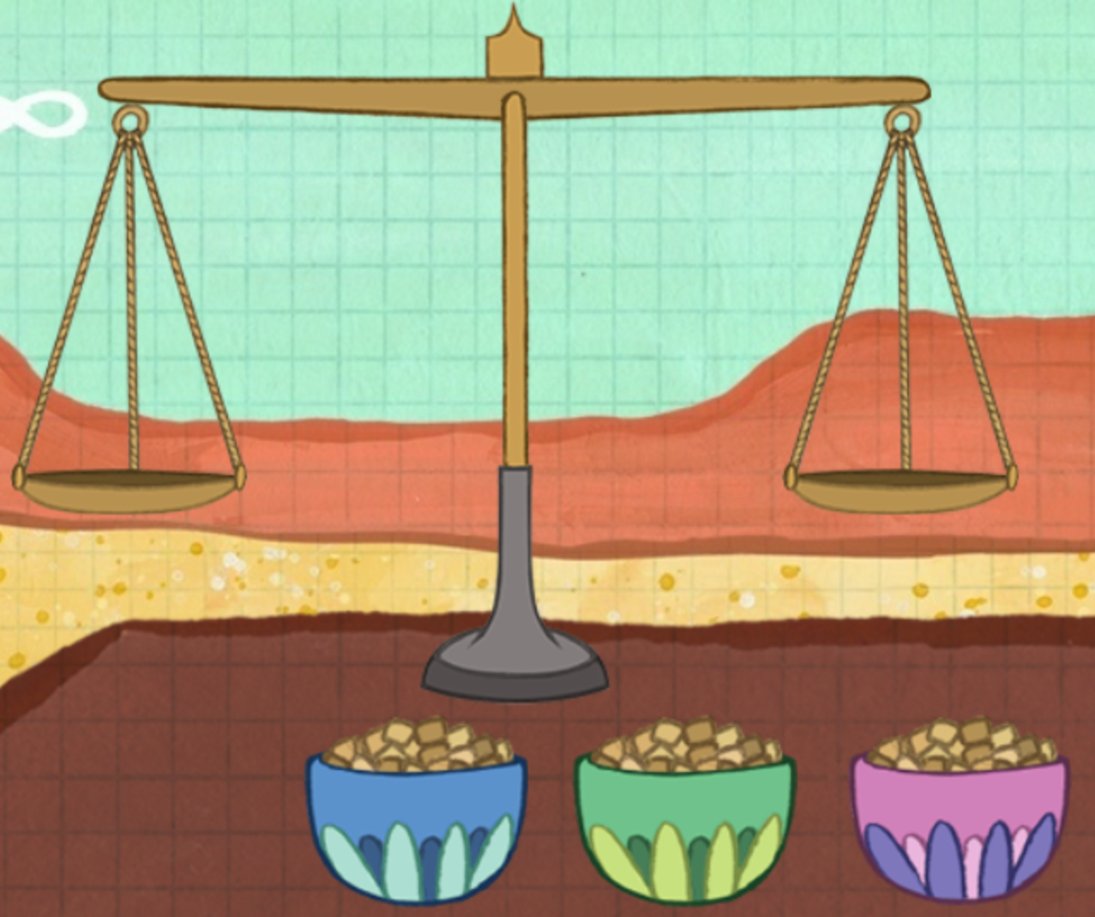
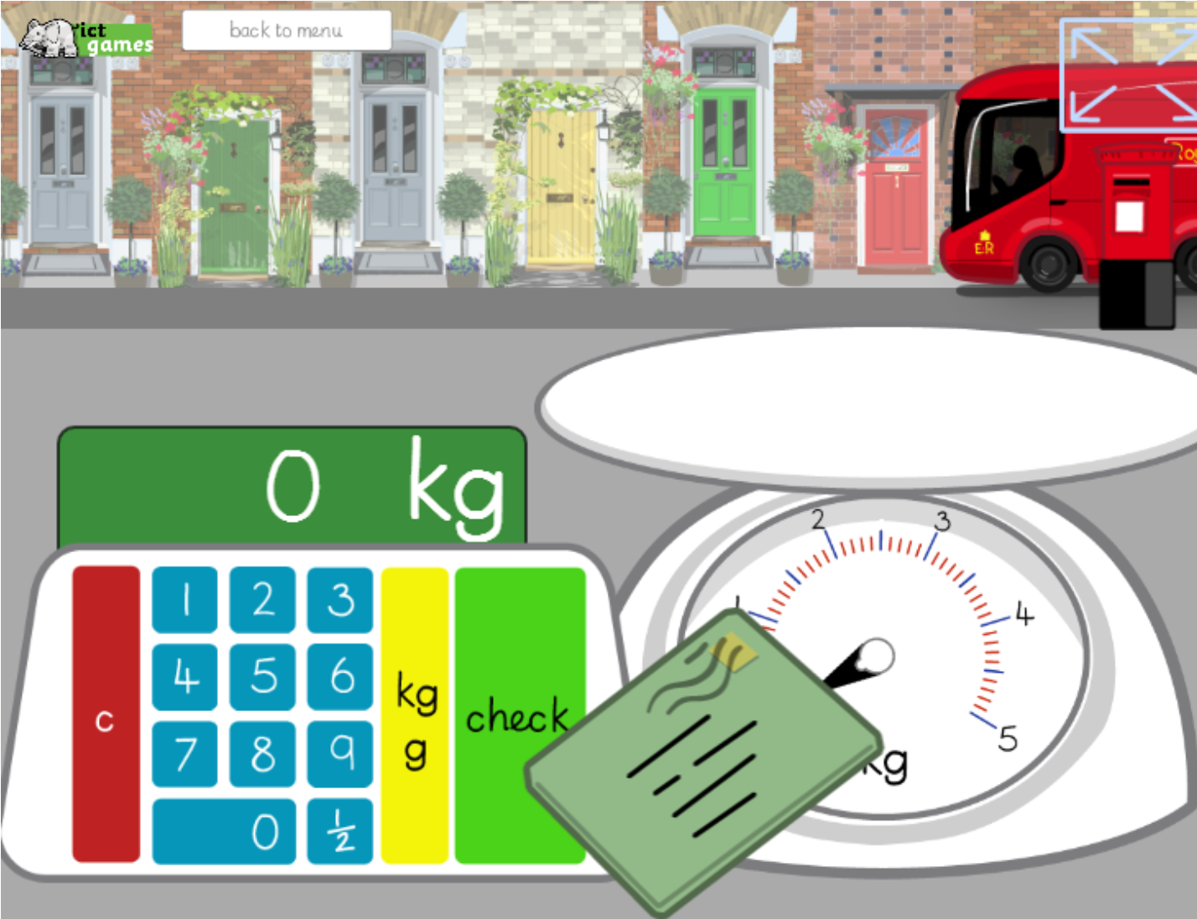
Math
I can relate a unit of measure to measure mass.
Step 1
Click the video to learn about temperature.
User: westminster1
Password: westie1
Step 2
Do the EASY or HARD quiz found under the video.
Step 3
Use the balance to find the weight.
Weigh the letters to find out the mass.

Slide 9
Daily Physical Activity
Choose one (or more) activities for your DPA.
GoNoodle
Fresh Start Fitness
Maximo
Calming Down
Mrs. McIntyre DPA

