Slide 1
BRAICO’s Class 1/2
Wednesday, April 29, 2020

Slide 2
Table of Contents
Morning Message
Word Work
Reading
Writing
Math
Daily Physical Activity

Slide 3
Morning Message
Hello Kiddos,
Happy Wednesday! I hope you were able to use your measuring skills around the house yesterday. Today we will be looking at the ‘gl’ consonant blend, we will continue with The Rabbit Listened to learn about theme or messages in stories, and we will be looking closer at measuring length or distances using cm, m, and km.
Happy Learning,
Mr. Braico

Slide 4
Word Work
I can apply a variety of strategies to help solve words.
Step 1
Click and watch the video.
Step 2
Read a book from home or on RAZ kids.
Find any ‘fl’ words in your book. Remember to put your lips together to get ready for the sounds using Lips the Fish.
Step 3
Share your words you found with a parent or share it with Mr. Braico in an email or on your ClassDojo portfolio.
dan.braico@lethsd.ab.ca

Slide 5
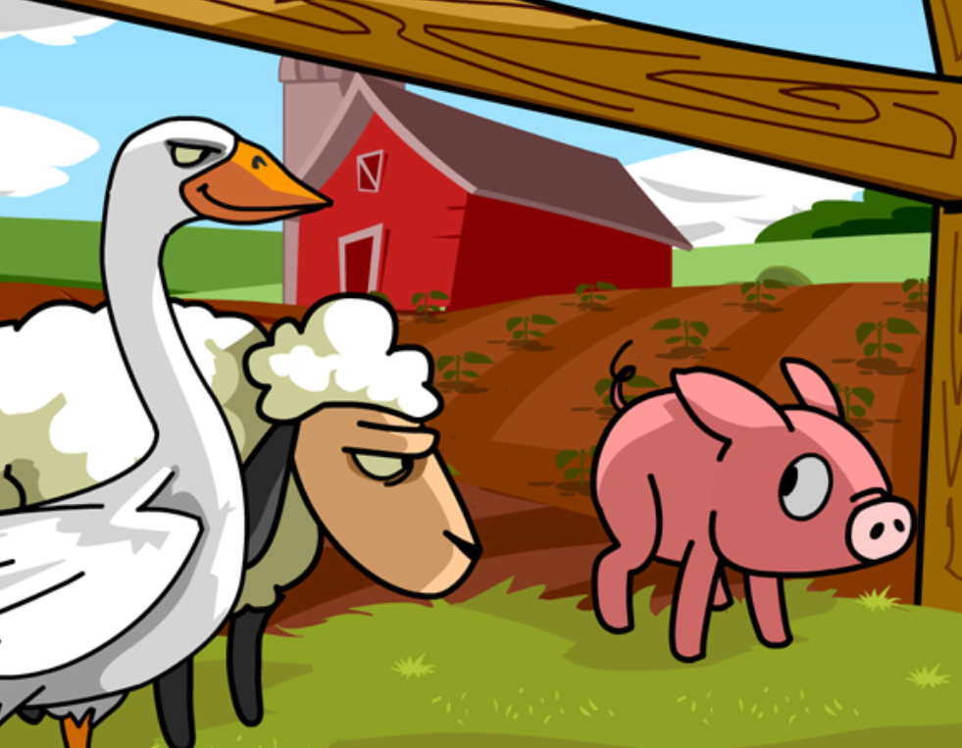
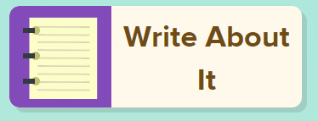
Reading
I can construct a meaning from stories I read.
Step 1
Click and watch the video on theme.
Step 2
Click and watch Mr. Braico reading The Rabbit Listened by Cori Doerrfeld. What do you think the them of the story is? What was the message the author was trying to give?
Step 3
Write your answers in BrainPop Jr.

Slide 6
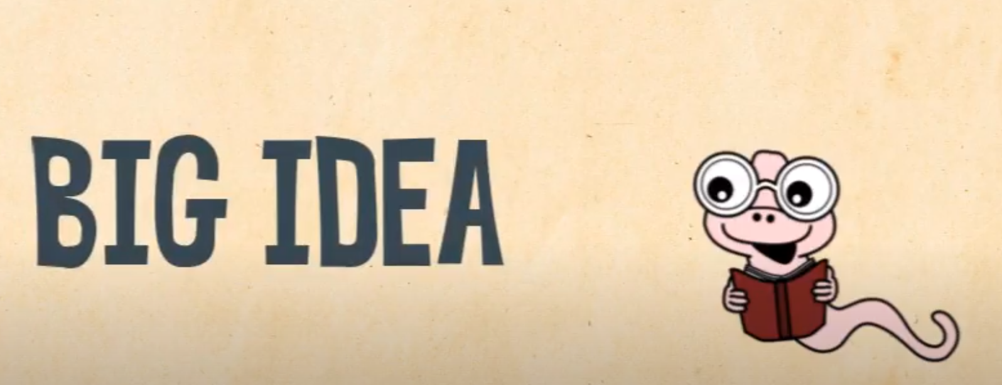
Writing
I can create narrative stories that have a meaning.
Step 1
Click the video to learn more about adding themes to writing.
Step 2
Today, when working on your story, think of a big idea you can add. What do you want your readers to learn from reading your story? What is the lesson you are trying to teach?
Step 3
Write in the “My Story” document and add a theme or a message for your readers to learn. Remember to save your work.

Slide 7
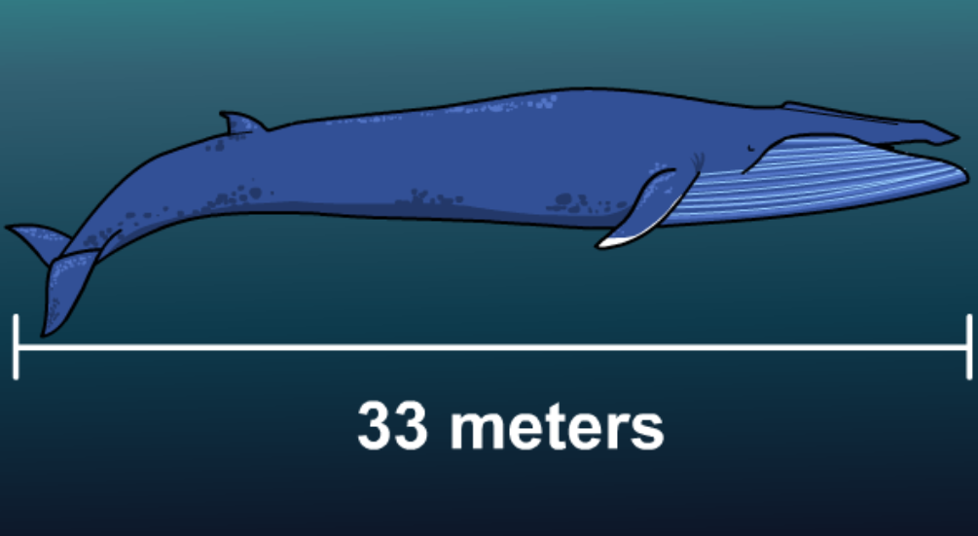
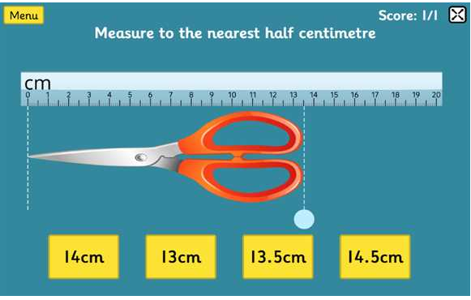
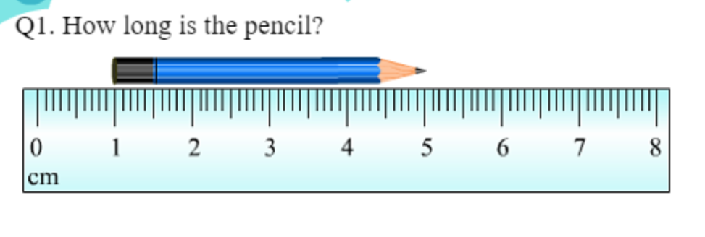
Math
I can relate a unit of measure to measure a length.
Step 1
Click the video to learn more about centimeters, meters, and kilometers.
User: westminster1
Password: westie1
Step 2
Do the EASY or HARD quiz found under the video.
Step 3
Use the ruler to measure in centimeters.
Measure the objects using a ruler.

Slide 8
Daily Physical Activity
Choose one (or more) activities for your DPA.
GoNoodle
Fresh Start Fitness
Maximo
Calming Down
Mrs. McIntyre DPA

