Slide 1
BRAICO’s Class 1/2
Thursday, April 30, 2020

Slide 2
Table of Contents
Morning Message
Word Work
Reading
Writing
Math
Daily Physical Activity

Slide 3
Morning Message
Hello Kiddos,
Happy Thursday! I am looking forward to reading and learning from the theme of your story. Today we will be looking at the ‘pl’ double consonant, we will read The Rabbit Listened and look at the usage of punctuation, and we will be measuring temperature.
Happy Learning,
Mr. Braico

Slide 4
Word Work
I can apply a variety of strategies to help solve words.
Step 1
Click and watch the video.
Step 2
Read a book from home or on RAZ kids.
Find any ‘pl’ words in your book. Remember to put your lips together to get ready for the sounds using Lips the Fish.
Step 3
Share your words you found with a parent or share it with Mr. Braico in an email or on your ClassDojo portfolio.
dan.braico@lethsd.ab.ca

Slide 5
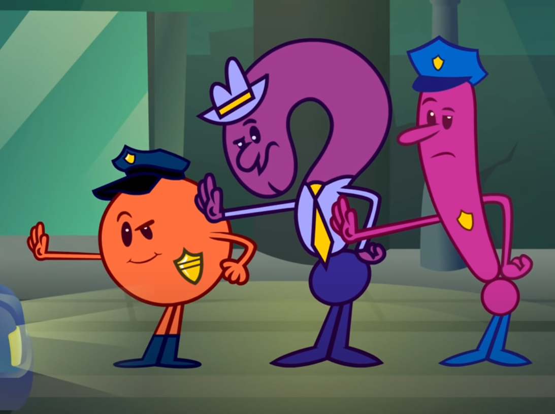
Reading
I can read stories with appropriate expression.
Step 1
Click and watch the video on punctuation.
Step 2
Click and watch Mr. Braico reading The Rabbit Listened. What were some of the punctuation marks you saw? How did Mr. Braico’s voice change?
Step 3
Punctuation helps tell readers how to read the book. When you are reading, try and change your expression to match the punctuation mark.

Slide 6
Writing
I can add punctuation to my narrative story.
Step 1
Click the video to learn more about adding themes to writing.
Step 2
Today, we will continue our fiction writing piece. I want you to add punctuation to your story. If it is just a fact, add a period. If it is exciting, add an exclamation! If it is a question, add a question mark?
Step 3
Write at least one period, exclamation and question mark in your “My Story” document to help make your readers know how they should read a sentence. Remember to save it.

Slide 7
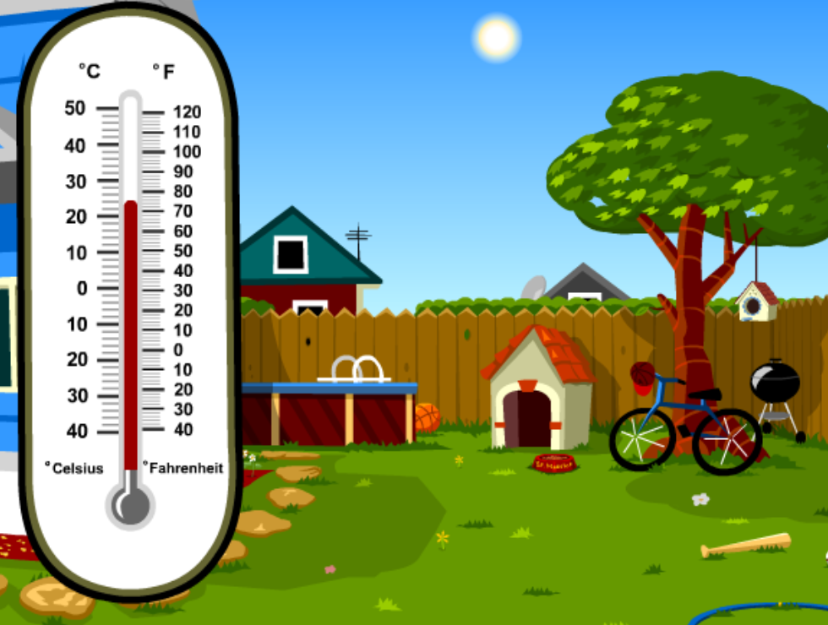
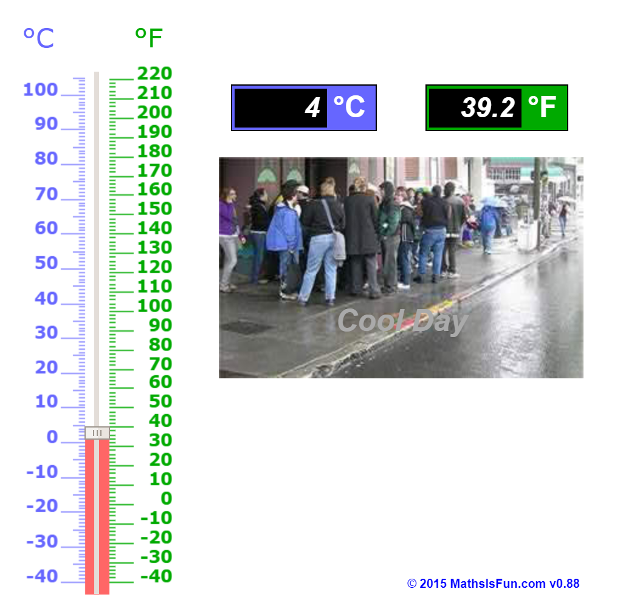
Math
I can relate a unit of measure to measure a temperature.
Step 1
Click the video to learn about temperature.
User: westminster1
Password: westie1
Step 2
Do the EASY or HARD quiz found under the video.
Step 3
Use the thermometer to see the different temperatures.
Choose the more reasonable temperature.

Slide 8
Daily Physical Activity
Choose one (or more) activities for your DPA.
GoNoodle
Fresh Start Fitness
Maximo
Calming Down
Mrs. McIntyre DPA

