Slide 1
BRAICO’s Class 1/2
Monday, April 27, 2020

Slide 2
Table of Contents
Morning Message
Word Work
Reading
Writing
Math
Daily Physical Activity

Slide 3
Morning Message
Hello Kiddos,
Happy Monday! I hope you had a terrific weekend and you are coming back refreshed and ready to learn. This week we will be looking at 2 consonant blends, we start with ‘bl’, we will read The Rabbit Listened and look at the usage of dialogue, and we will be learning about the tools we use for measurement.
Happy Learning,
Mr. Braico

Slide 4
Word Work
I can apply a variety of strategies to help solve words.
Step 1
Click and watch the video.
Step 2
Read a book from home or on RAZ kids.
Find any ‘bl’ words in your book. Remember to put your lips together to get ready for the sounds using Lips the Fish.
Step 3
Share your words you found with a parent or share it with Mr. Braico in an email or on your ClassDojo portfolio.
dan.braico@lethsd.ab.ca

Slide 5
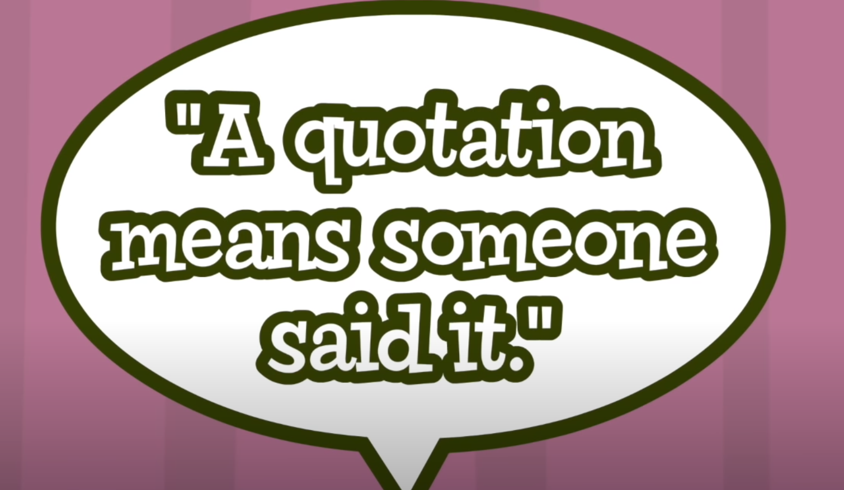
Reading
I can identify how elements can enhance stories.
Step 1
Click and watch the video about quotations.
Step 2
Click and watch Mr. Braico reading The Rabbit Listened by Cori Doerrfeld.
Step 3
When reading dialogue, you will see quotation marks (“ “). This means someone is talking. When reading today, try to change your voice when you see quotations.

Slide 6
Writing
I can create particular effects in narrative stories.
Step 1
Click the video to learn about writing dialogue in stories.
Step 2
Today, we will continue with our “My Story”. I want you to try adding some dialogue to it. Have your characters have a conversation by adding quotation marks and a speaker tag.
For example, “Try this out today.” Mr. Braico said.
Step 3
Open the “My Story” document and add some dialogue.

Slide 7
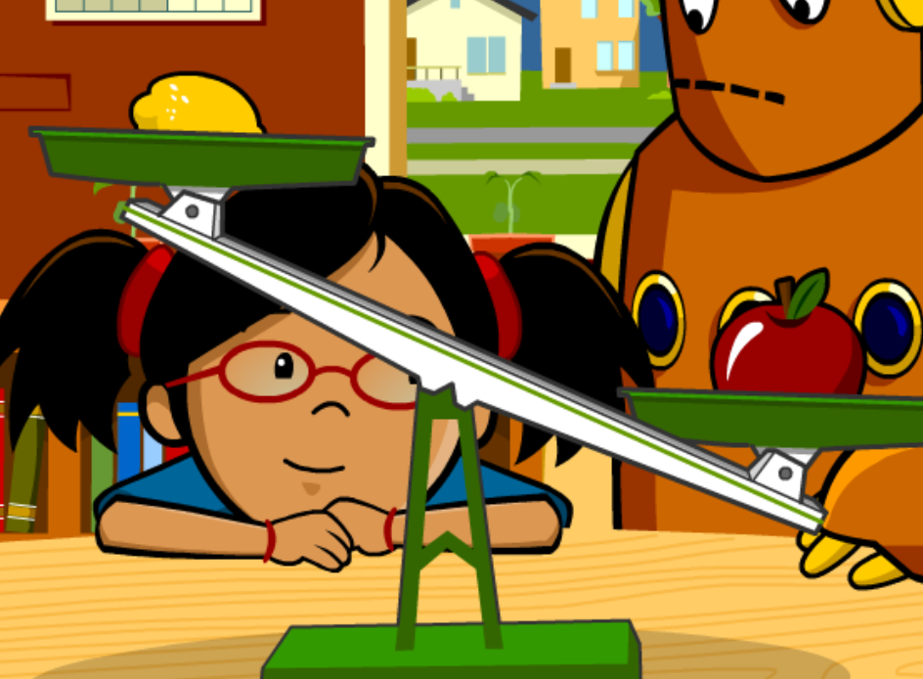
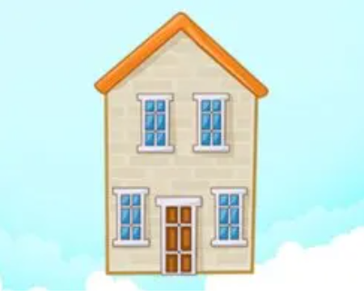
Math
I can relate a unit of measure to measure a length or mass.
Step 1
Click the video to learn more about measurement tools.
User: westminster1
Password: westie1
Step 2
Do the EASY or HARD quiz found under the video.
Step 3
Estimate Length – Metric Units
Click Sign In → Class → JUMJUU → find name
Password: 1234
Read the story and take the quiz about tools of measurement.

Slide 8
Daily Physical Activity
Choose one (or more) activities for your DPA.
GoNoodle
Fresh Start Fitness
Maximo
Calming Down
Mrs. McIntyre DPA

