Slide 1
Braico’s Class1/2
Friday, April 24, 2020

Slide 2
Table of Contents
Morning Message
Word Work
Reading
Writing
Math
Daily Physical Activity

Slide 3
Morning Message
Hello Kiddos,
Happy Friday! I hope you were able to add some events into your writing yesterday. Today we will be looking at the ‘ur’ controlled vowel, we will read Tops and Bottoms and use it to help write a good beginning of a story, and we will be learning about 3D objects.
Happy Learning,
Mr. Braico

Slide 4
Word Work
I can apply a variety of strategies to help solve words.
Step 1
Click and watch the video.
Step 2
Read a book from home or on RAZ kids.
Find any ‘ur’ words in your book. Remember you can break down words using Chunky Monkey.
Step 3
Share your what words you found with a parent or share it with Mr. Braico in an email or on your ClassDojo portfolio.
dan.braico@lethsd.ab.ca

Slide 5
Reading
I can tell or represent the beginnings of stories.
Step 1
Click and watch the video on events.
Step 2
Click and watch Mr. Braico reading Tops and Bottoms. Think of the beginning of the story.
Step 3
Reading a beginning of a story gets you ready for the rest of the book. It helps introduce you to the characters and the setting of the story. What happened in the beginning of Tops and Bottoms?
Write your answers in BrainPop Jr.

Slide 6
Writing
I can create a beginning of a narrative story.
Step 1
Click the video to learn more about writing a setting.
Step 2
Today, we will be making the beginning of our story meaningful. Look back at your writing. Did you make sure to introduce your characters? Did you describe the setting? Can you capture your reader’s attention with a big event?
Step 3
Open the “My Story” document. Make sure you introduce your characters and the setting. Add a strong and interesting start to the beginning of your story. Remember to save your work.

Slide 7
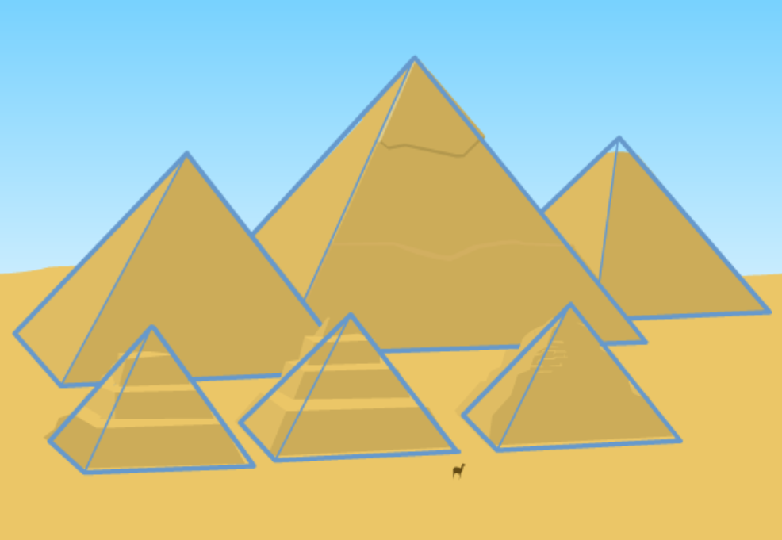
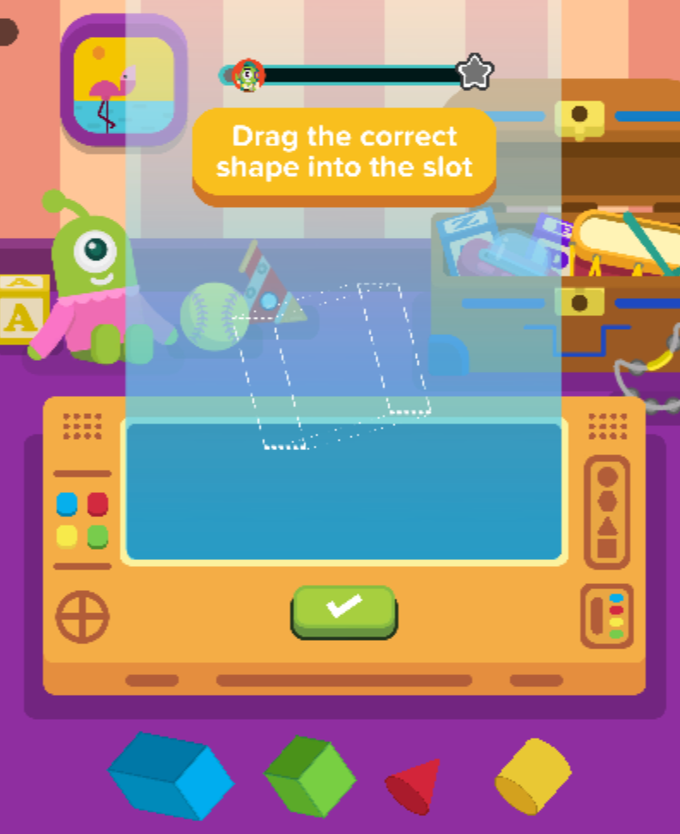
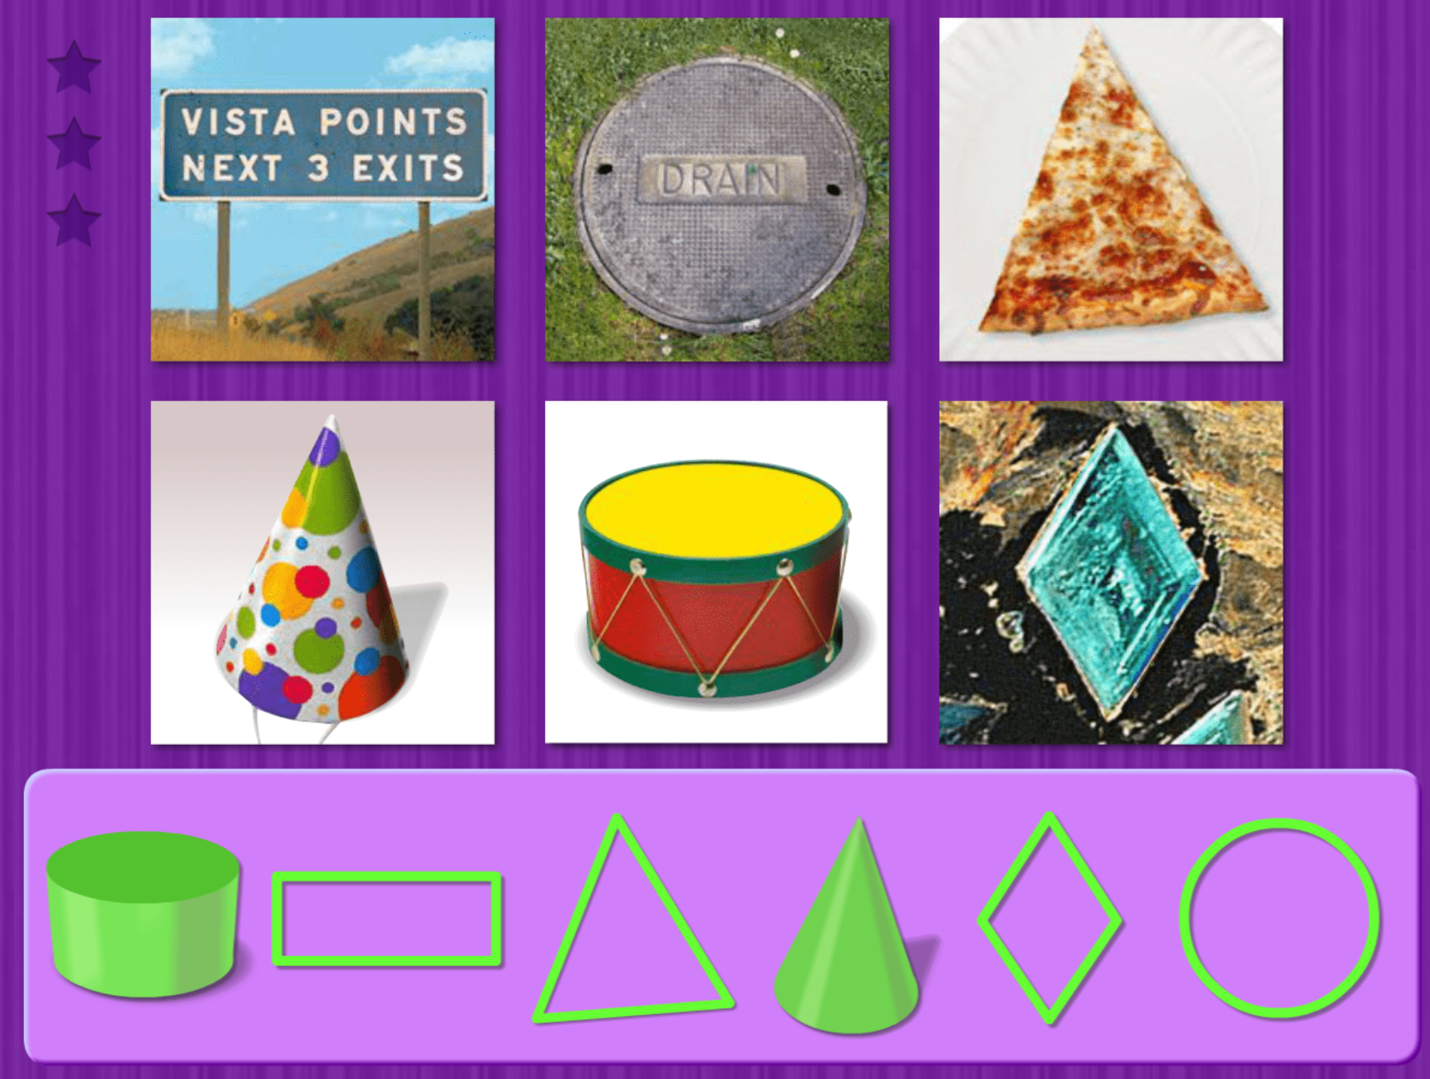
Math
I can identify and sort 2D shapes based on attributes.
Step 1
Click the video to learn more about 2D Shapes.
User: westminster1
Password: westie1
Step 2
Do the EASY or HARD quiz found under the video.
Step 3
Slide the correct shapes to make the object.
Match the shapes to the real – world objects.

Slide 8
Daily Physical Activity
Choose one (or more) activities for your DPA.
GoNoodle
Fresh Start Fitness
Maximo
Calming Down
Mrs. McIntyre DPA

