Slide 1
Braico’s Class1/2
Thursday, April 23, 2020

Slide 2
Table of Contents
Morning Message
Word Work
Reading
Writing
Math
Daily Physical Activity

Slide 3
Morning Message
Hello Kiddos,
Happy Thursday! I am excited to read about how your characters got past the problems in your stories. Today we will be looking at the ‘or’ controlled vowel, we will read Tops and Bottoms and look at the events that happen in a story, and we will be comparing similarities of 2D shapes.
Happy Learning,
Mr. Braico

Slide 4
Word Work
I can apply a variety of strategies to help solve words.
Step 1
Click and watch the video.
Step 2
Read a book from home or on RAZ kids.
Find any ‘er’ words in your book. Remember you can break down words using Chunky Monkey.
Step 3
Share your what words you found with a parent or share it with Mr. Braico in an email or on your ClassDojo portfolio.
dan.braico@lethsd.ab.ca

Slide 5
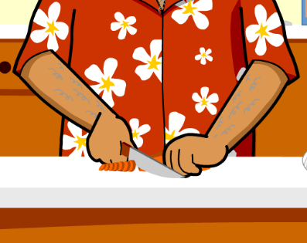
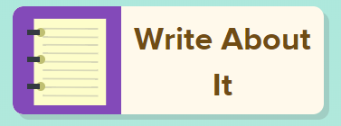
Reading
I can identify the sequence of a story.
Step 1
Click and watch the video on events.
Step 2
Click and watch Mr. Braico reading Tops and Bottoms. What events do you remember from the story? Think of 3.
Step 3
Retelling the events of a story can help you better understand what you read. What happened first? Then what happened? Finally, what was the last thing that happened?
Write your answers in BrainPop Jr.

Slide 6
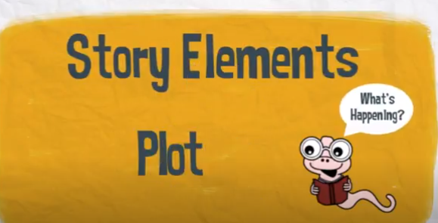
Writing
I can create narrative stories where main characters perform actions.
Step 1
Click the video to learn more about writing a setting.
Step 2
Today, we will continue our fiction writing piece. I want you to think of 3 things that can happen to your character. What happens first, next, last?
Step 3
Write in the “My Story” document and add 3 events that will happen to your character. Remember to save it.

Slide 7
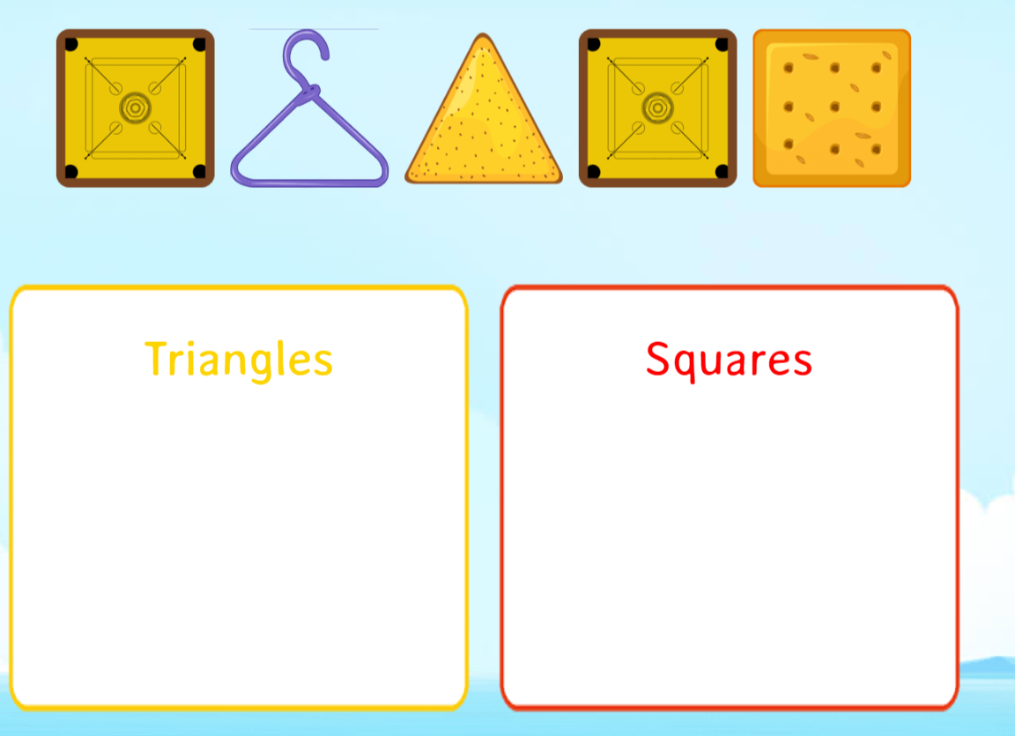
Math
I can identify and sort 2D shapes based on attributes.
Step 1
Click the video to learn more about 2D Shapes.
User: westminster1
Password: westie1
Step 2
Do the EASY or HARD quiz found under the video.
Step 3
Sort the Two Dimensional shapes in KG.
Click Sign In → Class → JUMJUU → find name → Password: 1234
Are the shapes similar or congruent? Take the quiz

Slide 8
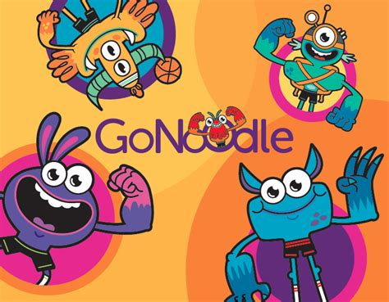
Daily Physical Activity
Choose one (or more) activities for your DPA.
GoNoodle
Fresh Start Fitness
Maximo
Calming Down
Mrs. McIntyre DPA

