Slide 1
BRAICO’s Class 1/2
Tuesday, April 21, 2020

Slide 2
Table of Contents
Morning Message
Word Work
Reading
Writing
Math
Daily Physical Activity

Slide 3
Morning Message
Hello Kiddos,
Happy Tuesday! I look forward to reading about your characters. Let’s do our best writing… using a computer. Today we will be looking at the ‘er’ controlled vowel, we will read Tops and Bottoms and look at the setting of a story, and we will learning more about 2D shapes.
Happy Learning,
Mr. Braico

Slide 4
Word Work
I can apply a variety of strategies to help solve words.
Step 1
Click and watch the video.
Step 2
Read a book from home or on RAZ kids.
Find any ‘er’ words in your book. Remember you can break down words using Chunky Monkey.
Step 3
Share your what words you found with a parent or share it with Mr. Braico in an email or on your ClassDojo portfolio.
dan.braico@lethsd.ab.ca

Slide 5
Reading
I can identify places and events in stories.
Step 1
Click and watch the video on setting.
Step 2
Click and watch Mr. Braico reading Tops and Bottoms. Think about the setting. Where is the story taking place?
Step 3
Understanding where and when the story takes place can help you remember important parts of the story. Where does the story take place? When does this story take place?
Write your answers in BrainPop Jr.

Slide 6
Writing
I can create narrative stories with a setting.
Step 1
Click the video to learn more about writing a setting.
Step 2
Today, we will continue our fiction writing piece. I want you to come up with a setting. Where is the story taking place? When is the story taking place? Answer these questions about your setting.
Step 3
Write about your setting in your “My Story” Word document you started last time. Please remember to save your work.

Slide 7
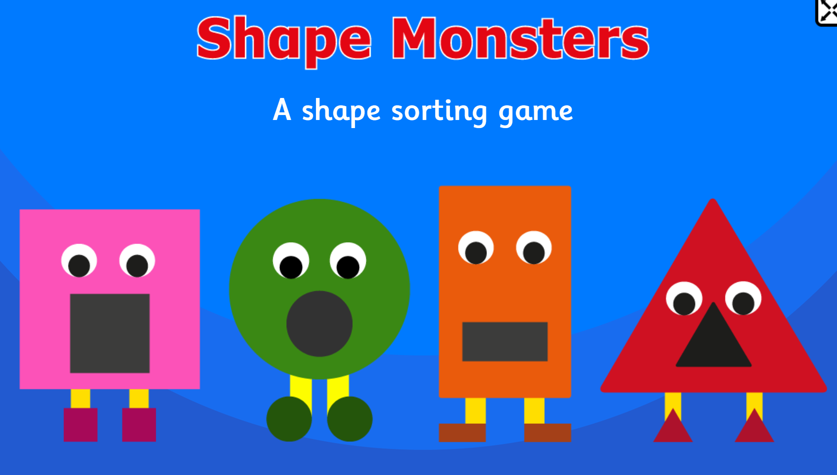
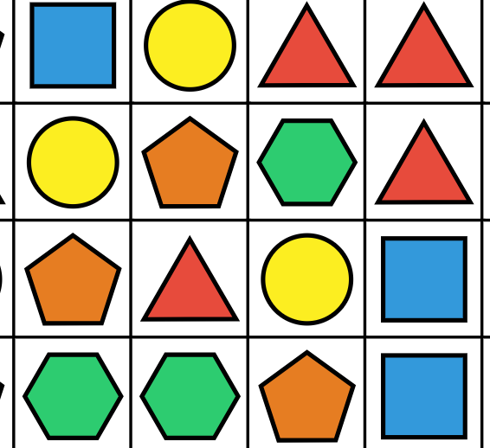
Math
I can identify and sort 2D shapes based on attributes.
Step 1
Click the video to learn more about 2D Shapes.
User: westminster1
Password: westie1
Step 2
Do the EASY or HARD quiz found under the video.
Step 3
Choose the shape that matches the monster.
Match three of the same shapes in a row.

Slide 8
Daily Physical Activity
Choose one (or more) activities for your DPA.
GoNoodle
Fresh Start Fitness
Maximo
Calming Down
Mrs. McIntyre DPA

