Slide 1
BRAICO’s Class 1/2
Monday, April 20, 2020

Slide 2
Table of contents
Morning Message
Reading
Writing
Math
Daily Physical Activity
Word Work

Slide 3
Morning message
Hello Kiddos,
Happy Monday! I hope you had an amazing break and great “vacation”. Let’s get back to learning! This week we will be looking at ‘r’ controlled vowels, we start with ‘ar’, we will read Tops and Bottoms and look at story elements, today is a focus on characters, and we will be looking back at patterns.
Happy Learning,
Mr. Braico

Slide 4
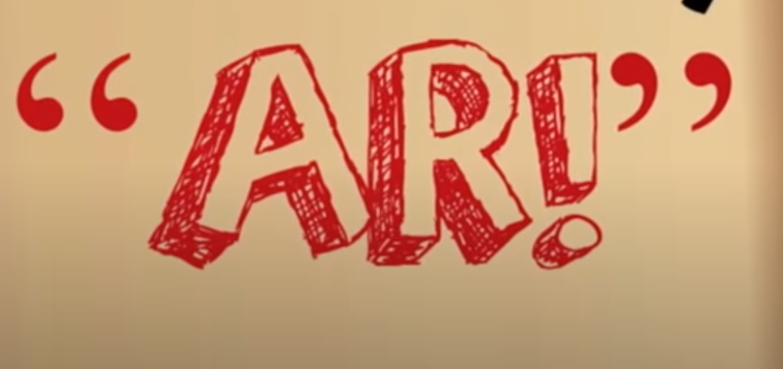
Word work
Step 1
Click and watch the video.
Step 2
Read a book from home or on RAZ kids.
Find any ‘ar’ words in your book. Remember you can break down words using Chunky Monkey.
Step 3
Share your what words you found with a parent or share it with Mr. Braico in an email or on your ClassDojo portfolio.
dan.braico@lethsd.ab.ca
I can apply a variety of strategies to help solve words.

Slide 5
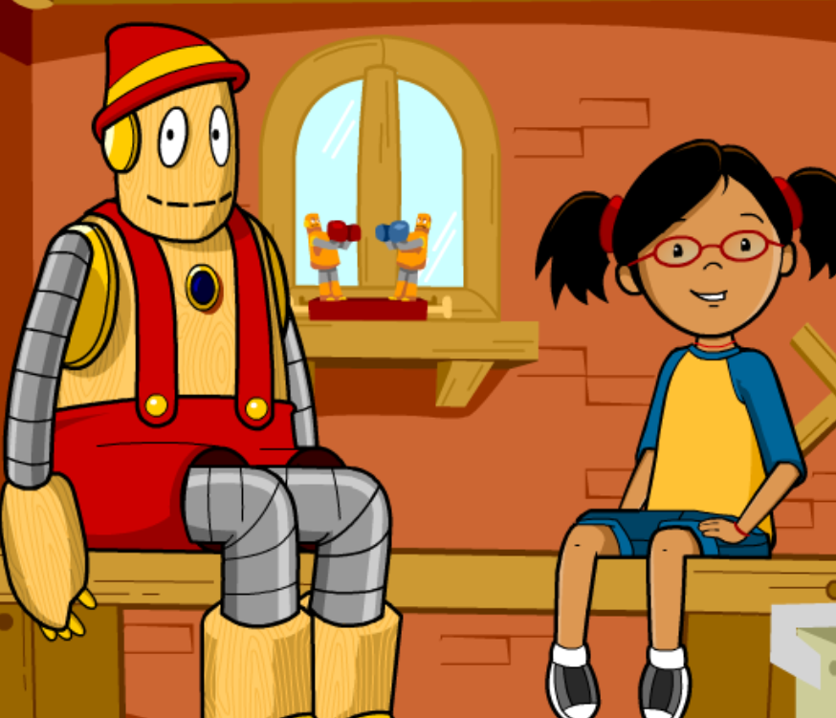
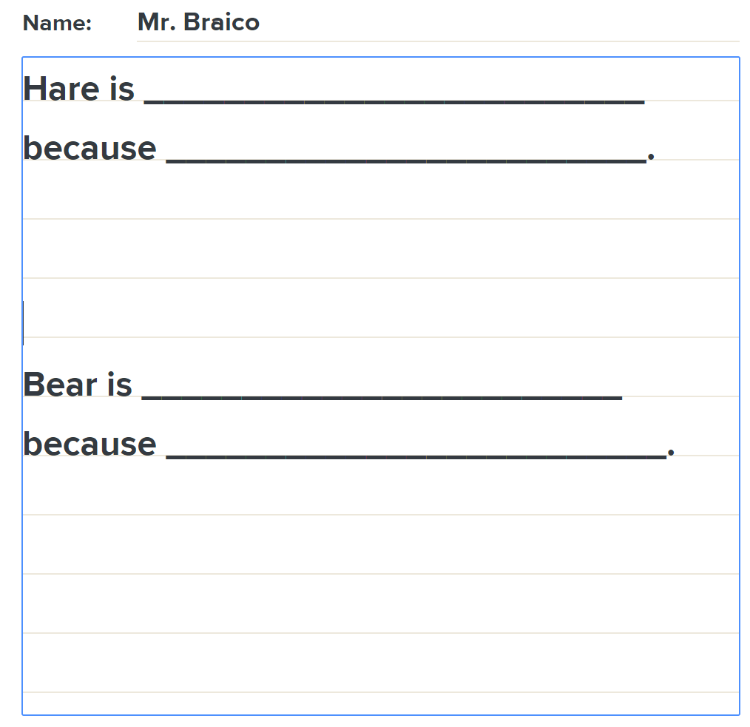
Reading
Step 1
Click and watch the video on characters.
User: westminster1
Password: westie1
Step 2
Click and watch Mr. Braico reading Tops and Bottoms by Janet Stevens.
Step 3
You can learn a lot about a character by the way they act and the things they say. What do you know about Hare and Bear? Write a few sentences about them in BrainPop Jr.
I can identify main characters and their traits.

Slide 6
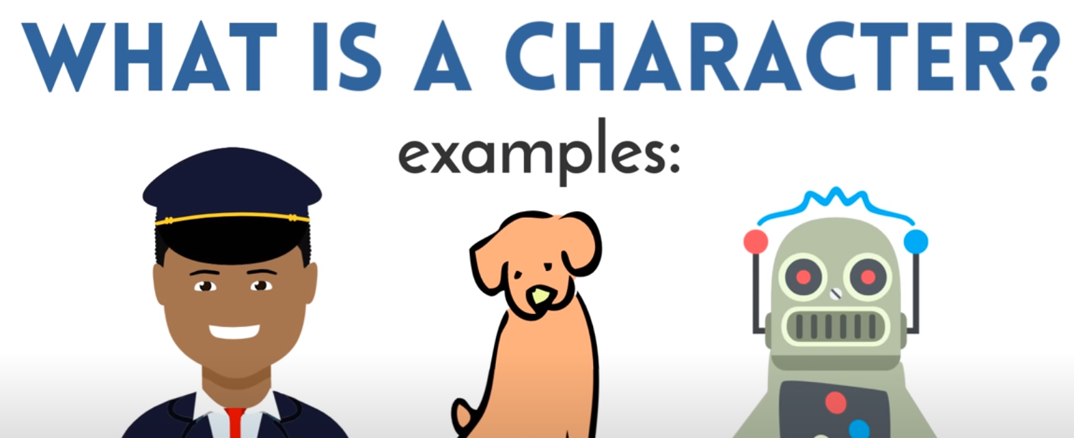
Writing
Step 1
Click the video to learn more about writing characters.
Step 2
Today, we will be starting a fiction writing piece. I want you to come up with at least one character to write about. Who is this person? What do they look like? What do they sound like? What do they do? What do they like?
Step 3
Start a Word document titled “My Story” and answer the questions from step 2 to create a character in your writing.
I can create narrative stories with characters.

Slide 7
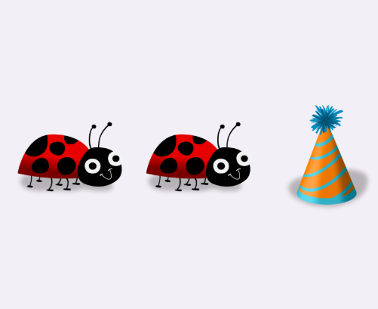
Math
Step 1
Click the video to learn more about patterns.
User: westminster1
Password: westie1
Step 2
Do the EASY or HARD quiz found under the video.
Step 3
Head to the links for practice.
Answer the pattern questions by clicking the correct answers.
Place the correct shape to complete the bridge.
I can demonstrate my understanding of repeating patterns.

Slide 8
DAILY PHYSICAL ACTIVITY
Choose one (or more) activities for your DPA.
GoNoodle
Fresh Start Fitness
Maximo
Calming Down
Mrs. McIntyre DPA

