Slide 1
SPRING BREAK
Ready to go on a holiday?

Slide 2
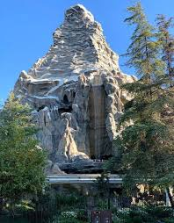
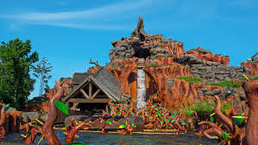
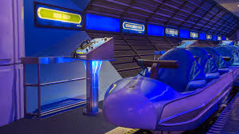
Day # 1 – Disneyland
We are going to the “Happiest Place on Earth”. DISNEYLAND! Click on the pictures to ride on one of the rollercoasters.
Splash Mountain
Space Mountain
Matterhorn

Slide 3
Day # 1
My Travel Log
Write about your favourite ride. What was your favourite ride and why?
Disneyland

Slide 4
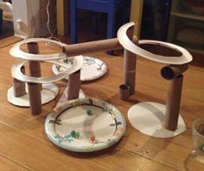
Day # 1
My Play Log
Build your own rollercoaster using items you can find around your house.
Go for a ride on a rollercoaster with KooKooKangaroo! Pretend you are on a rollercoaster.
Disneyland

Slide 5
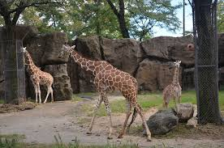
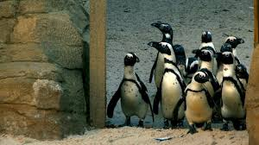
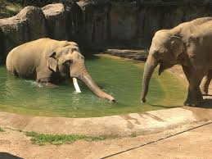
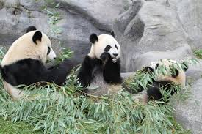
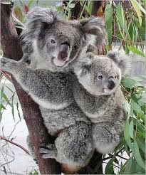
Day # 2 – San Diego Zoo
Welcome to the San Diego Zoo. Let’s take a look at some of the animals. Click the picture to check out the animals.
Giraffes
Penguins
Elephants
Pandas
Koalas

Slide 6
Day # 2
My Travel Log
Write about your favourite animal you saw. Why did you like that animal so much?
San Diego Zoo

Slide 7
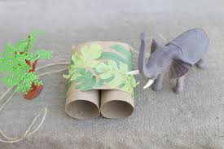
Day # 2
My Play Log
Build some binoculars using toilet paper rolls.
If you have stuffed animals, set them up around the house and go on a safari walk with your binoculars.
If you don’t have stuffed animals, head on outside and take a nature walk and see if you can find some animals.
San Diego Zoo

Slide 8
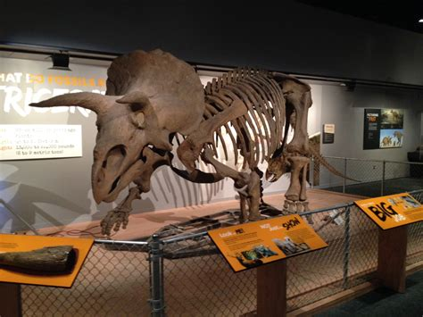
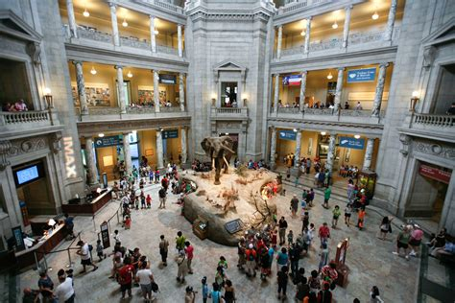
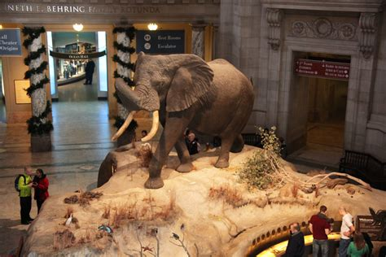
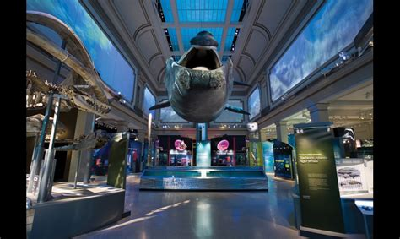
Day # 3 – Smithsonian Museum
Today we are going to visit the Smithsonian Museum. It has animals, dinosaurs, and ancient artifacts. Let’s take a visit by clicking the picture..
Dinosaur Exhibit
Explore the Museum
Ocean Exhibit
Animal Exhibit

Slide 9
Day # 3
My Travel Log
Write about your favourite exhibit. Which one did you like the best and why? What else did you see?
Smithsonian Museum

Slide 10
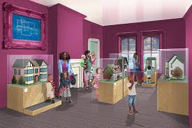
Day # 3
My Play Log
Grab some items around your house (ex. toys, books, pillows, plates, bowls, pictures) and make your own museum for your family.
Pretend to be a tour guide and tell your family all about the interesting “artifacts” at your museum.
Smithsonian Museum

Slide 11
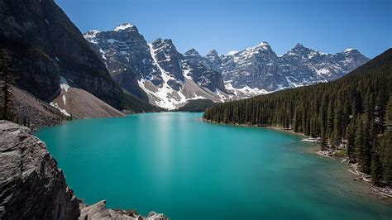
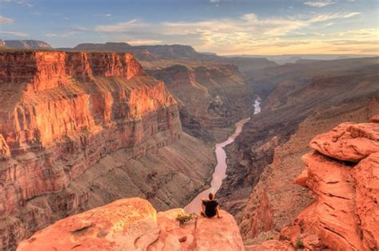
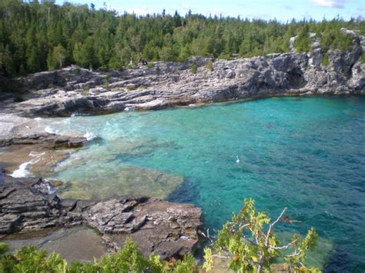
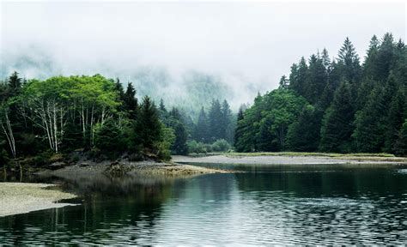
Day # 4 – National Parks
If we can’t go outdoors, we will bring the outdoors to you. Here are some national parks you might like to visit. Click the picture to head on over.
Banff National Park, Alberta
US National Parks
Bruce Peninsula National Park, Ontario
Pacific Rim National Park, BC

Slide 12
Day # 4
My Travel Log
Write about which National Park was your favourite. Which National Park was your favourite and why? What did you see?
National Parks

Slide 13
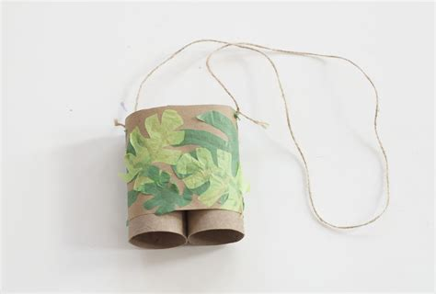
Day # 4
My Play Log
Grab your toilet paper roll binoculars. Go for a nature walk. Write about what you saw, heard, and smelt.
National Parks

