Slide 1
BRAICO’s Class 1/2
Wednesday, April 8, 2020

Slide 2
Table of contents
Morning Message
Reading
Writing
Math
Daily Physical Activity

Slide 3
Morning message
Hello Kiddos,
Happy Wednesday! Today we will be looking at the ‘ch’ digraph, we are making butterfly life cycles, and practicing addition and subtraction with fact families.
Happy Learning,
Mr. Braico

Slide 4
Reading
Step 1
Click and watch the video.
Step 2
Read a book from home or on RAZ kids.
Find any ‘ch’ words in your book. Remember to stretch each sound like Stretchy Snake.
Step 3
Share your what words you found with a parent or share it with Mr. Braico in an email or on your ClassDojo portfolio.
dan.braico@lethsd.ab.ca
I can apply a variety of strategies to help solve words.

Slide 5
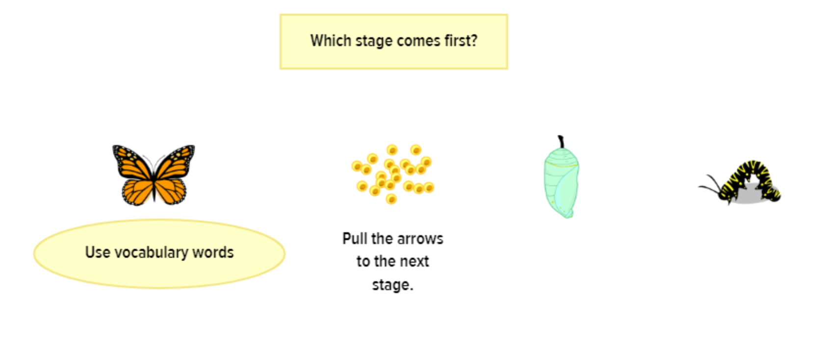
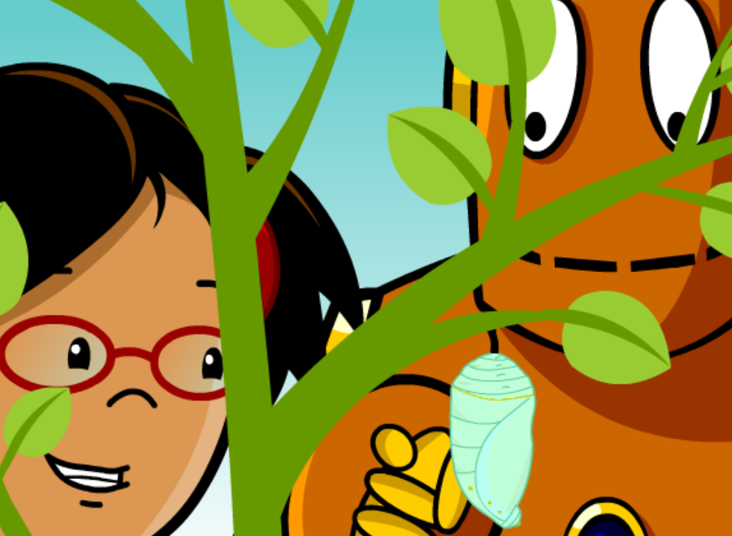
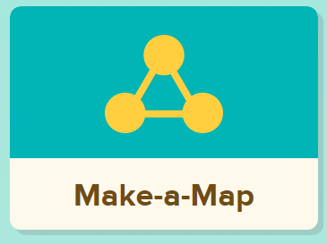
Writing
Step 1
Click and watch Mr. Braico reading the book.
Focus from 1:01 to 4:17 or listen to the whole thing.
Step 2
Watch the video about butterflies.
Step 3
Click Make a Map under the video to make a life cycle of a butterfly.
Click Images and Key Words to add information to your life cycle.
I can record ideas and information in ways that make sense.

Slide 6
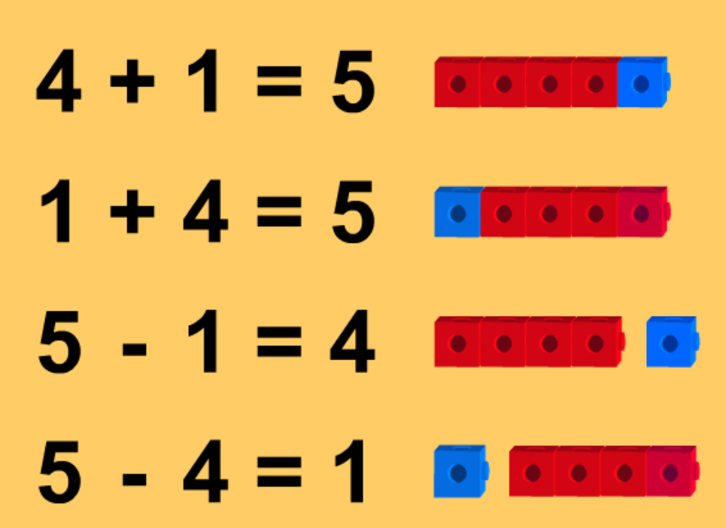
Math
Step 1
Click the video to learn more about addition and subtraction fact families.
User: westminster1
Password: westie1
Step 2
Do the EASY or HARD quiz found under the video.
Step 3
Head to the link.
Choose addition and subtraction. Choose 3 numbers that are in the fact family to get rid of the blocks. For example, 3, 2, and 5.
I can show my understanding of adding and subtracting numbers.

Slide 7
DAILY PHYSICAL ACTIVITY
Choose one (or more) activities for your DPA.
GoNoodle
Fresh Start Fitness
Maximo
Calming Down
Mrs. McIntyre DPA

