Slide 1
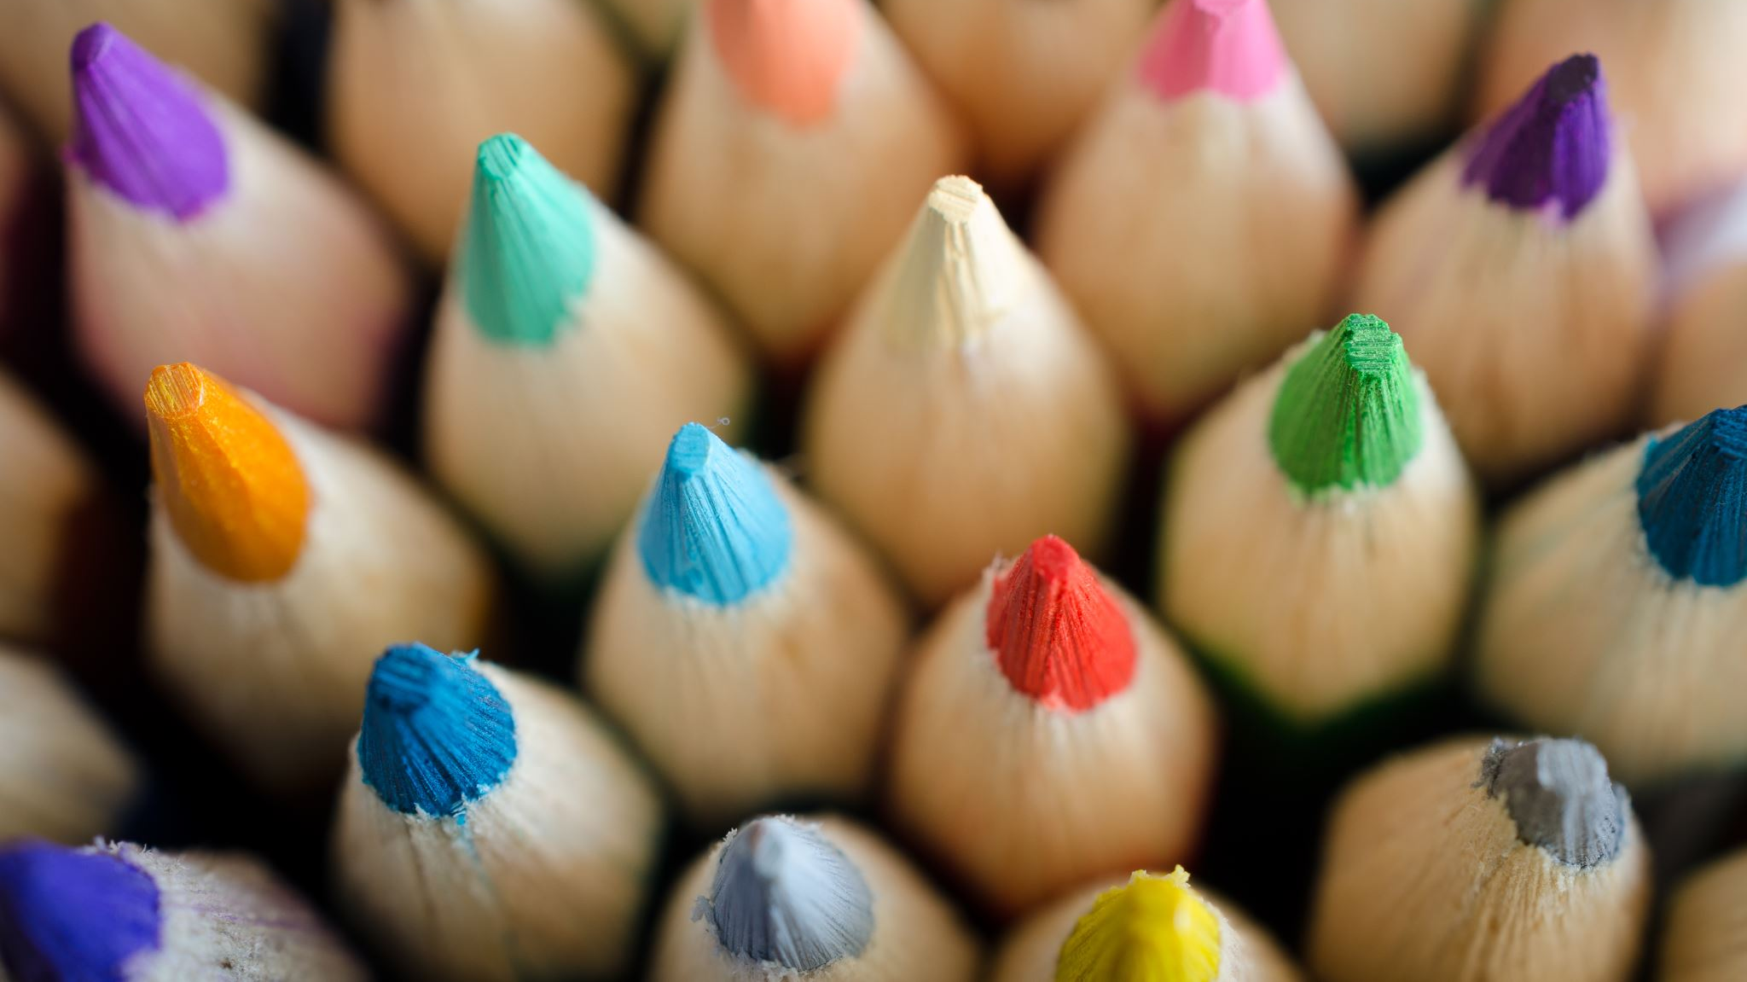
BRAICO’s Class 1/2
Tuesday, March 31, 2020

Slide 2
Table of contents
Morning Message
Reading
Writing
Math
Daily Physical Activity

Slide 3
Morning message
Hello Kiddos,
Happy Tuesday. How did yesterday go? I hope you enjoyed the different activities.
Today we will try words 2-Ways in reading, write about what happened in March, and using the Make 10 strategy in math.
Happy Learning,
Mr. Braico

Slide 4
Reading
I can apply a variety of strategies to help solve words.
Step 1
Click and watch the video below
Step 2
Read a book from home or on RAZ kids.
Find any long A sounds in your book. Remember to try reading words 2-ways using Flippy Dolphin.
Step 3
Share your what words you found with a parent or share it with Mr. Braico on your ClassDojo portfolio or in an email.
dan.braico@lethsd.ab.ca

Slide 5
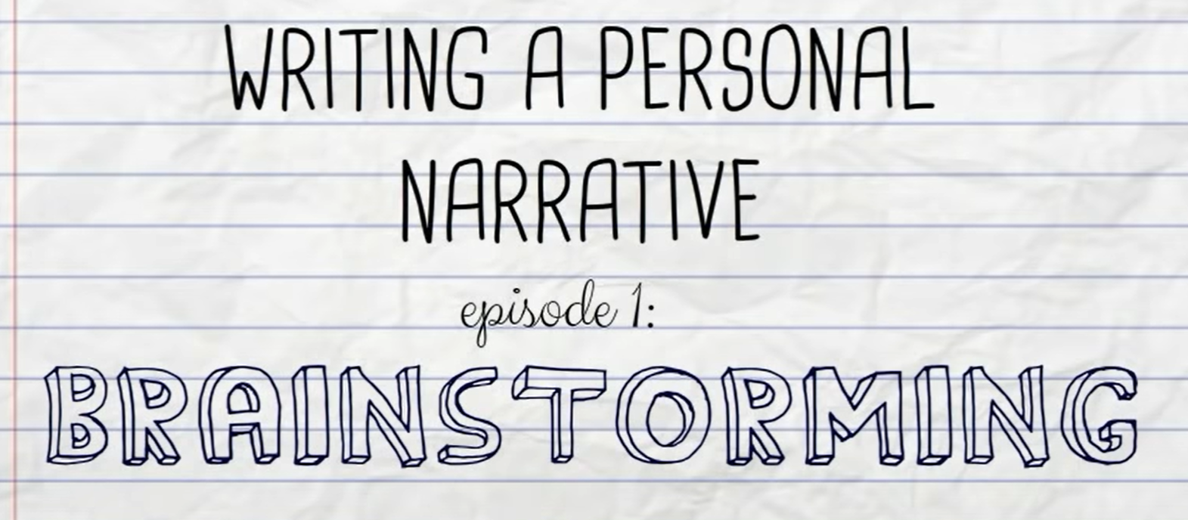
Writing
I can retell important or interesting aspects of my own experiences.
Step 1
Click and watch the video below.
Step 2
Think about what you remember from the month of MARCH.
Decide what you want to write about.
Start your first sentence with: In March, I remember...
Step 3
Click the link.
Write your response.

Slide 6
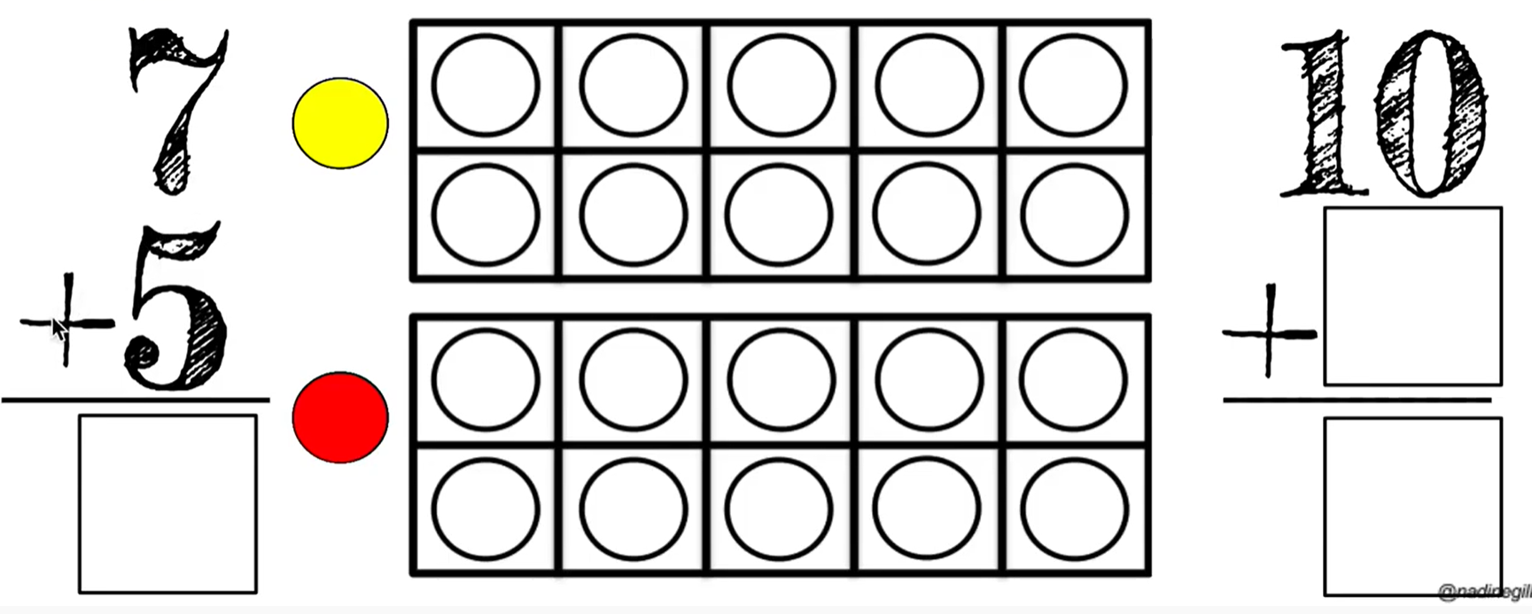
Math
I can show my understanding of adding numbers.
Step 1
Watch the Video to learn how to make 10.
Step 2
Watch the Video to learn the Make 10 strategy.
Step 3
Click the links.
Use the Make 10 Strategy to help solve the answers.
Make 10 Game
How Many More to Make 10
Ten Frame Mania
Tools to Use
Rekenreks
Double 10 Frame

Slide 7
DAILY PHYSICAL ACTIVITY
Choose one (or more) activities for your DPA.
GoNoodle
Fresh Start Fitness
Maximo
Calming Down

