Slide 1
BRAICO’s Class 1/2
Wednesday, April 1, 2020

Slide 2
Table of contents
Morning Message
Reading
Writing
Math
Daily Physical Activity

Slide 3
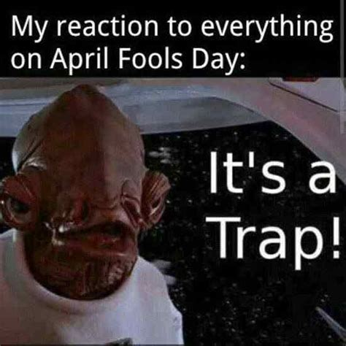
Morning message
Hello Kiddos,
Happy Wednesday. Hope we were able to see most of the links yesterday. It was nice to see some of you!
Today we will try words 2-Ways in reading looking at long E sounds, Mrs. Biesbroek reads us a book, and we will practice using the doubles addition strategy.
Happy Learning,
Mr. Braico

Slide 4
Reading
I can apply a variety of strategies to help solve words.
Step 1
Click and watch the video below.
Step 2
Read a book from home or on RAZ kids.
Find any long E sounds in your book. Remember to try reading words 2-ways using Flippy Dolphin.
Step 3
Share your what words you found with a parent or share it with Mr. Braico in an email or on your ClassDojo portfolio.
dan.braico@lethsd.ab.ca

Slide 5
Writing
I can express thoughts related to the events and characters in the book..
Step 1
Click and watch Mrs. Biesbroek reading the book:
Step 2
Inference - Readers use the clues in the story to help them understand what is happening.
Write about “Why do you think Grandpa keeps ignoring the grandkids?”
Step 3
Click the link.
Write your response.

Slide 6
Math
I can show my understanding of adding numbers.
Step 1
Click the video to learn about doubles facts.
User: westminster1
Password: westie1
Step 2
Do the EASY or HARD quiz found under the video.
Step 3
Head to the link.
Click doubles and then choose a difficulty.

Slide 7
DAILY PHYSICAL ACTIVITY
Choose one (or more) activities for your DPA.
GoNoodle
Fresh Start Fitness
Maximo
Calming Down
Mrs. McIntyre DPA

