Slide 1
BRAICO’s Class 1/2
Friday, April 3, 2020

Slide 2
Table of contents
Morning Message
Reading
Writing
Math
Daily Physical Activity

Slide 3
Morning message
Hello Kiddos,
Happy Friday. This is it! Our first week of online learning.
Today we will try words 2-Ways in reading looking at long O sounds, we are doing some research in writing from yesterday’s story, and we will practice all our strategies in addition.
Happy Learning,
Mr. Braico

Slide 4
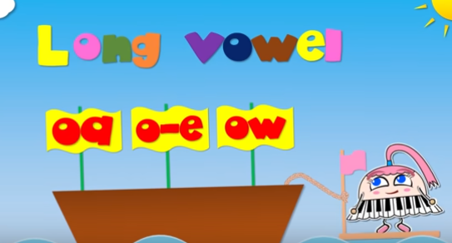
Reading
I can apply a variety of strategies to help solve words.
Step 1
Click and watch the video below.
Step 2
Read a book from home or on RAZ kids.
Find any long O sounds in your book. Remember to try reading words 2-ways using Flippy Dolphin.
Step 3
Share your what words you found with a parent or share it with Mr. Braico in an email or on your ClassDojo portfolio.
dan.braico@lethsd.ab.ca

Slide 5
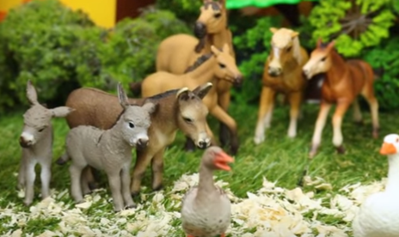
Writing
I can use text features to get information.
Step 1
Click and watch Mrs. Biesbroek reading the book:
Step 2
Watch this video to 2:33.
Think of the animal products farm animals provide from the book.
Step 3
Click the link.
Write your response. What products come from cows, chickens, pigs, goats, and sheep.

Slide 6
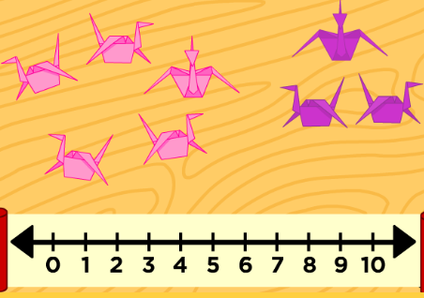
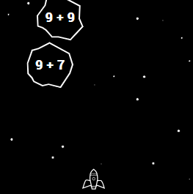
Math
I can show my understanding of adding numbers.
Step 1
Click the video to learn more about basic addition.
User: westminster1
Password: westie1
Step 2
Do the EASY or HARD quiz found under the video.
Step 3
Head to the link.
Click START and use the arrows and numbers to answer the problems to shoot the asteroids.

Slide 7
DAILY PHYSICAL ACTIVITY
Choose one (or more) activities for your DPA.
GoNoodle
Fresh Start Fitness
Maximo
Calming Down
Mrs. McIntyre DPA

