Slide 1
BRAICO’s Class 1/2
Monday, March 30, 2020

Slide 2
Table of contents
Morning Message
Reading
Writing
Math
Daily Physical Activity

Slide 3
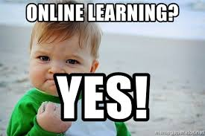
Morning message
Hello Kiddos,
Happy Monday. Today is our first day of online learning. Are you excited?
We will work on asking questions in reading, having an opinion in writing and adding in math today.
Happy Learning,
Mr. Braico

Slide 4
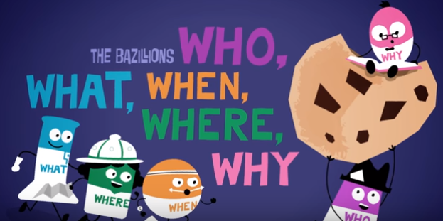
Reading
I can identify important elements of a story.
Step 1
Click and watch the video below
Step 2
Read a book from home or on RAZ kids.
Think about the Who, What, When, Where, and Why of the story.
Step 3
Share your thinking with a parent or share it with Mr. Braico an email or put it on your ClassDojo portfolio.
dan.braico@lethsd.ab.ca

Slide 5
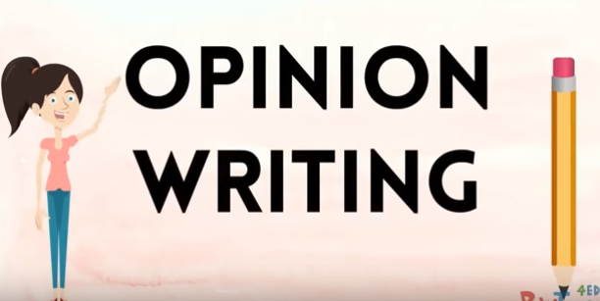
Writing
I can connect my ideas and experiences to a topic.
Step 1
Click and watch the video below.
Step 2
Think about the WORST food to eat with your fingers.
Decide from SPAGHETTI, YOGURT, RICE, or SOMETHING ELSE.
Explain your OPINION.
Step 3
Click the link.
Write your response. Make sure to use the word BECAUSE.

Slide 6
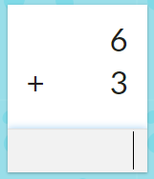
Math
I can show my understanding of adding numbers.
Step 1
Watch Video
Step 2
Click the link.
Choose Addition and a level to answer the flashcards (10 minutes).
Step 3
Click the link.
Choose addition and a level to answer the questions (10 minutes).

Slide 7
DAILY PHYSICAL ACTIVITY
Choose one (or more) activities for your DPA.
GoNoodle
Fresh Start Fitness
Maximo
Calming Down

